Slide 1
CSS: CONCEPTS, ARCHITECTURE, NUTSHELL EXAMPLES, OUTLOOK
Vukasin Goliįanin

Slide 2
01.
GANTT-CHART
02.
PRELIMINARY RESULTS 11.04.24

Slide 3
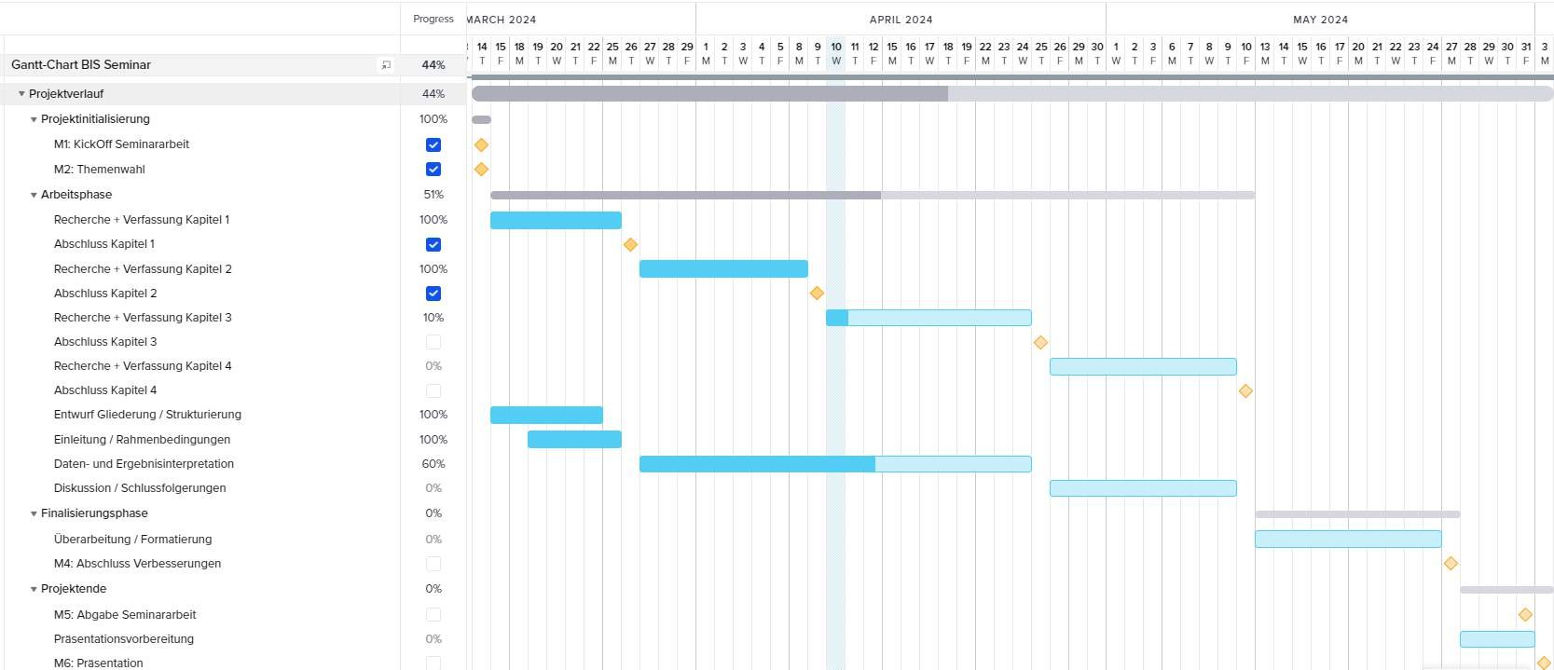

Slide 4
EINLEITUNG BASIC CONCEPTS ARCHITECTURE OUTLOOK

Slide 5
NEXT STEPS
UNTIL 25.04.
LIETRATURE RESEARCH FOR CH.3 DRAFTING CH.3
FINALISATION OF CH.3

Slide 6
THANK YOU
for your attention

