Slide 1

CSS: CONCEPTS, ARCHITECTURE, NUTSHELL EXAMPLES, OUTLOOK
Vukasin Goliįanin

Slide 2
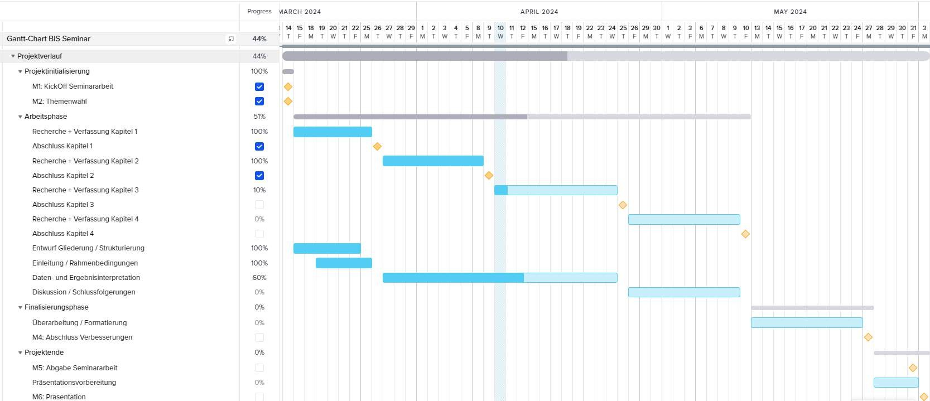
Old Gantt-Chart

Slide 3

EINLEITUNG BASIC CONCEPTS ARCHITECTURE OUTLOOK

Slide 4
  Importance of CSS Architecture
  Principles of Architecture
  Architecture methodologies
    OOCSS
    BEM
    CSS in JS
    Atomic CSS
3.4 Comperative Analysis

Slide 5
NEXT STEPS
UNTIL 16.05.
FINALISATION OF CHAPTER 3 DRAFTING CHAPTER 4
REVISE CHAPTER 1-2

Slide 6
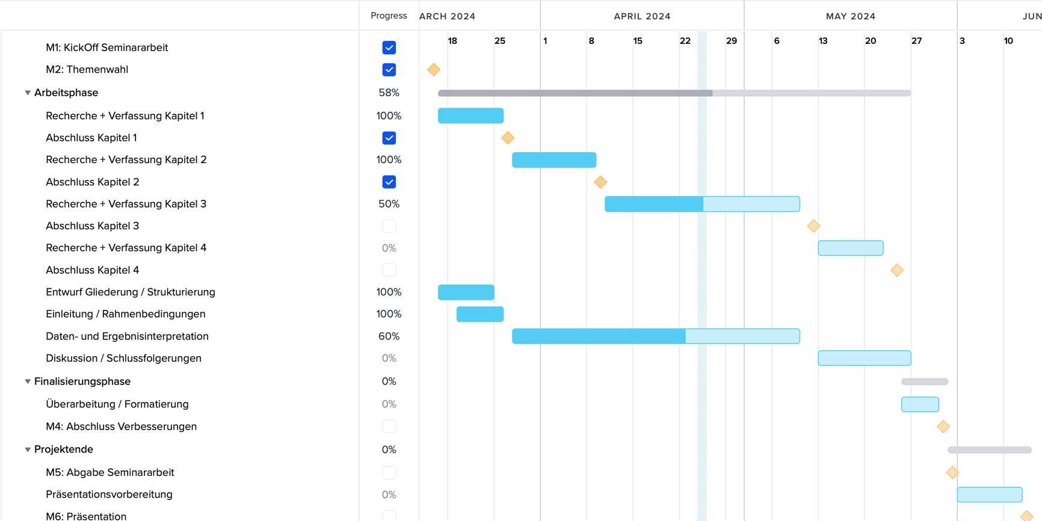
New Gantt-Chart

Slide 7
THANK YOU
for your attention

