Slide 1
CSS: CONCEPTS, ARCHITECTURE AND OUTLOOK
Vukasin Golijanin
H1615742
BIS SEMINAR
JUNE 2024

Slide 2
TABLE OF CONTENT
01
02
Basic Concepts
Architecture
03 Outlook

Slide 3
INTRODUCTION
Initiated by Hakon Wium Lie at CERN in 1994; CSS addressed the need for styling
HTML texts without altering their structure
Formally released in December 1996 and quickly adopted by major browsers (Netscape, Internet Explorer)
Has advanced to options like Google Fonts, Typekit, and animations, significantly
improving user experiences and website customization.
As of today, CSS is used by approximately 97% of all websites to visually enhance their interfaces.

Slide 4
BASIC CONCEPTS
1
CSS (Cascading Style Sheets) is designed to enhance the visual
appeal of web pages
Applies styles to HTML documents, defining fonts, colors, spacing,
and more

Slide 5
SYNTAX
CSS syntax consists of rules and guidelines for styling
HTML documents
Includes a selector and a declaration block, which contains one or more declarations.
Each declaration is made up of a property and its value, separated by a colon.

Slide 6
SELECTORS
SIMPLE
PSEUDO-ELEMENT/ CLASS
COMBINATOR
Element Selector
Class Selector
ID Selector
Descendant Combinator
Child Combinator
Sibling Combinators
Pseudo-Classes
Pseudo-Elements

Slide 7
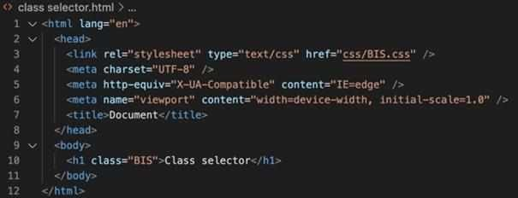
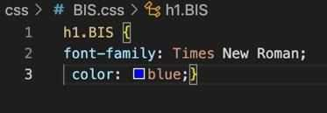
SELECTORS

Slide 8
SELECTORS

Slide 9
PROPERTIES AND VALUES
PROPERTIES
Define the styles applied to specified selectors,
appearing before the values in the CSS ruleset and separated by a colon
Common property types include list properties, font properties, border properties, and text properties
These are essential for styling web pages and can be
applied to various selectors
VALUES
CSS values come in different types, each serving a specific
purpose (example: Text values are used for properties like
color and text-align)
Relative and Absolute Units
URLs and Colors

Slide 10
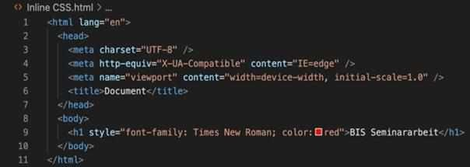
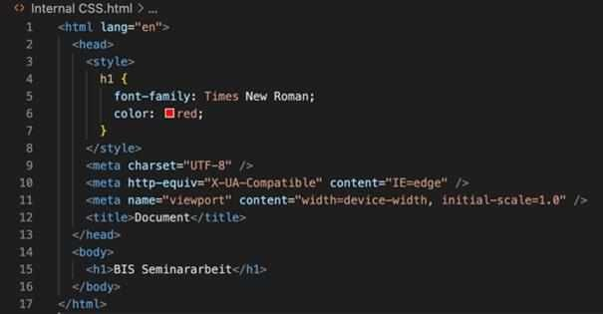
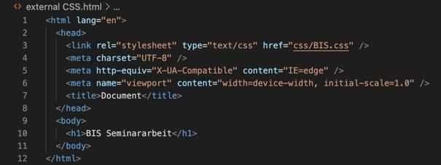
INCLUDING CSS IN HTML
01
Inline CSS
involves adding CSS styles directly elements using the "style" attribute
within
HTML
Internal CSS
defined within the <style> tag inside the <head> section of an HTML document
02
External CSS
involving a separate CSS file linked to the HTML file using a <link> tag in the <head> section
03

Slide 11
CSS SPECIFICITY
SPECIFICITY
The total specificity value determines which rule is applied when multiple rules target the same element
!IMPORTANT RULE
It overrides any previously calculated specificity values, giving it the highest rank in terms of specificity

Slide 12
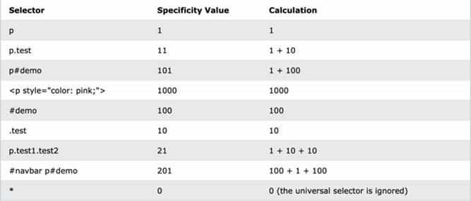
CSS SPECIFICITY

Slide 13
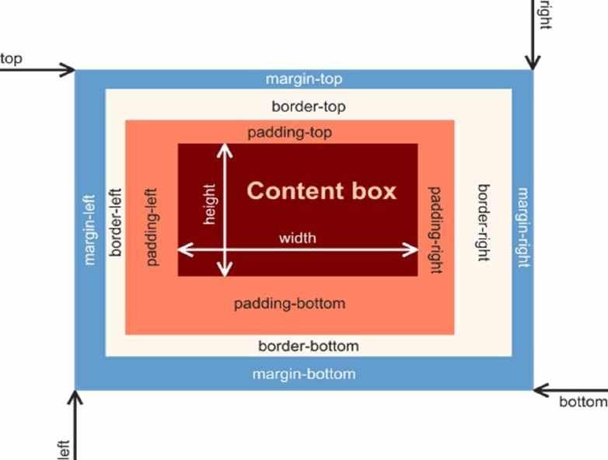
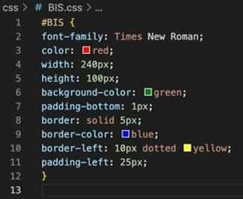
BOX MODEL
Everything on webpages is determined by boxes, often
not noticeable due to uniform background colors.
The box model consists of the content, padding, border, and margin

Slide 14
2
ARCHITECTURE
READABILITY
Code should be simple and clear, with uniform formatting, easy-to-understand names, and comments when needed
SPECIFICITY
Selectors should be only as specific as necessary to avoid overly specific or complicated selectors that negatively impact maintainability
MODULARITY
Styles should be reusable across different parts of the application to reduce repetition and boost efficiency
SEPARATIONOF CONCERNS
CSS files should be divided into logical sections, each focusing on a specific aspect of styling

Slide 15
ARCHITECTURE METHODOLOGIES
OBJECT-ORIENTED CSS (OOCSS)
BLOCK, ELEMENT,MODIFIER (BEM)
SCALABLE AND MODULAR ARCHITECTURE FOR CSS (SMACSS)
ATOMICCSS (UTILITY- FIRST CSS)

Slide 16
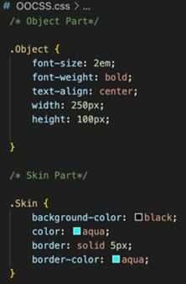
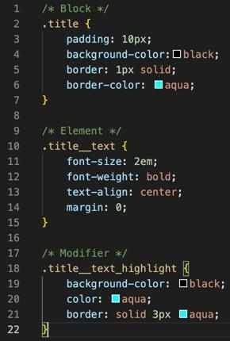
ARCHITECTURE METHODOLOGIES
OBJECT-ORIENTED CSS (OOCSS)
BLOCK, ELEMENT, MODIFIER (BEM)

Slide 17
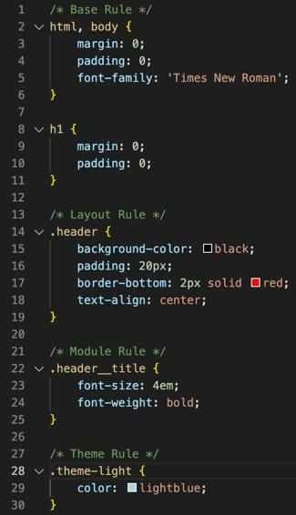
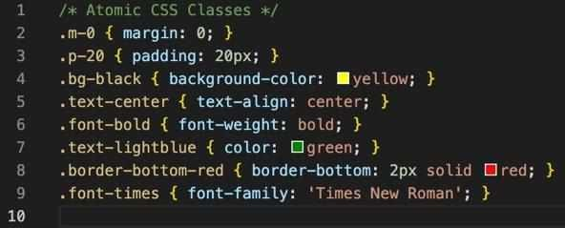
ARCHITECTURE METHODOLOGIES
SCALABLE AND MODULAR ARCHITECTURE FOR CSS
(SMACSS)
ATOMIC CSS (UTILITY-FIRST CSS)

Slide 18
OOCSS
BEM
Focuses on modularity and reusablecode with a strict naming convention
Naming conventionsdefine relationshipsbetweenelement for
more organizedand structured files
Promotes collaborationamong multiple developers
Potential for over-nesting and increased complexity in large
codebases
Strict naming conventions can be challengingfor new developers to learn
Separatesstructurefrom visual content (object from skin)
No specific naming conventions, making it intuitiveto understand
and use
Lack of naming conventions can hindershared understanding
among developers
Different perceptions of properties(e.g., border) can lead to inconsistencies
SMACSS
Aims to logically divide CSS code for scalabilityand maintainability
Divides code into five categories for easier management and
updates
Larger CSSfiles become more structured
No specific naming conventionsdespite appearingrigid
Adheringto five categories can be time-consuming and tends to
be mis categorized
Miscommunicationamong developers can lead to categorization
issues
ATOMIC CSS
Involves creating reusable single-property classes
Simplifies code updates by naming properties as classes in HTML
Promotes quick code writing and reduces redundancywith pre
processors
Multiple propertiesattached to classes can make the code
complex and hardto read
Numeroussingle-propertyclasses can bloat the CSS file
Naming conventionsintroduce another learning curve

Slide 19
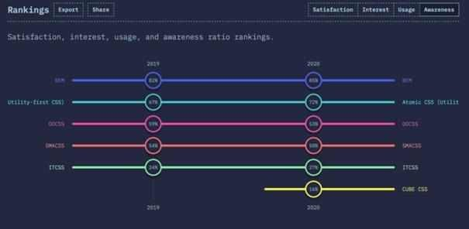
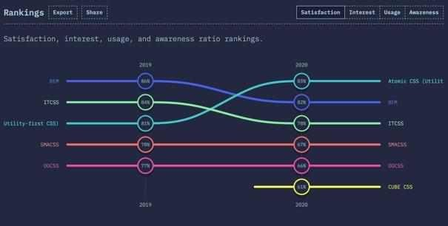
SATISFACTION
AWARENESS

Slide 20
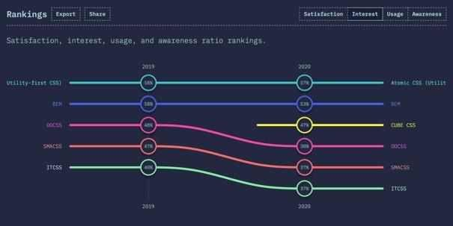
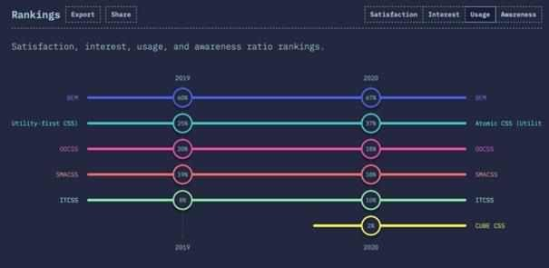
INTEREST
USAGE

Slide 21
3
OUTLOOK
CSS will continue to evolve and adapt to the changes of web development and become more versatile
Methodologies like BEM, OOCSS, SMACSS, and Atomic CSS have laid the foundation for scalable and reusable CSS
CSS will play an important role in enabling new forms of interaction and animation, especially with the rise of VR
The integration of AI into web development could change how CSS is written and managed

Slide 22
“AIis here and it’sbeing used at scale.92% of
U.S.-based developers are already using AI
codingtools both in and outsideof work.“
“Developersalso see big benefitsto AI. 70% say AI coding tools will offer them an advantage at work and cite better code quality, completion time, and resolving incidents as some of the top anticipated
( STA F F, 2 0 2 3 )
benefits.“
( STA F F, 2 0 2 3 )

Slide 23
Thank you for your attention!

Slide 24
REFERENCES
A brief history of CSS until 2016. (o. J.). Abgerufen 18. März 2024, von https://www.w3.org/Style/CSS20/history.html
Advance CSS - 101.school. (o. J.). Abgerufen 3. Mai 2024, von https://101.school/courses/advance-css/modules/9-css-architecture-and-methodologies/units/1-introduction-to-bem-and- smacss
Base Rules—Scalable and Modular Architecture for CSS. (o. J.). Abgerufen 31. Mai 2024, von https://smacss.com/book/type-base/
Categorizing CSS Rules—Scalable and Modular Architecture for CSS. (o. J.). Abgerufen 31. Mai 2024, von https://smacss.com/book/categorizing/
Combinators—Learn web development | MDN. (2024, Jänner 1). https://developer.mozilla.org/en-US/docs/Learn/CSS/Building_blocks/Selectors/Combinators
contributors, V.S., Vladimir Starkov and. (o. J.). BEM — Block Element Modifier.Abgerufen 29. Mai 2024, von http://getbem.com/
Cruz, J. C. Y.(o. J.). CSS Methodologies | Juan Carlos Yovera Cruz. Abgerufen 16. Mai 2024, von https://jconsoftwares.com/blog/24
CSS Combinators. (o. J.). Abgerufen 2. April 2024, von https://www.w3schools.com/css/css_combinators.asp
CSS Introduction. (2018, April 10). GeeksforGeeks. https://www.geeksforgeeks.org/css-introduction/
CSS Pseudo-elements. (o. J.). Abgerufen 2. Juni 2024, von https://www.w3schools.com/css/css_pseudo_elements.asp
CSS Selectors. (o. J.). Abgerufen 1. April 2024, von https://www.w3schools.com/css/css_selectors.asp
CSS Selectors, Properties and Values. (o. J.). CodeCoda.Com. Abgerufen 31. Mai 2024, von https://codecoda.com/en/blog/entry/css-selectors-properties-and-values?limit=all
CSS Specificity. (o. J.). Abgerufen 1. April 2024, von https://www.w3schools.com/css/css_specificity.asp
CSS Syntax.(2019, Februar 13). GeeksforGeeks. https://www.geeksforgeeks.org/css-syntax/
CSS values and units - CSS: Cascading Style Sheets | MDN. (2024, März 21). https://developer.mozilla.org/en-US/docs/Web/CSS/CSS_Values_and_Units
Difference Between CSS, CSS2 And CSS3 | What is CSS? (o. J.). Hackr.Io. Abgerufen 18. März 2024, von https://hackr.io/blog/difference-between-css-css2-and-css3
History / Methodology / BEM. (o. J.). Abgerufen 29. Mai 2024, von https://en.bem.info/methodology/history/
How to Link CSS to HTML – Stylesheet File Linking. (2022, Juni 14). freeCodeCamp.Org. https://www.freecodecamp.org/news/how-to-link-css-to-html/
HTML a rel Attribute. (o. J.). Abgerufen 29. März 2024, von https://www.w3schools.com/tags/att_a_rel.asp
HTML and CSS – Inline Style, External Stylesheet, CSS Code Examples.(2021, August 12). freeCodeCamp.Org. https://www.freecodecamp.org/news/html-and-css-inline-style-external-
stylesheet-css-code-examples/
HTML Standard. (o. J.). Abgerufen 29. März 2024, von https://html.spec.whatwg.org/#the-link-element
HTML Styles CSS. (o. J.). Abgerufen 28. März 2024, von https://www.w3schools.com/html/html_css.asp

Slide 25
REFERENCES
Introduction—Scalableand Modular Architecture for CSS. (o. J.). Abgerufen 31. Mai 2024, von https://smacss.com/book/
Layout Rules—Scalable and Modular Architecture for CSS. (o. J.). Abgerufen 31. Mai 2024, von https://smacss.com/book/type-layout/
Let’sDefine ExactlyWhat Atomic CSS is. (2017, April 10).CSS-Tricks. https://css-tricks.com/lets-define-exactly-atomic-css/
Mastering Object-Oriented CSS (OOCSS). (2023, Juni 22). DEV Community. https://dev.to/ladunjexa/mastering-object-oriented-css-oocss-3b5h
Module Rules—Scalable and Modular Architecturefor CSS. (o. J.). Abgerufen 31. Mai 2024, von https://smacss.com/book/type-module/
Most commonly used tags in HTML. (2018, August 23). GeeksforGeeks. https://www.geeksforgeeks.org/most-commonly-used-tags-in-html/
olawanletjoel. (2022, Juni 8). Inline Style in HTML – CSS Inline Styles. freeCodeCamp.Org. https://www.freecodecamp.org/news/inline-style-in-html/
Pseudo-classes and pseudo-elements—Learn web development | MDN. (2024, Jänner 1). https://developer.mozilla.org/en-US/docs/Learn/CSS/Building_blocks/Selectors/Pseudo-
classes_and_pseudo-elements
Quick start / Methodology / BEM. (o. J.). Abgerufen 29. Mai 2024, von https://en.bem.info/methodology/quick-start/
Simuratli. (2020, Oktober 16). What is OOCSS(Object Oriented CSS)? Simuratli. https://medium.com/simuratli/what-is-oocss-object-oriented-css-c8667fd65dfe
Staff,I. S.,GitHub. (2023, Juni13). Survey revealsAI’s impact on the developerexperience.The GitHub Blog. https://github.blog/2023-06-13-survey-reveals-ais-impact-on-the-developer-
experience/
State Rules—Scalable and Modular Architecture for CSS. (o. J.). Abgerufen 31. Mai 2024, von https://smacss.com/book/type-state/
Team, E. A. (2023, Dezember 21). Will Generative AI Replace or Empower HTML & CSS Developers? Exadel.https://exadel.com/news/gen-ai-and-html-css-developers/
The box model—Learnweb development| MDN. (o. J.). Abgerufen 30. April 2024, von https://developer.mozilla.org/en-
US/docs/Learn/CSS/Building_blocks/The_box_model#using_display_inline-block
The Making of Atomic CSS: An Interview With Thierry Koblentz. (2022, Februar 3). CSS-Tricks. https://css-tricks.com/thierry-koblentz-atomic-css/
The State of CSS 2020: CSS Methodologies. (o. J.). Abgerufen 2. Juni 2024, von https://2020.stateofcss.com/en-US/technologies/methodologies/
Theme Rules—Scalable and Modular Architecturefor CSS. (o. J.). Abgerufen 31. Mai 2024, von https://smacss.com/book/type-theme/
Usage Statistics of CSS for Websites, March 2024. (o. J.). Abgerufen 18. März 2024, von https://w3techs.com/technologies/details/ce-css

