Slide 1



CSS: CONCEPTS, ARCHITECTURE, NUTSHELL EXAMPLES, OUTLOOK
Vukasin Golijanin

Slide 2


EINLEITUNG
BASIC CONCEPTS
ARCHITECTURE
OUTLOOK

Slide 3
NEXT STEPS
UNTIL 06.06.
FINALISATION OF CHAPTER 4
PREPARE PRESENTATION

Slide 4
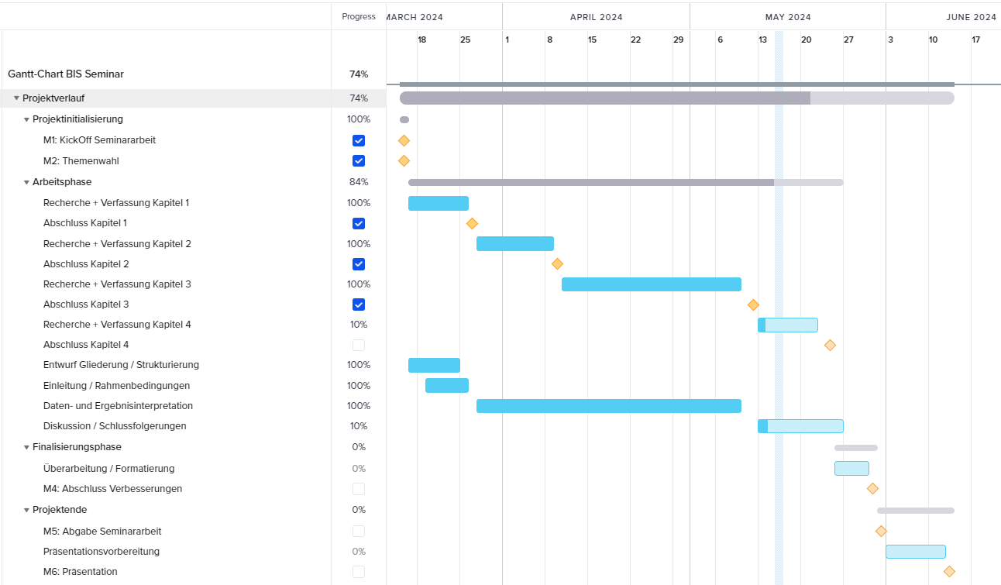
Gantt-Chart

Slide 5
THANK YOU
for your attention

