Slide 1
BSF4ooRexx/Java: Apache POI
Cookbook with Nutshell Examples

Slide 2
Content of this seminar paper
Java Library Apache POI accessed via BSF4ooRexx to create and manipulate Microsoft Office files
Microsoft Office applications include Microsoft Word, Microsoft PowerPoint and Microsoft Excel
Creating BSF4ooRexx Nutshell Examples for Apache POI
The Nutshell examples are coded in IntelliJ

Slide 3
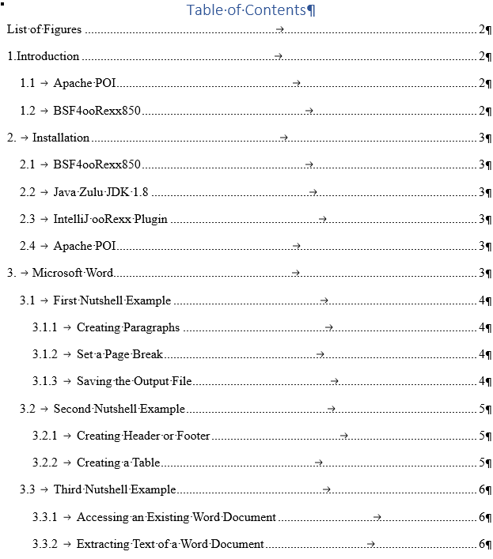
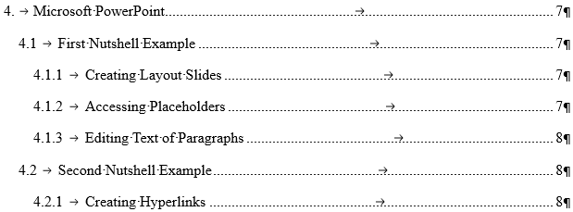
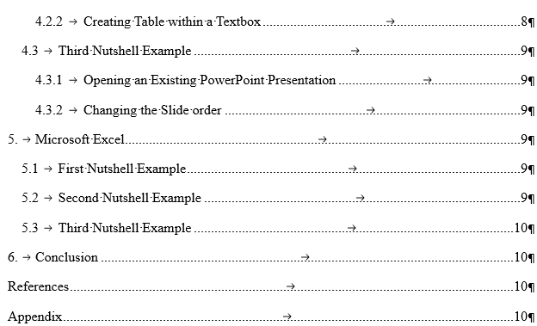

Slide 4
Microsoft Word
First nutshell example shows how to create a Word document
Paragraph alignment and text setting
Editing text within a paragraph
Placing a paragraph at the top of the second page
Saving the output file

Slide 5
Microsoft Word
Second nutshell example additionally shows how to create a header and a table
Creating a header and a footer on each page
Place a paragraph in the header and footer and setting individual text
Creating of a table
Addressing individual table cells

Slide 6
Microsoft Word
Third nutshell example shows how to get access to previously created Microsoft Word Documents
Extracting Text of another Word Document

Slide 7
Microsoft PowerPoint
First Nutshell Example shows how to create a PowerPoint Presentation
Creating Slides with existing layouts
Accessing placeholder on slides
Editing set text of paragraphs

Slide 8
Microsoft PowerPoint
Second nutshell example additionally shows how to create a hyperlink and a table within a textbox
Setting a link to a previously set text
Creating a custom textbox
Creating a table within the textbox

Slide 9
Microsoft PowerPoint
Third nutshell example shows how to get access to a previously created PowerPoint presentation
Changing slide order
Editing text of paragraphs

Slide 10

Planned Timetable

Slide 11
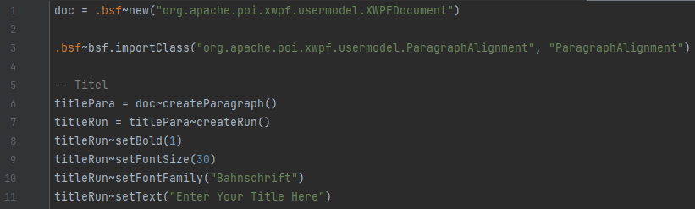
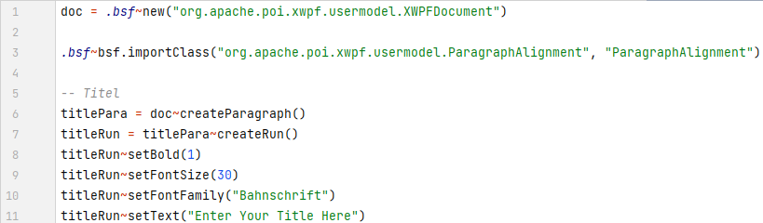
Code Snippets

