Slide 1



Security Concerns in Proprietary and Opensource Software
Julian Drexler

Slide 2
Agenda
Introduction
Security Overview
Open-Source Software
Proprietary Software
Comparison

Slide 3
Introduction
2022 around 25.082 vulnerabilities were made public [1]
Enterprise open source gaining market share [2]

Slide 4

Security Overview: Goals
Authenticity
Integrity
Confidentiality
Availability
Non-Repudiation
Anonymisation

Slide 5
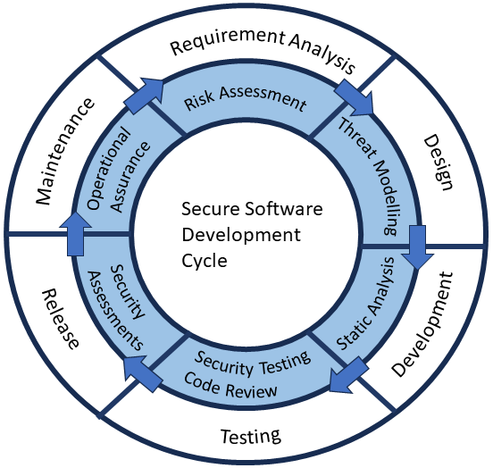


Security Overview: Development - Process
(own representation)

Slide 6
Security Overview: Development - Methods
Static Code Analyse (SAST)
Dynamic Application Testing (DAST)
Software Composition Analysis (SCA)

Slide 7
Open Source: Definitions
Open Source Initiative
Free Software Foundation

Slide 8
Open Source: History
4 Phases [3] + 1
Collective inventions - 1950’s
Commodification and Emerging Subcultures - 1960’s
Institutionalization – 1980’s
Growth – 1998
(Large Acquisitions – 2015)

Slide 9
Open Source: Licencing
Strong Copyleft Licence
  GPLv3.0
Weak Copyleft Licence
  LGPL 2.1
Non Copyleft Licence
  Apache 2.0

Slide 10
Open Source: Maintenance and Organization
Maintenance
  Contributions: top 3 motivations are non-monetary [4]
  Open-source projects can get abandoned

Slide 11
Open Source: Maintenance and Organization
3 Phases [5]
  Non formal coordination
  Internal governance
  Governance towards outside parties
Approaches [6]
  Autonomous
  Associated
  Integrated

Slide 12
Open Source: Funding
Foundations and project communities
  Donations
  Code contributions
Open-source companies
  code contributions
  7 open-source business model archetypes [7]

Slide 13
Open Source: Security
  Improvements through processes, tools and knowledge
  Survey: 89% think that open source is more secure than proprietary [2]
  Auditable by everyone
Notes:
Dependencies
Improvements through SSDLC, Secure coding practices, audits, tools
Training

Slide 14
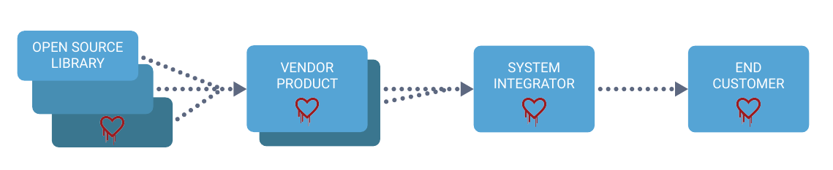
Open Source: Security Issues Examples
9.658 new vulnerabilities in 2020 (50% increase to 2019) [8]
OpenSSL: Heartbleed (2014)
Log4j: Log4Shell (2021)
Source: Synopsys, Inc. (2017) Diary of a Heartbleed. Available at: https://www.synopsys.com/content/dam/synopsys/sig-assets/whitepapers/diary-of-heartbleed.pdf.

Slide 15
Proprietary Software: Definition and Licencing
45% of enterprise software is proprietary [2]
Ownership
Licences for proprietary software

Slide 16
Proprietary Software: Maintenance
25% - 33% development efforts of creating the software [9]
Outdated software in supply chains

Slide 17
Proprietary Software: Open-Source Components
96% have open-source components [10]
Licence conflicts
Maintenance
Contributions to open-source

Slide 18
Proprietary Software: Security
“Black box”
Vulnerabilities can hide
Reverse Engineering
Supply chain attacks

Slide 19
Proprietary Software: Security Issues Examples
Windows SMB Protocol: EternalBlue (2017)
CCLeaner: Supply chain attack (2017)

Slide 20
Comparison
Transparency and trust
Security issues reporting

Slide 21
Conclusion and Discussion
Many factors are influential
Bias information on surveys and on security reports
General view on Software

Slide 22
Questions?

Slide 23
References
[1] SecurityScorecard (2023) Security Vulnerabilities Published In 2022. Available at: https://www.cvedetails.com/vulnerability-list/year-2022/vulnerabilities.html
[2] Gordon Haff (no date) The State of Enterprise Open Source 2022. Red Hat Inc. Available at: https://www.redhat.com/en/enterprise-open-source-report/2022.
[3] Schrape, J.-F. (2016) Open-Source-Projekte als Utopie, Methode und Innovationsstrategie: historische Entwicklung - sozioökonomische Kontexte - Typologie. Glückstadt: vwh, Verlag Werner Hülsbusch, Fachverlag für Medientechnik und -wirtschaft (Medienwirtschaft).
[4] Frank Nagle et al. (2020) Report on the 2020 FOSS Contributor Survey, The Linux Foundation & The Laboratory for Innovation Science at Harvard. Available at: https://www.linuxfoundation.org/resources/publications/foss-contributor-2020.
[5] De Laat, P.B. (2007) ‘Governance of open source software: state of the art’, Journal of Management & Governance, 11(2), pp. 165–177. Available at: https://doi.org/10.1007/s10997-007-9022-9.
[6] Eckert, R., Stuermer, M. and Myrach, T. (2019) ‘Alone or Together? Inter-organizational affiliations of open source communities’, Journal of Systems and Software, 149, pp. 250–262. Available at: https://doi.org/10.1016/j.jss.2018.12.007.
[7] Duparc, E. et al. (2022) ‘Archetypes of open-source business models’, Electronic Markets, 32(2), pp. 727–745. Available at: https://doi.org/10.1007/s12525-022-00557-9.
[8] Adam Murray (2021) All About Mend’s 2021 Open Source Security Vulnerabilities Report. Available at: https://www.mend.io/blog/2021-state-of-open-source-security-vulnerabilities-cheat-sheet/ (Accessed: 19 November 2023).
[9] Zelkowitz, M.V. (1978) ‘Perspectives in Software Engineering’, ACM Computing Surveys, 10(2), pp. 197–216. Available at: https://doi.org/10.1145/356725.356731.
[10] SYNOPSIS Inc. (2023) 2023 OPEN SOURCE SECURITY AND RISK ANALYSIS REPORT. 8. Available at: https://www.synopsys.com/software-integrity/resources/analyst-reports/open-source-security-risk-analysis.html.

