Slide 1
Comparison and Critical Comparison of Charges for Data Roaming
Presentation by Franziska Mayrhofer

Slide 2
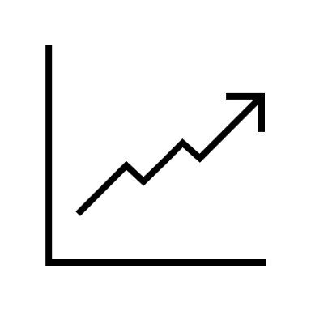
Agenda
Introduction into Data Roaming
Mobile Communication Evolution
Roaming Prices & Markets
Roaming Regulations
Conclusion
2

Slide 3
Introduction into Data Roaming
Understanding Data Roaming in a Globalized World
Introduction into Data Roaming -- Importance of global connectivity
Explanation of Roaming -- Roaming allows mobile connection abroad using foreign networks.
Challenges and Responses -- High roaming fees led to low usage. The EU's response, the "Roam Like At Home" policy.
3

Slide 4
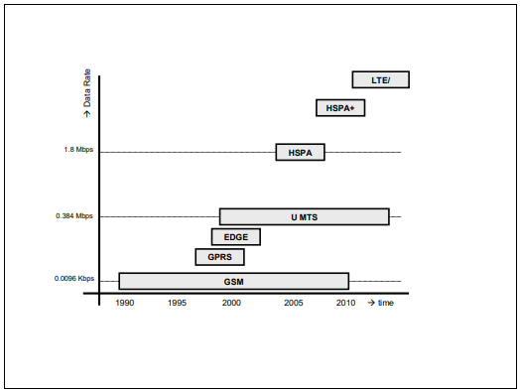
Mobile Communication Evolution
From GSM to LTE: Mobile Tech Evolution
Definition of Roaming
Types of Roaming
History: GSM to LTE
4

Slide 5
Roaming Prices & Markets
Roaming Prices & Market Dynamics
Pricing Strategies
Price Transparency
Impact on consumer behavior and market competition.
Evolution of strategies over time.
Example: Vodafone's evolving approach in roaming pricing.
Critical for understanding International Mobile Roaming (IMR) costs.
European Commission's efforts to enhance consumer awareness.
Regulatory measures to ensure clear and fair pricing in the market.
5

Slide 6
Roaming Regulations
Regulatory Frameworks:
Reshaping Data Roaming
EU regulatory measures -- EU actions to reduce high roaming charges, aligning them with domestic rates for fairness in the market.
RLAH policy -- Eliminated extra charges for mobile use in the EU, allowing roaming at domestic prices.
Market reaction to RLAH -- Notable increase in mobile usage abroad with RLAH, yet usage levels remained lower compared to home usage.
6

Slide 7
Conclusion
Key Takeaways & Future Outlook
Conclusion -- Data roaming charges are shaped by evolving mobile technologies and regulations, impacting connectivity and costs.
Future Outlook -- Ongoing dynamics in data roaming, with focus on regulatory impacts, consumer behavior, and new technologies like 5G.
Summary -- Understanding data roaming is key in a connected world, blending technology, economics, and regulation for future industry strategies.
7

Slide 8
Thank you for your attention!

