Slide 1
BSF4ooRexx/Java: Apache POI
Cookbook with Nutshell Examples

Slide 2
Overview
Introduction
Software components
Microsoft Word
Microsoft PowerPoint
Microsoft Excel
Conclusion

Slide 3
Introduction
Why using ooRexx?
Easy to learn und read for humans
Learned it last semester in Business Programming 1 & 2
Apache POI-OpenXML4J
Java API for creating and manipulating Microsoft Office documents
Components for Word (XWPF), PowerPoint (XSLF) and Excel (XSSF)

Slide 4
Software Components
Open Object Rexx 5.0.0
BSF4ooRexx850
Azul Java Version Zulu 1.8
Apache POI-OpenXML4J Java API binary version 5.2.3
IntelliJ IDEA integrated development environment and ooRexx plugin

Slide 5
Open Object Rexx & BSF4ooRexx
ooRexx download includes programming GUI
Necessary to execute .rexx programs via the terminal
BSF4ooRexx Bridge between ooRexx and Java
Contains package to get access to Java classes and libraries

Slide 6
Binary distributed version 5.2.3 was used to code the examples
Java API contains all necessary .jar files to create Microsoft documents.
Has to be connected with Java in the class path environment variable

Slide 7
Java
Azul Zulu Java version 8.70.0.23 was used
There are two restrictions when choosing a Java version:
Same bit rate as the used ooRexx version, 32- or 64-Bit version
To work correctly with Apache POI at least Java 8 is required

Slide 8
IntelliJ IDEA
Additional not required software component
Integrated development environment used for more convenient coding
Requires an ooRexx plugin to create and execute .rexx programs

Slide 9
Microsoft Word
Creating blank Word document
Creating header and footer of a document
Saving a created Word document
Accessing existing Word document

Slide 10
Creating Blank Word Document
Instancing main class
Containing the most necessary methods and classes

Slide 11
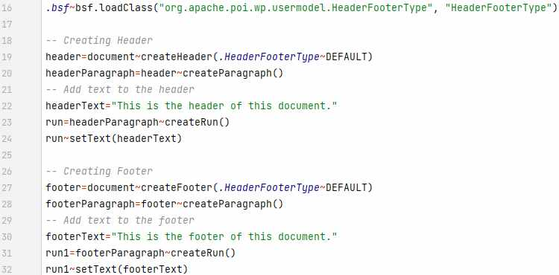
Creating Header and Footer
Requires additional class for headers and footers
Creating default header and footer
Setting individual text

Slide 12
Saving Created Word Document
Source of coded program is required
Directory path is needed and concatenated with the created document
Qualifying entire file
Creating output document

Slide 13
Accessing Existing Word Document
Source and directory of existing Word document is required
Entire correct name has to be used to get access
New file input stream for importing content
Creating new document

Slide 14
Microsoft PowerPoint
Creating blank PowerPoint slideshow
Creating slides with standard layouts
Embedding hyperlink in existing text
Changing slideshow slide order

Slide 15
Creating Blank PowerPoint Slideshow
PowerPoint presentations are called slide show in this context
Instancing main class
Containing the most necessary methods and classes

Slide 16
Creating Slides with Standard Layouts
PowerPoint contains a slide master for standard layout slides
Slide layout class is required
Slide layouts are retrieved from slide master
Creating slides with chosen layout

Slide 17
Embedding Hyperlink in Existing Text
Accessing placeholder by inserting index
Clearing text before setting new one
Creating hyperlink text
Embedding link with URL

Slide 18
Changing Slideshow Slide Order
PowerPoint memorizes how many slides are created and the order of the slides
Individually addressing any slide by their index
Changing slide order by setting new index

Slide 19
Microsoft Excel
Creating blank workbook and spreadsheet
Setting individual cell format for dates
Rotating cell content
Creating cell content using formulars

Slide 20
Creating blank Workbook and Spreadsheet
Instancing main class of workbooks
Spreadsheet class is additionally required
Allows to create spreadsheets with individual names

Slide 21
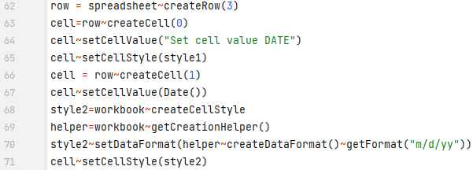
Setting Individual Cell Format for Dates
Created cells are automatically standard cells
Setting cell format individually
Creating style with new cell format
Setting format of the cell

Slide 22
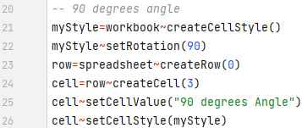
Rotating Cell Content
Creating new style which contains rotation
Any rotation angle from 0 to 360 degrees is possible
Setting content to cells
Applying the style to a cell

Slide 23
Creating Cell Content Using Formulars
Possibility to create cell values via Excel built in formular rand between
Creating 100 random numbers in column A from 0 to 1000
Values created in cell A:3 to A:102 with a loop

Slide 24
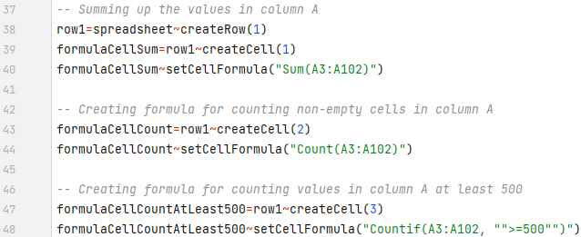
Evaluation Using Formulars
Creation of Excel formular to sum up all created values
Counting how many values are generated
Counting cells with a specific value

Slide 25
Conclusion
Includes only a small part of what is possible with Apache POI
Apache Software Foundation is constantly developing the API
Source packages for Apache POI version 5.2.4 & 5.2.5 are currently available on the homepage

