Slide 1
BSF4ooRexx/Java: Apache POI
Cookbook with Nutshell Examples

Slide 2
Content of this seminar paper
Java Library Apache POI accessed via BSF4ooRexx to create and manipulate Microsoft Office files
Microsoft Office applications include Microsoft Word, Microsoft PowerPoint and Microsoft Excel
Creating BSF4ooRexx Nutshell Examples for Apache POI
The Nutshell examples are coded in InteliJ

Slide 3
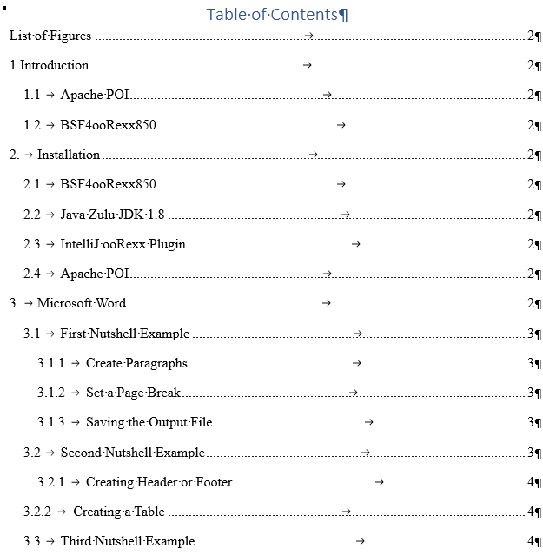
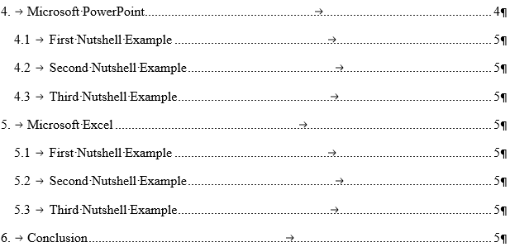

Slide 4
Microsoft Word
First Nutshell Example shows how to create a Word document
Paragraph alignment and text setting
Editing text within a paragraph
Placing a paragraph at the top of the second page
Saving the output file

Slide 5
Microsoft Word
Second Nutshell Example additionally shows how to create a header and a table
Creating a header and a footer on each page
Place a paragraph in the header and footer and setting individual text
Creating of a table
Addressing individual table cells

Slide 6
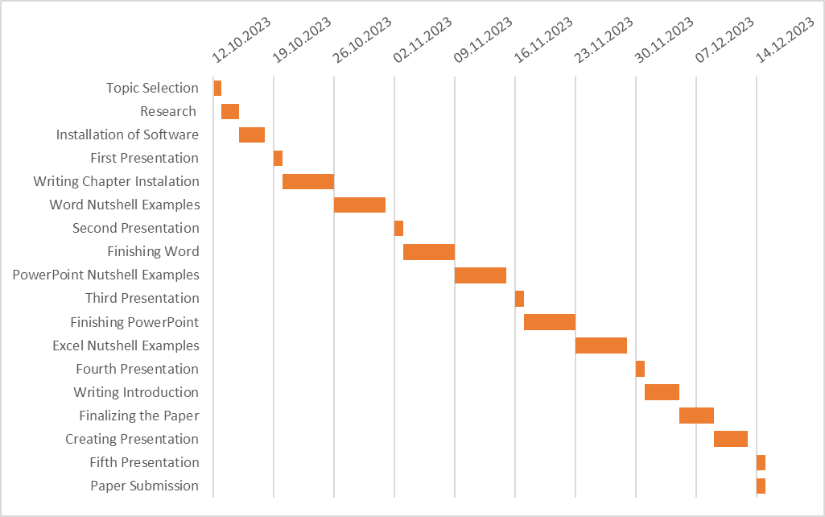
Planned Timetable

