Slide 1
BSF4ooRexx/Java: Apache POI
Cookbook with Nutshell Examples

Slide 2
Content of this seminar paper
Java Library Apache POI accessed via BSF4ooRexx to create and manipulate Microsoft Office files
Microsoft Office applications include Microsoft Word, Microsoft PowerPoint and Microsoft Excel
Creating BSF4ooRexx Nutshell Examples for Apache POI
The Nutshell examples are coded in IntelliJ

Slide 3
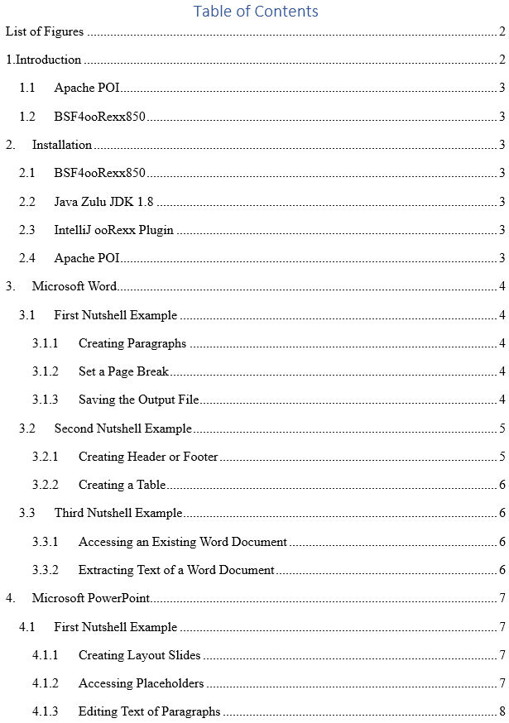
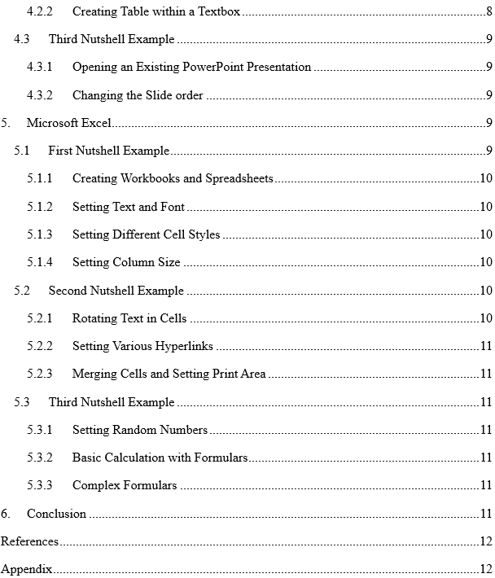

Slide 4
Microsoft Word
First nutshell example shows how to create a Word document
Paragraph alignment and text setting
Editing text within a paragraph
Placing a paragraph at the top of the second page
Saving the output file

Slide 5
Microsoft Word
Second nutshell example additionally shows how to create a header and a table
Creating a header and a footer on each page
Place a paragraph in the header and footer and setting individual text
Creating of a table
Addressing individual table cells

Slide 6
Microsoft Word
Third nutshell example shows how to get access to previously created Microsoft Word Documents
Extracting Text of another Word Document

Slide 7
Microsoft PowerPoint
First Nutshell Example shows how to create a PowerPoint Presentation
Creating Slides with existing layouts
Accessing placeholder on slides
Editing set text of paragraphs

Slide 8
Microsoft PowerPoint
Second nutshell example additionally shows how to create a hyperlink and a table within a textbox
Setting a link to a previously set text
Creating a custom textbox
Creating a table within the textbox

Slide 9
Microsoft PowerPoint
Third nutshell example shows how to get access to a previously created PowerPoint presentation
Changing slide order
Editing text of paragraphs

Slide 10
Microsoft Excel
First nutshell example shows how to create an Excel workbook and a spreadsheet
Setting Text in Cells and editing the text
Setting Different Cell Styles
Setting Column Size

Slide 11
Microsoft Excel
Second nutshell example additionally shows how to rotate text in cells
Setting various Hyperlinks, URL, file and spreadsheet
Merging cells
Setting Print Area of a spreadsheet

Slide 12
Microsoft Excel
Third nutshell example shows how to generate random numbers in a given range
Performing basic calculations, addition, multiplication, sum and count
Setting complex formulars, countif, mean, average and standard deviation

Slide 13
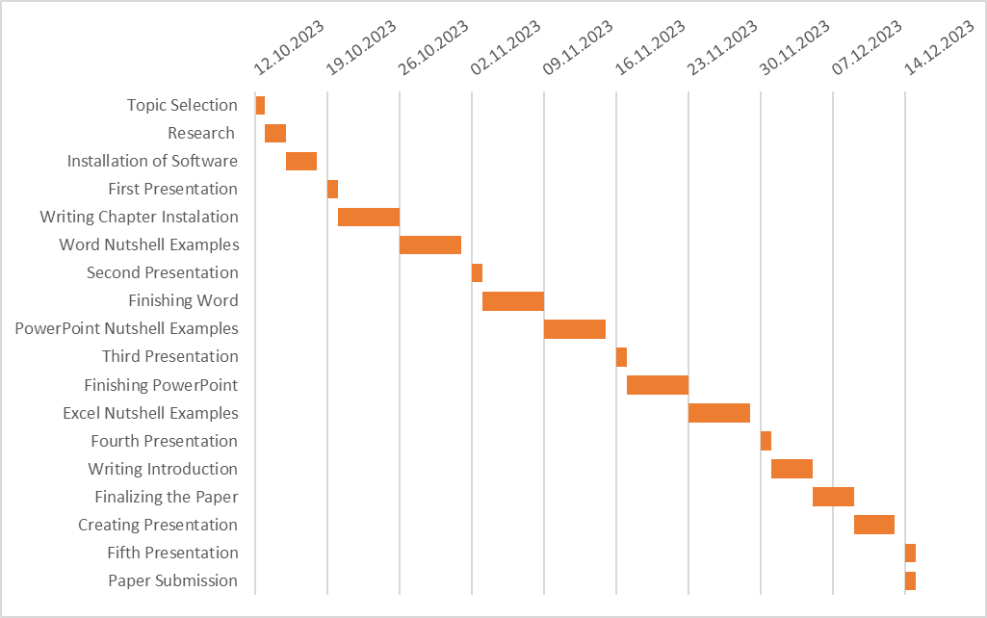
Planned Timetable

Slide 14
Code Snippets

