Slide 1
Proprietary vs. Open Markets in IT: Apple, Microsoft, Google
Felix Schaier

Slide 2
Table of Contents
Abstract
Introduction
Open Markets
2.1 Functionality and Properties
2.2 Pricing
2.3 Products existing in Open IT Markets
Proprietary Markets
3.1 Properties of Proprietary Markets
3.2 Compliance with the Term „Market“
3.3 Pricing and Just Prices within Proprietary IT-Markets
3.4 Emergence of Proprietary IT-Markets
3.4.1 Apple
3.4.2 Microsoft
3.4.3 Google
3.5 Licensing of Software and Hardware Products
3.6 Restrictions and Barriers for Market Entrants
Soft- and Hardware Products in Proprietary Markets
4.1 Apple
4.2 Microsoft
4.3 Google
Conclusion
5.1 Opportunities and Threats
5.2 Opinion of the Author

Slide 3
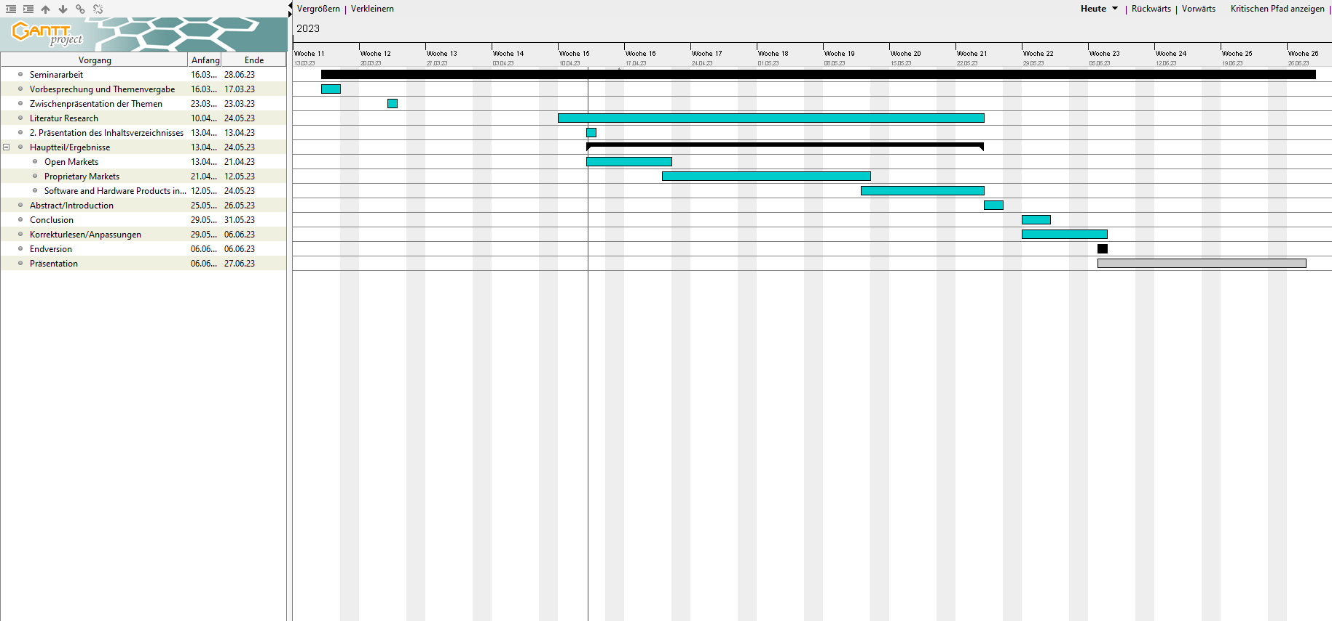
Gantt Chart

