Slide 1
An Introduction to WEKA: The All in One Machine Learning Software in Java

By Jakov Pavic
h11719023

Slide 2
Main Goal of the Paper:
To be able to compute first little machine learning projects after reading the paper!

Slide 3
Table of Contents
1. Introduction
2. Overview: Machine Learning
2.1 Supervised Machine Learning
2.2 Unsupervised Machine Learning
2.2.1 Clustering
2.2.2 Association Rules
2.2.3 Dimensionality Reduction
2.3 Reinforcement Machine Learning
2.4 Semi-Supervised Machine Learning
3. Overview: WEKA
3.1 Graphical User Interface (GUI)
3.2 Application Programming Interface (API)
3.3 Packages
3.4 ARFF
4. Data Preparation
4.1 Importing Data
4.2 Combining Data
4.3 Understanding Data
4.4 Selecting Data
4.5 Cleaning Data
4.6 Creating New Data
4.7 Train/Test Split
5. Machine Learning
5.1 Supervised Learning
5.1.1 Linear Regression
5.1.2 Logistic Regression
5.1.3 Decision Tree
5.1.4 Random Forest
5.1.5 Support Vector Machine (SVM)
5.1.6 Naive Bayes Algorithm
5.1.7 K-Nearest Neighbor
5.2 Unsupervised Learning
5.2.1 Principal Component Analysis
5.2.2 K-Means Clustering
6. Data Visualization
7. Summary
8. References

Slide 4
Introduction
Intelligence: “the ability to learn, understand, and make judgments or have opinions that are based on reason”
Alan Turing in 1950: Machines could be capable of making decisions similarly to humans with the help of information and reason

Slide 5
Overview: Machine Learning
Data + Algorithms → Gain new information
Tasks:
Description
Prediction
Causal Inference
Types:
Supervised Machine Learning
Unsupervised Machine Learning
Reinforcement Machine Learning
Semisupervised Machine Learning

Slide 6
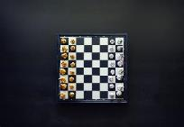
Types of Machine Learning
Supervised ML
Labeled data
Regression
Housing Prices
Classification
Dog or Cat
Unsupervised ML
Unlabeled data
Clustering
Dimensionality Reduction
Association Rules
Reinforcement ML
Unlabeled data
Learning by doing
Get feedback
Semisupervised ML
Small amount labeled
Self-Training
Pseudo-Labeling
CAT
Cat
?
DOG
?
?

Slide 7
WEKA
All in one software for machine learning
Preparing the data
Building machine learning models
Visualizing the data
How to use?
Graphical User Interface (GUI)
Application Programming Interface (API)
3.8.6 3.7.6
STABLE RELEASE
DEVELOPMENT RELEASE

Slide 8
GNU General Public Licence
Found by Richard Stallman in 1989
Free Software
Freedoms to:
Run
Study
Share
Modify

Slide 9
Graphical User Interface (GUI)
Complete a machine learning project without a single line of code
GUI Chooser
Explorer
KnowledgeFlow
Experimenter
Workbench
SimpleCLI

Slide 10
Application Programming Interface (API)
Required:
WEKA
Java
Optional:
Integrated Development Environment (IDE)

Slide 11
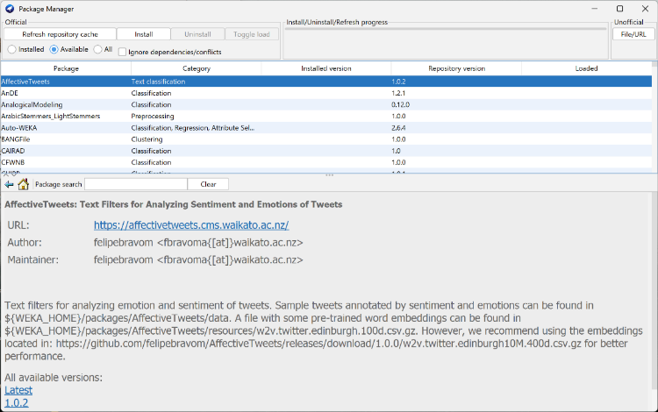
Package Manager
Over 200 official packages
Unofficial packages

Slide 12
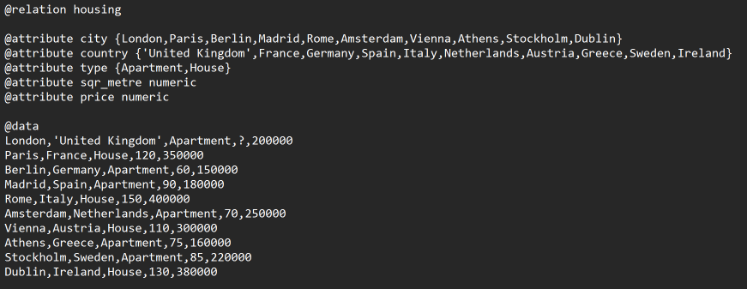
Attribute-Relation File Format (ARFF)
Sections:
Header
Information
Data Types:
Numeric
String
Date
Nominal-specification

Slide 13
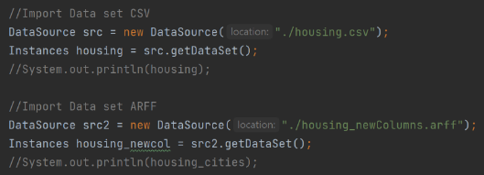
Data Preparation
Importing Data
JSONLOADER
XRFFLOADER
CSV, ARFF:
Combining Data
Merging Data
Appending Data

Slide 14
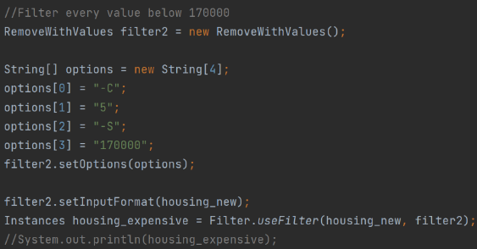
Data Preparation
Understanding Data
Look at the Data
Get summary
Print Mean/Mode
Print Minimum/Maximum
Selecting Data
Columns
Rows

Slide 15
Data Preparation
Clean Data
Remove duplicates
Remove missing values
Rename variable
Make new data

Slide 16
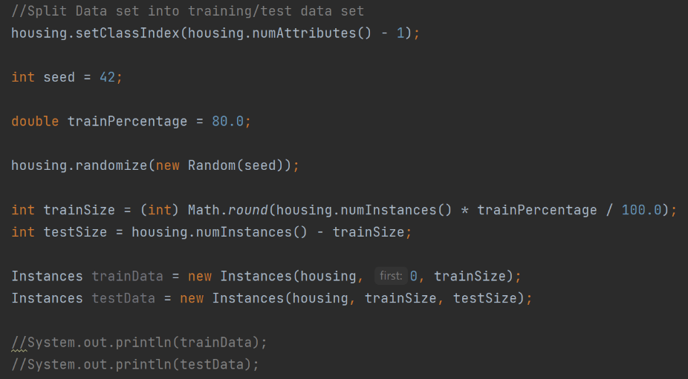
Data Preparation
Train/Test Split

Slide 17
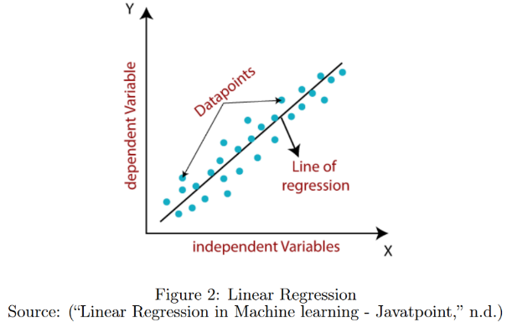
Linear Regression
Regression
Types:
Simple Linear Regression
Multiple Linear Regression
Evaluation:
Root Mean Squared Error (RMSE)
Price = 1138.9569 * SquareMeters + 57701.7943 * Bathrooms + 1570.6529
RMSE = 20315.711

Slide 18
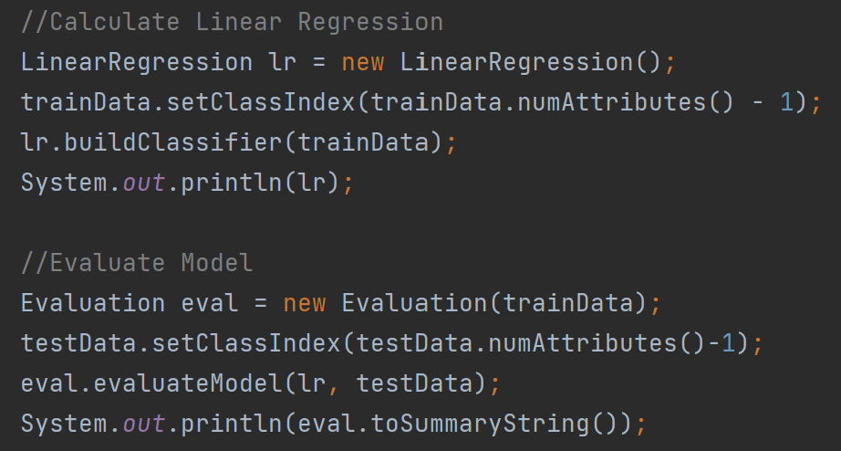
Linear Regression

Slide 19
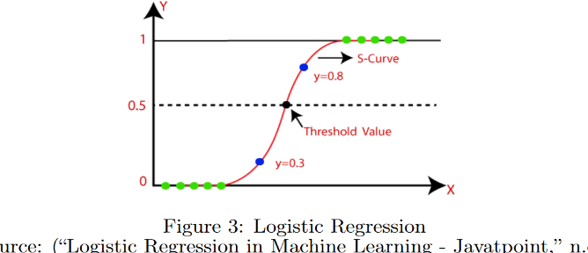
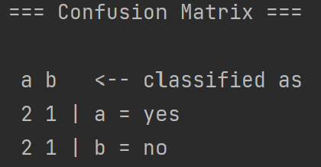
Logistic Regression
Classification
Types:
Binomial
Multinomial
Ordinal
Evaluation:
Confusion Matrix

Slide 20
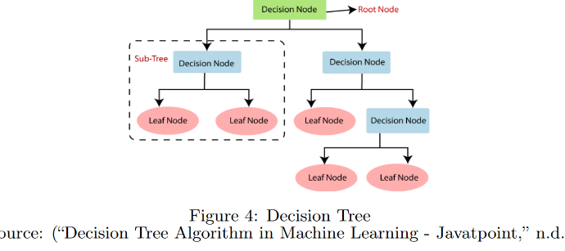
Decision tree & Random Forest
Regression / Classification
Process:
Root node with all data
Detect best attribute
Divide data set based on attribute
Repeat
Pruning the tree
Multiple Decision Trees = Random Forrest

Slide 21
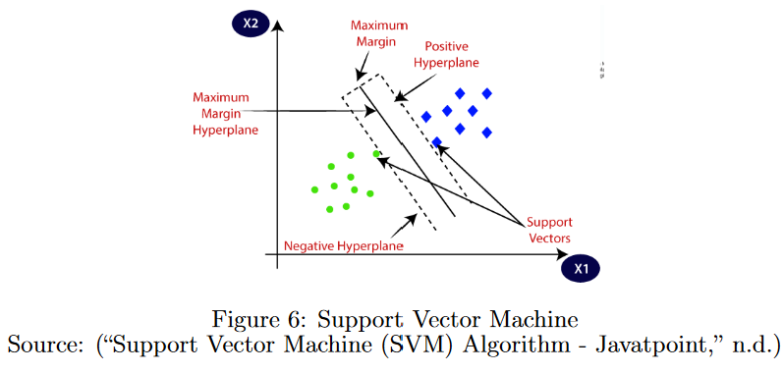
Support Vector Machine
Regression / Classification
Types:
Linear SVM
Non-linear SVM

Slide 22
Naive Bayes
Classification
Naive
No dependencies between attributes
Bayes
Bayes Theorem

Slide 23
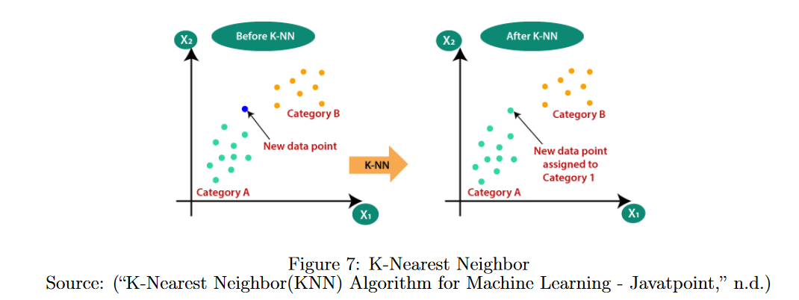
K-Nearest Neighbor
Regression / Classification

Slide 24
Principal Components Analysis
Problem with high dimensionality:
Increases complexity
Hard to visualize
Solution: Dimensionality Reduction
Dimensions:
No correlation between them
Principal components decrease in importance

Slide 25
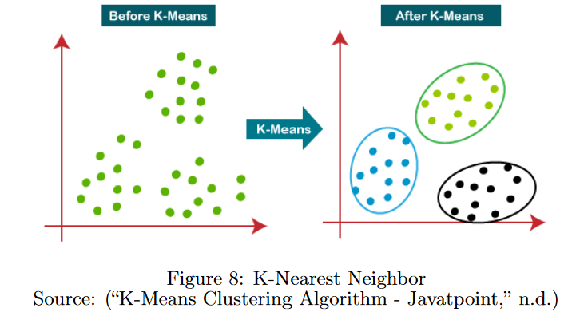
K-Means Clustering
Clustering

Slide 26
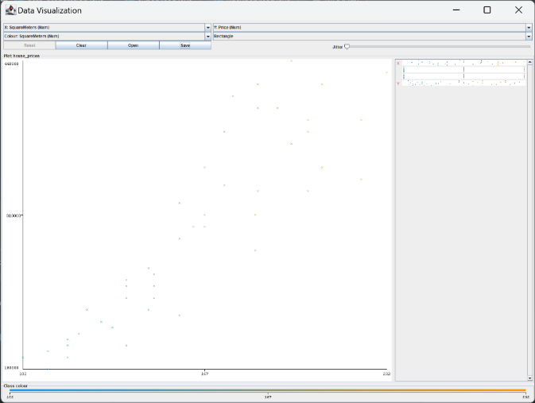
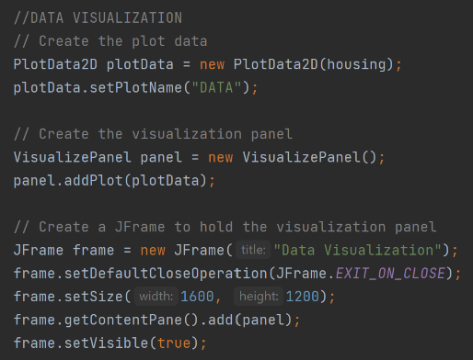
Data Visualization
Making the results understandable for everyone

Slide 27
Thank you for your attention!

