Slide 1
Comparison and Critical Comparison of Charges for NFC Payments Accounted by Credit Cards and Debit Cards Instead of Paying with Cash
Introduction
NFC Technology
2.1. Development and History
2.2. The functionality of NFC
2.3. Credit Card and Debit Card Overview 2.4. Mobile Payment
Fees and Charges Associated with NFC Payments Using Credit, Debit Cards, or Cash
3.1. Bank A
3.2. Bank B
3.3. Bank C
3.4. Bank D
3.5. Comparison
NFC Security and Privacy
4.1. NFC Security Risks and Threats
4.2. NFC Security Measures and Protocols
4.3. NFC Privacy Concerns and Solutions
Conclusion

Slide 2
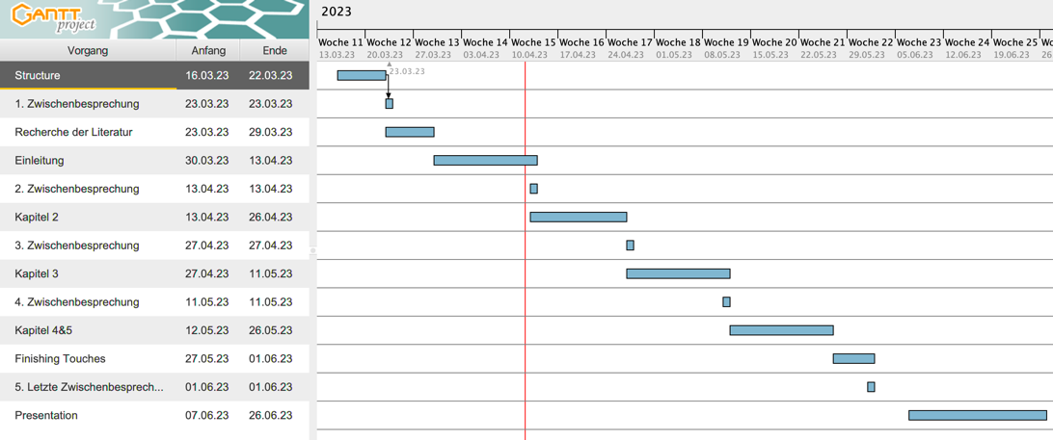
Gantt Chart

