Slide 1

HTML5
Nikita Pikulenko

Slide 2

◆ Hypertext Markup Language
◆ Set of instructions for web browsers to
display content
Introduction
◆ Addresses advanced web needs
◆ Multimedia, functionality, compatibility
◆ Enables cross-platform, responsive design
◆ Adoption accelerated due to benefits

Slide 3

Definition of HTML5
◆ Markup language used to create web pages and
applications
◆ Latest version of HTML
◆ standardized by W3C
◆ Enhances web technology with new features
◆ Better multimedia support, semantic markup, and form
controls
◆ Designed for cross-platform compatibility

Slide 4

Founders and History
◆ Developed by the World Wide Web Consortium (W3C)
◆ HTML5 Finalized in 2014
◆ Ian Hickson
◆ Over 100 members from various organizations
◆ Collaboration todevelop HTML5

Slide 5

◆ Makes rules and standards for the web
◆ Protocols and guidelines
◆ Shaping HTML
W3C
◆ Created HTML Working Group

Slide 6
Purpose and Significance
◆ Improve web experience
◆ Developers
◆ Users
◆ New features to make creation easier
◆ Responsive, interactive, accessible web applications
◆ Catalyst for groewth of web-based technologies

Slide 7
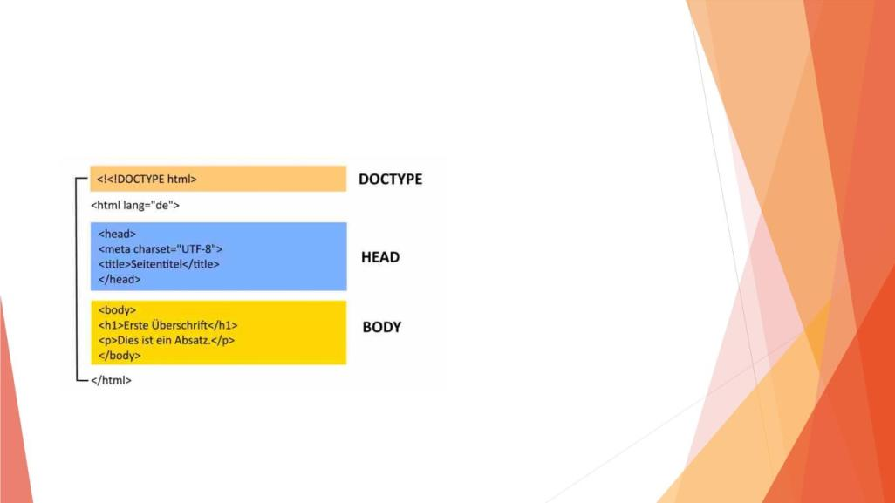
HTML5 Basics
◆ Hierarchical tree structure
◆ Document Object
Model (DOM)
◆ Basic structure:
◆ <!DOCTYPE>
◆ <html>
◆ <head>
◆ <body>
◆ Interplay with CSS and JS

Slide 8
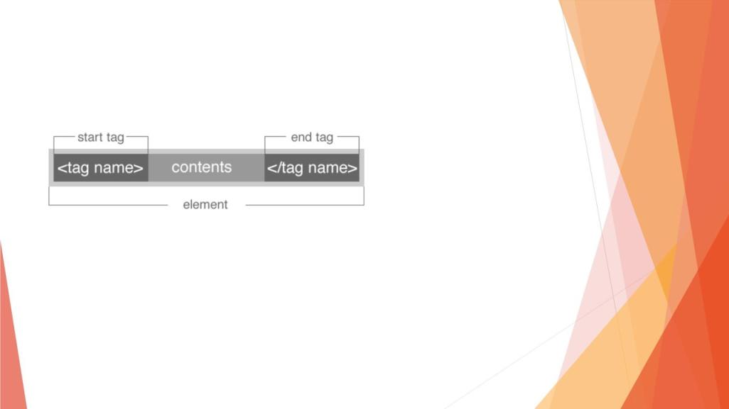
Tags and Syntax
◆ Opening and closing tags
◆ Associated attributes
◆ Define elements like
headings, paragraphs, links,
images, forms
◆ Different types of tags
◆ Comments <!-- -- >
◆ Not case sensitive

Slide 9
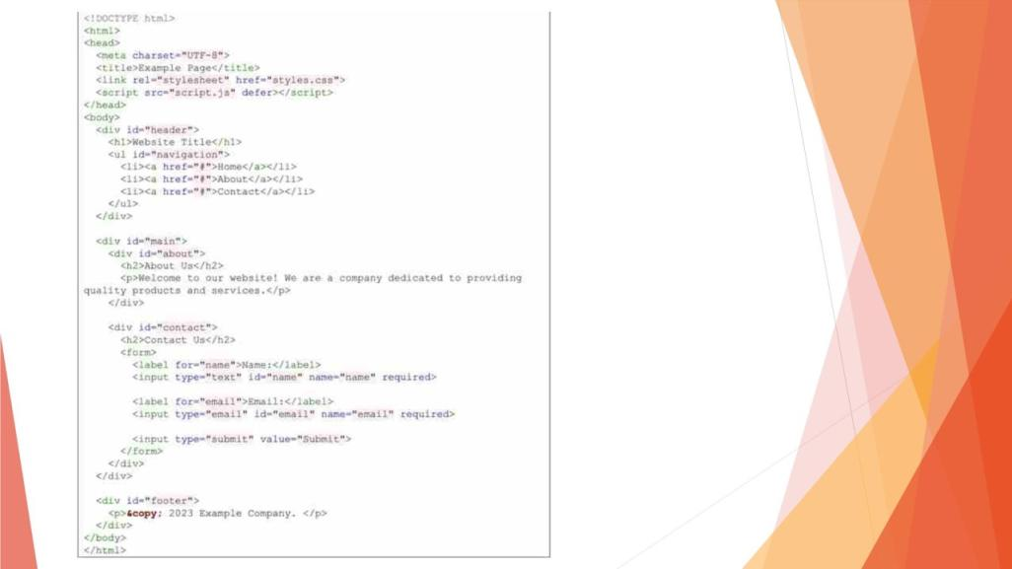

Slide 10
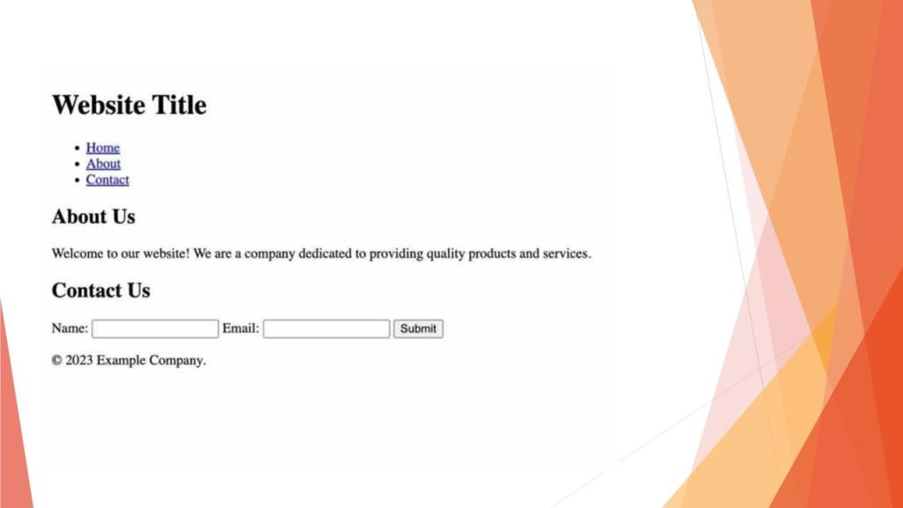

Slide 11
Semantic Elements
◆ Add meaning and context
◆ Improves accessibility and readability for both users and search
engines
◆ SEO
◆ Help define different parts of the web page
◆ Main content
◆ Navigation
◆ Footer sections

Slide 12

Key Semantic Elements

Slide 13
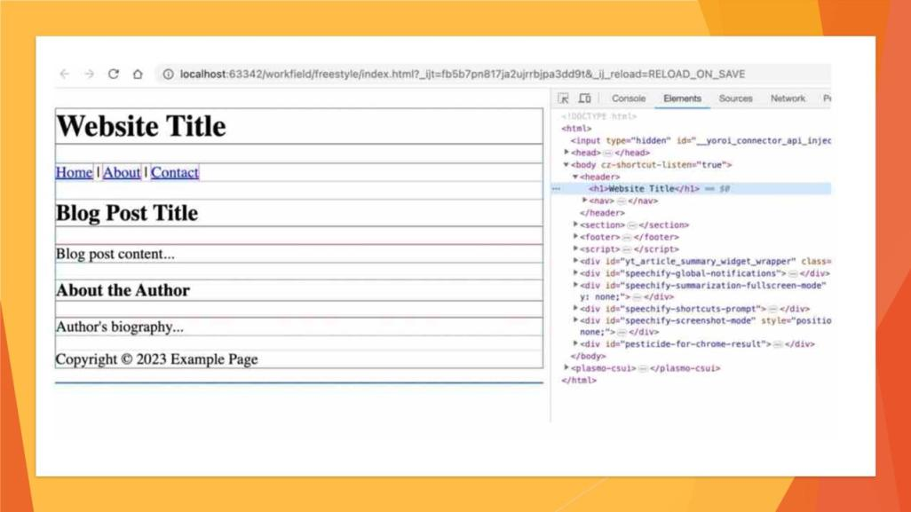

Slide 14

Usage Examples
Institutions
Companies
Organizations

Slide 15
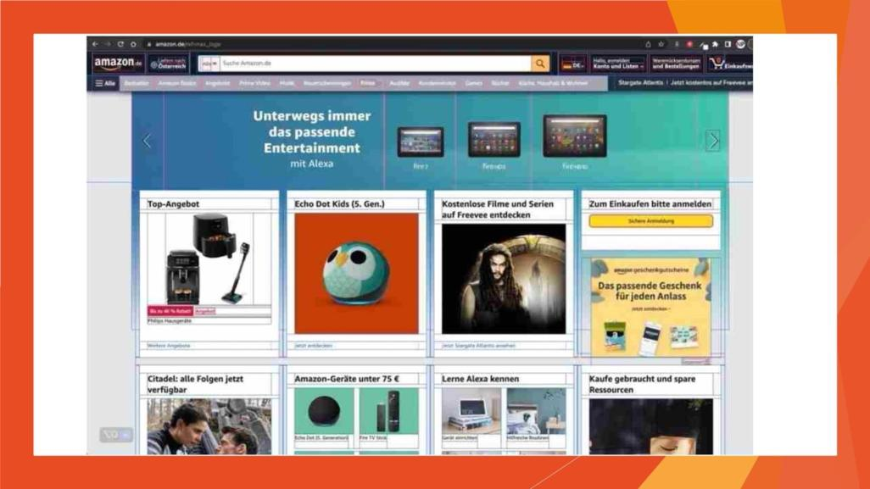

Slide 16
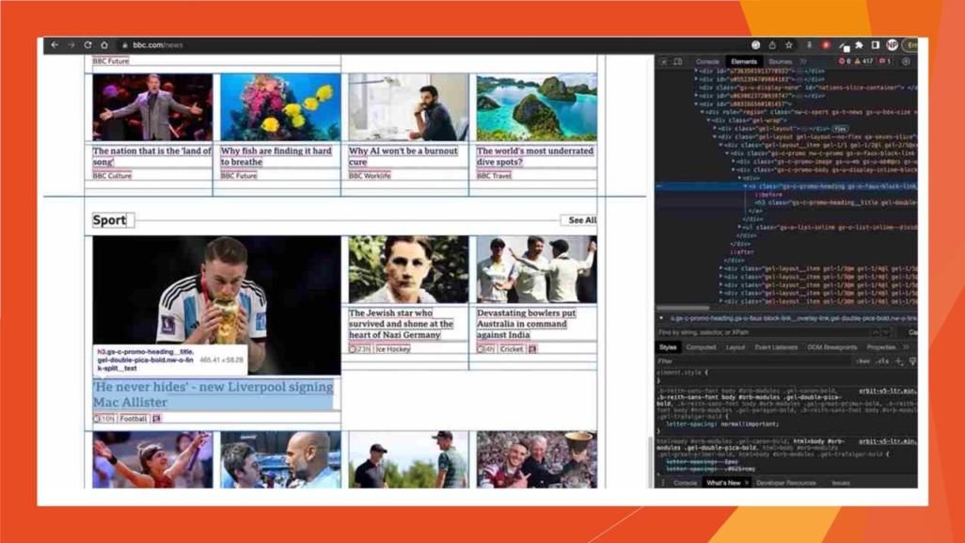

Slide 17
Multimedia
◆ Revolutionizes multimedia content incorporation
◆ Introduces audio, video, canvas, and SVG
elements
◆ Enables rich, multimedia-intensive web
applications

Slide 18
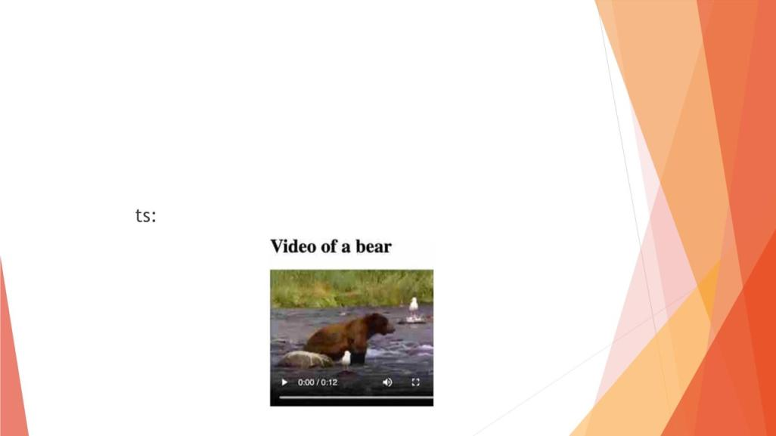
Multimedia
◆ Embedding of multimedia content into web pages
◆ Elemen
◆ <audio>
◆ <video>
◆ <canvas>
◆ <svg>

Slide 19

Issues
Compatibility issues with older browsers
Potential misuse leading to security and privacy issues
Accessibility challenges
Inconsistencies due to lack of full standardization
Performance can be affected by rich features

Slide 20
Overcoming Issues
◆ Feature detection
◆ Across differnet Broswers
◆ Progressive enhancement for browsers
◆ Security
◆ Users input
◆ More semantic elements for clearer view
◆ Trying on different browsers

Slide 21

Evolution of HTML
1991
1997
2000
HTML 1.0
HTML 3.2
XHTML 1.0
• Tim Berners-Lee
• CSS
• Using XML syntax
HTML 4.0
HTML 2.0
• Support for multimedia
elements
• Tables and forms
HTML 5
1995
1997
2014

Slide 22
Future Outlook
◆ Widely adopted stadnard for web development
◆ Relevance of multimedia will only increase
◆ More content consumption
◆ HTML5 will remain a key standard

Slide 23

Resources for Learning
◆ relatively easy language to learn, with a wide range of
resources available for beginners
◆ W3C
◆ Provides many resources for learning
◆ Online Tutorials (also on YouTube)
◆ Books
◆ Online Educational plattforms (Udemy, Codecademy)

Slide 24

Thank you for your
attention

