Slide 1
Machine Learning with
JAVA - WEKA

By Jakov Pavic
h11719023

Slide 2
Table of Contents for the Paper
1. Introduction
2. Machine Learning explained
3. WEKA explained
4. Data Preparation with WEKA
5. Supervised Learning with WEKA
6. Unsupervised Learning with WEKA
7. Data Visualization with WEKA
8. Summary
9. References

Slide 3
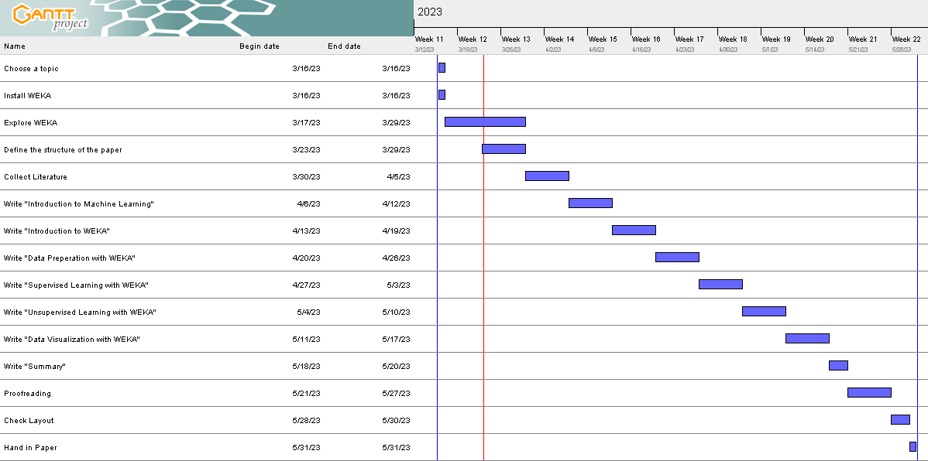
GANTT - Chart

Slide 4
Thank you for your attention!

