Slide 1

Roaming and Comparison of Roaming Fees
Ardit Bacaj

Slide 2
Introduction
Mobile devices are essential in our daily lives
Roaming allows us to use mobile devices abroad for internet access, phone calls, and text messages
78% of respondents in Austria traveled to another EU-Country in the last 12 months (Flash Eurobarometer 468, 2018)
Compare roaming fees between countries and different mobile operators

Slide 3



History and Development
History goes back to the 1980s
During early stages of mobile communication, roaming didn‘t exist
Only in home networks
Switch SIM-Card when travelling abroad
T-Mobile, Vodafone or Orange started to invest in infrastructure
Quickly gained popularity
Key part of roaming: development of Global System of Mobile Communication (GSM)

Slide 4
Functionality
Roaming not always activated automatically
Depends on the contract with mobile operator
When Roaming activated → devices automatically searches and connets with foreign mobile carrier‘s network
Most common Roaming standards: GSM and CDMA

Slide 5
GSM and CDMA
Transform data from mobile phones into radio waves
Global System for Mobile Communication (GSM)
  Digital communication technologies to transmit data and voice over airwaves
  Transmits signal using TDMA (Time Division Multiple Access) and FDMA (Frequency Division Multiple Access)
  900 MHz, 1800 MHz, 1900 MHz
  Used by 80% of mobile networks
Code Division Multiple Access (CDMA)
  Spread spectrum technology for best use of available bandwidth
  Send data over full frequency spectrum
  Uses Ultra High Frequency (UHF): 800 MHz and up to 1900 MHz

Slide 6
Evolution of Mobile Networks
First Generation (1G)
  Late 1970s and supported only phone calls
  No Roaming support
Second Generation (2G) & 2.5G
  1991 under GSM standard
  Allowed sending text messages, MMS, and picture messages
  2.5G: faster than 2G
  Packet-switched data transmission
  Basic internet browsing and E-Mail possible
Third Generation (3G)
  Introduced in 2001
  Enabled faster internet speeds, video calling, etc.

Slide 7
Evolution of Mobile Networks
Fourth Generation (4G)
  Launched in 2009
  Significant improvements in data speeds, latency, and capacity
  Offered high-speed video streaming and fast web-browsing
  Up to 1Gbit per second
Fifth Generation (5G)
  Latest generation introduced in the 2010s
  Even faster internet speeds and lower latency
  Up to 10 Gbit per second

Slide 8
Inernational and Domestic Roaming
International Roaming: mobile device connects to local mobile network outside of home country
Domestic Roaming: when mobile device is outside of network‘s coverage area (in home country) → automatically connect to different domestic network

Slide 9
Roaming Fees
Mobile operator applies surcharges for the use of roaming services
Types of Roaming Fees: outgoing calls, incoming calls, SMS, Data Roaming
Depends on location, roaming service, mobile operator
Example:
  Traveling to USA with Austrian SIM-Card (Magenta for example)
  Phone call 1,99€ per Minute
  15,36€ per MB of data

Slide 10
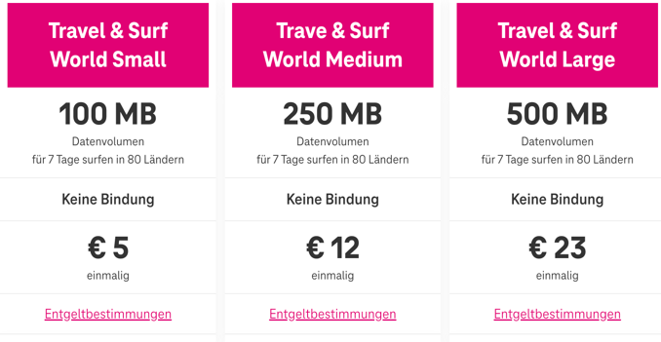
Prices Difference between Mobile Operators –
Roaming Packages – Magenta
International Roaming packages by Magenta
Source: https://www.magenta.at/handytarife/zusatzpakete/travel-surf

Slide 11
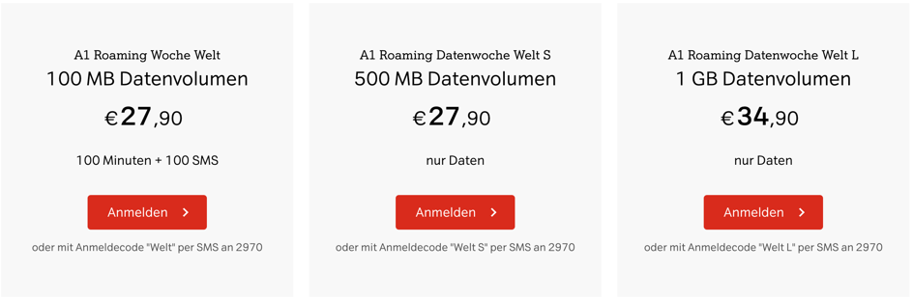
Prices Difference between Mobile Operators –
Roaming Packages – A1
International Roaming packages by A1 (Wochenpakete)
Source: https://www.a1.net/handys-tarife/zusatzoptionen/roaming-tarife

Slide 12
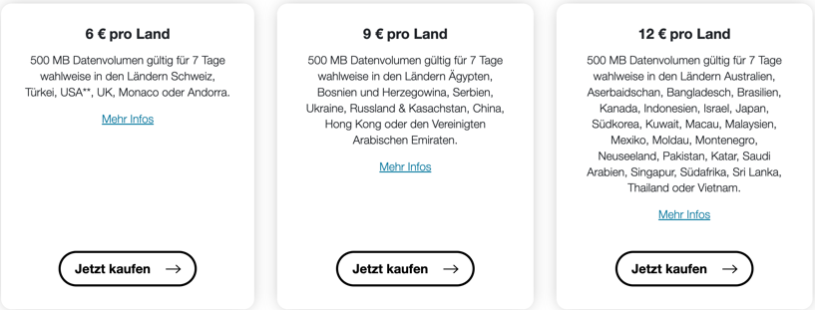
Prices Difference between Mobile Operators –
Roaming Packages – Drei
International Roaming packages by Drei
Source: https://www.drei.at/de/info/roaming/roamingtickets/

Slide 13
Prices Differences between Mobile Operators without Roaming Packages
Example: Travelling to Canada with Austrian SIM-Card
To Austria and Inside of Canada | Phone Call per Minute | Data per MB | SMS | MMS
Magenta | 4,29€ | 15,36€ | 0,45€ | 0,24€
A1 | 4,99€ | 19,90€ | 0,99€ | 0,99€
Drei | 1,99€ | 10,00€ | 0,35€ | 0,84€

Slide 14
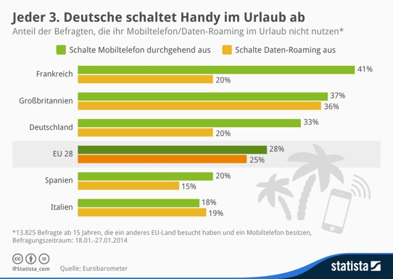
Critics on Roaming Fees
Caused many issues to consumers
Survey by ZDNet: 80% had received roaming bill that was too high
20% think romaing in general is too expensive
Travelers unsure how to act when travelling abroad

Slide 15
Before EU-Regulation
No EU-Roaming Regulation until 2007
Demand for Roaming was high
High Roaming charges, even in Europe
International calls were 4 times higher than national calls
After complains, European Commission started investigations

Slide 16
Phases of EU-Regulation
Regulation 1 in 2007
  Reduced costs for incoming and outgoing calls in EU, price cap
Regulation 2 in 2009
  Additional price caps, introduced regulations for incoming and outgoing SMS, and data
  After certain billing amount for data is reached (50€ by default) customer needs to be informed
In 2010, Roam Like At Home (RLAH) and Roam Like A Local (RLAL) were mentioned but not yet ready to launch
Regulation 3 in 2012
  Lowering price caps
RLAH in June 15th, 2017
  Using mobile data across EU and EEA countries without additional roaming fees

Slide 17
Impact on Roaming Fees
Significant impact on consumers
Much lower costs (for data zero costs)
Higher transparency due to SMS information about roaming charges
Information when 80% and 100% of data is used
Example: Travelling to Germany with Austrian SIM-Card
  Phone call from Germany to Austria: 0,0021€ and 0€ for incoming calls

Slide 18
Regulations outside of the EU
No similar regulation like in the EU
In North America: North American Numbering Plan (NANP)
  Assigning phone numbers in a standardized way across North America (no need for using internaiontal dialing codes)
Countries have own regulations for example USA
  Federal Communications Commission (FCC) only within USA

Slide 19
Alternatives of Roaming – Wi-Fi
Wireless Fidelity (Wi-Fi): Wireless technology that connects mobile devices to the internet via radio waves
Advantage: In many cases it is free
Disadvantage: high dependency on Wi-Fi networks, phone calls only via internet, quality not always guaranteed, (public) Wi-Fi might be unsecure

Slide 20
Alternatives of Roaming – Local SIM-Cards
Buy a local (prepaid) SIM-Card in the visited country
Local prices
No Roaming charges
For example: T-Mobile USA
  10GB and unlimited calls and text for 40$ (1 month)
  Unlimited data, calls and text for 50$ (1 month)
AT&T
  Unlimited data, calls and text for 65$ (1 month)
  5GB data, unlimited calls and text for 30$ (1 month)

Slide 21
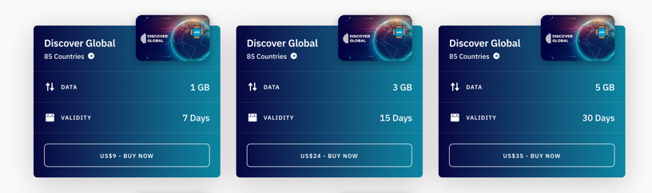
Alternatives of Roaming – International SIM-Cards
For people who plan to travel to more than 1 country
Can be used for multiple countries
Cheaper than buying local SIM-Cards for each country
Global SIM by „Airalo“
Source: https://www.airalo.com/global-esim

Slide 22
Thank you for your Attention

