Slide 1
An Introduction to WEKA: The All in One Machine Learning Software in Java

By Jakov Pavic
h11719023

Slide 2
Table of Contents
1. Introduction
2. Overview: Machine Learning
2.1 Supervised Machine Learning
2.2 Unsupervised Machine Learning
2.3 Reinforcement Machine Learning
2.4 Semi-Supervised Machine Learning
3. Overview: WEKA
3.1 Graphical User Interface (GUI)
3.2 Application Programming Interface (API)
3.3 Packages
3.4 Data Fortmats
4. Data Preparation
4.1 Importing Data
4.2 Understanding Data
4.3 Data Cleaning
4.3 Data Integration
4.4 Data Transformation
5. Machine Learning
5.1 Supervised Learning
5.1.1 Linear Regression
5.1.2 Logistic Regression
5.1.3 Decision Tree
5.1.4 Random Forest
5.1.5 Support Vector Machine (SVM)
5.1.6 Naive Bayes Algorithm
5.1.7 K-Nearest Neighbor
5.2 Unsupervised Learning
5.2.1 Principal Component Analysis
5.2.2 K-Means Clustering
5.2.3 Hierarchical Clustering
5.2.4 Local Outlier Factor (LOF)
5.2.5 Apriori Algorithm
6. Data Visualization
6.1 Bar Chart
6.2 Line Graph
6.3 Pie Chart
6.4 Scatter Plot
6.5 Histogram
7. Summary
8. References

Slide 3
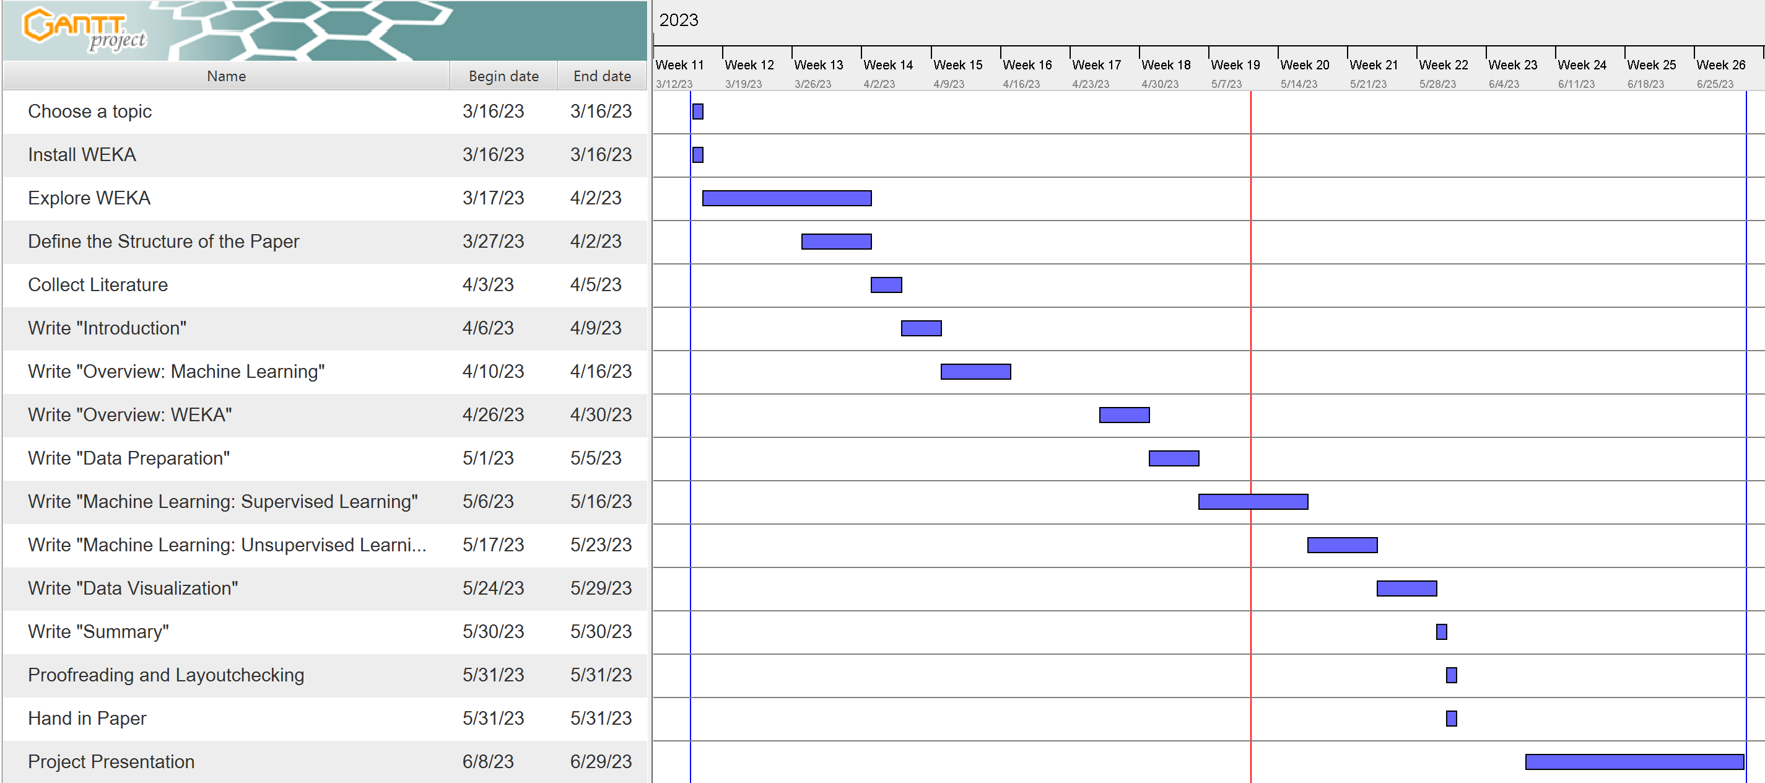
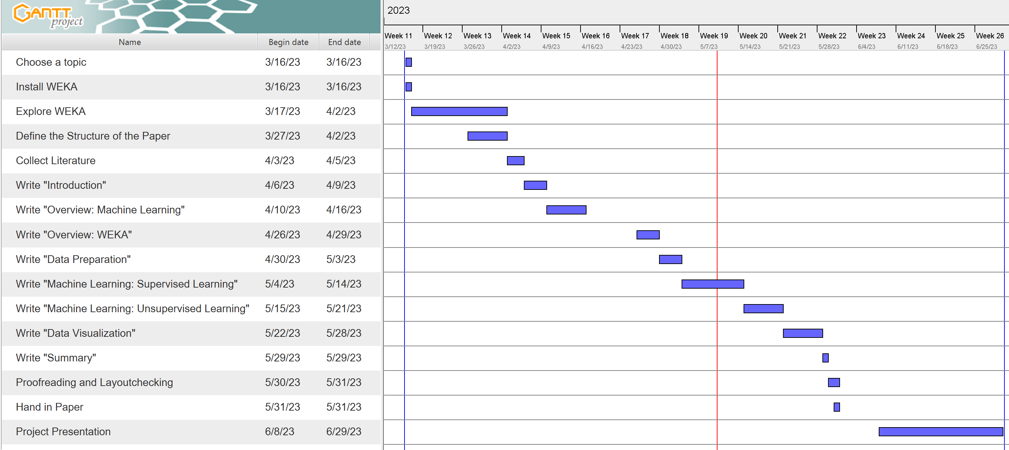
Anmerkung: alter GANTT Chart befindet sich immer hinter dem neuen. In der Präsentation erscheinen sie dann nacheinander
GANTT - Chart

Slide 4
Thank you for your attention!

