Slide 1
Web Browser – History, Concepts, Market
A presentation to the seminar paper of Alwin Krycha-Weilinger

Slide 2
Content
History and Development of Web Browser
WorldWideWeb
Mosaic
Netscape Navigator
Internet Explorer
Browser Wars
Mozilla Firefox
Opera
Safari
Google Chrome
Microsoft Edge
Browser Market and Trends

Slide 3
History and Development of Web Browser

Slide 4
WorldWideWeb / Nexus
Developed in 1990 by Tim Berners-Lee at Cern
First web browser ever
Only text based
HTML, URL, HTTP
Used for Information Exchange

Slide 5
Mosaic
Developed in 1993 by a team of computer scientists at the University of Illinois
First browser with Graphical User Interface
Innovated bookmarking, browser history and clickable hyperlinks
First browser to support images on webpages

Slide 6
Netscape Navigator
Developed in 1994
Direct successor to Mosaic
Introduction of Javascript and Cookies
First browser to support HTTPS-protocol
Plug-in support

Slide 7
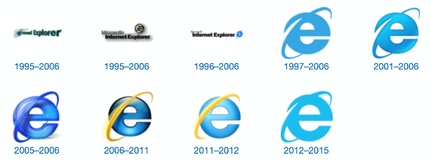
Internet Explorer
Developed by Microsoft in 1995
Default browser for Windows
Innovated Document Object Model (DOM) and Asynchronous Javascript and XML (AJAX)
Made CSS famous

Slide 8
Browser Wars
Between 1990s and early 2000s
Period of intense competition between Internet Explorer and Netscape Navigator
Unethical practices by Microsoft
Default browser on Windows
Threatening of smaller businesses
Contract with Apple for macOS
Antitrust lawsuit in 1998

Slide 9
Mozilla Firefox
Developed by Mozilla in 2004
Direct successor to Netscape Navigator
Open-source and non-profit
Innovated browser extensions
High reputation for its security

Slide 10
Opera
Developed in 1994
Initially launched as corporate software
Invented the tabbed-browsing functionality
Stayed under the radar for most users
Innovations like speed dial and Opera Turbo

Slide 11
Safari
Developed by Apple in 2003
Created after the contract with Microsoft expired
Tight integration with Apple‘s ecosystem
Inventor of the private browsing functionality

Slide 12
Google Chrome
Developed by Google in 2008
Open-source code base (Chromium)
Inventor of Omnibox and sandboxing technology
Current browser market leader

Slide 13
Microsoft Edge
Developed by Microsoft in 2015
Replaced Internet Explorer
Early version flopped
2020 – new Chromium based version
Innovative features like price comparison tool or AI writing assistant

Slide 14
Browser Market and Trends

Slide 15
Peak Market Shares of each Web Browser as of May, 2023
WorldWideWeb/Nexus 100%
Internet Explorer < 95%
Mosaic < 95%
Netscape Navigator < 90%
Google Chrome < 72%
Mozila Firefox < 32%
Microsoft Edge < 11%
Opera < 4%

Slide 16
Market Shares from 2009 - 2023

Slide 17
Trends for Web Browser
New Revenue Models
Instant page loading
AI-enhanced browsing
Increased privacy

Slide 18
Thank you for your attention

