Slide 1
BSF4ooRexx850 JDOR:
Java 2D Drawing for ooRexx
Elif Deger
h11919438

Slide 2
Content Overview
Introduction
JDOR (JAVA 2D Drawing)
Java Graphics Creation
Abstract Windowing Tool
Java 2D API
JDOR Command Handler
JDOR Nutshell Examples

Slide 3
Let‘s Start!
ooRexx
BSF4ooRexx
BSF4ooREXX850
JDOR

Slide 4
JDOR (JAVA 2D Drawing)
JDOR: Java 2D for ooRexx
Rexx Command Handler
Seamless integration with BSF4ooRexx850
User-friendly and efficient graphic creation
Exploit all of Java2D using simple Rexx commands
Java 2D knowledge essential for JDOR drawings

Slide 5
Java Graphic Creation
Java: Variety of tools and frameworks for graphics and GUI
Java Foundation Classes (JFC): Integrated tools in Java
Seminar paper focus: Creation of graphics with Java 2D API
Java 2D API: Extension of AWT
JDOR: REXX command handler for using Java 2D API in ooRexx
Seamless integration of Java 2D API in ooRexx
Graphics and Graphics2D classes in ooRexx, without Java syntax knowledge

Slide 6
Abstract Windowing Toolkit
GUI interface creation using graphical components in Java
Fixed part of Java class hierarchy
Java AWT components platform-dependent
AWT application appearance varies based on the operating system
AWT features include :
native user interface components
graphics and imaging tools
including shape, color, and font classes
flexible window layouts

Slide 7
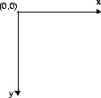
Java 2D API
Provides two-dimensional graphics, text, and imaging capabilities for Java programs through extensions to the Abstract Windowing Toolkit (AWT).
Use elements from“Graphics” and “Graphics2D” classes in ooRexx
The primary class in this API is the Graphics2D, which is a subclass of the Graphics class
Graphics2D provides control over 2D shapes, such as text, lines, and objects, compared to Graphics class.
User Space Coordinate System

Slide 8
JDOR Command Handler
Simplifies Java2D usage for Rexx programmers
Commands for drawing and manipulating graphics,
sets colors, fonts, and strokes...
Supports animation, configuration/state saving
Enables Rexx macros for Java 2D graphics
Canvas with an origin at the top left corner
Coordinate system: x increases right, y increases bottom
Mirror Java methods, x and y coordinates set separately
Simplifies Rexx commands, aligns with Java counterparts

Slide 9
JDOR Command Handler
Command | Description
background | Sets the color of the background.
color nickname | Supplying only the colorNickName argument will load the color from the internal register or from a Rexx variable by that name referring to a color.
drawImage | Draws an image which got previously loaded from the filesystem with the command loadImage and stored internally with an imageNickName in the internal image registry.
drawLine x y | Draws a line from the current coordinates to the given coordinates.
drawOval width height | Draws an oval in an invisible rectangle from the current coordinates (upper- left) with the given width and height.
drawPolygon | Draws a polygon using nPoints coordinates from xPoints-array and yPoints-array .The polygon gets closed by drawing a line from the first and last point.
drawPolyline | Draws a polyline using nPoints coordinates from xPoints-array and yPoints-array.
drawRect width height | Draws a rectangle from the current coordinates (upper- left) with the given width and height .
drawString text | Draws a string (=text) at the current coordinates.
fillOval width height | Fills an oval in an invisible rectangle starting from the current coordinates (upper- left) with the given width and height.
fillPolygon | Fills a polygon using nPoints coordinates from xPoints-array and yPoints-array.
fillRect width height | Fills a rectangle starting from the current coordinates (upper-left) with the given width and height.
font nickname | Sets a previously saved font as the font for the following commands.
fontSize size | Sets the font size for the following commands.

Slide 10
JDOR Command Handler
fontStyle style | Sets the font style for the following commands. Style-attribute (0: Normal, 1: Bold, 2: Italic, 3: Bold+Italic).
goto x y | Sets the x1 and y1 coordinates for the following commands.
loadImage nickname path | Saves an image from the given path under the given nickname
Rotate angle in degree | Rotates the following drawing in the given theta (=angle in degree) around the origin of the coordinate system. „x “and „y“sets a new origin for the rotation.
saveImage | Saves the current image to a file.
Scale | Queries and optionally changes ("concatenates") the scale factor for the x and y axis.
Shear | Applies a factor that determines how much an object shifts in relation to its “x” and “y” coordinates.
Sleep | Sleeps (halts execution) for the given interval expressed in seconds.
Stroke NickName width cap join miterlimit dashArray dashPhase | Defines a new stroke of width in pixels, cap, join, miterlimit, dashArray, dashPhase, stores it in the internal registry with the uppercased strokeNickName and returns the previous stroke via the Rexx variable RC.
Transform | An AffineTransform defines a matrix that gets used to calculate the effective x and y values for the target device according to this formula: x' = translateX + scaleX*x + shearX*y y' = translateY + scaleY*y + shearY*x
Translate x y | Sets a new origin for the coordinate-system.
winShow | Shows the current window.
winSize width height | Sets the size (width and height) of a new window.
winTitle | Queries and optionally sets the title of the frame (window) that displays the current image.

Slide 11
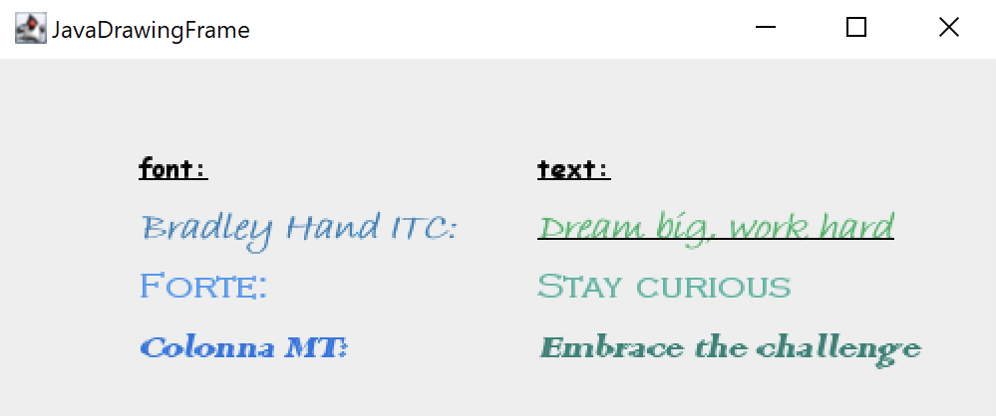
Creating Text
1
2
3
4
5
6
7
8
9
10
11
12
13
14
15
16
17
18
19
20
21
22
23
24
25
26
27
28
29
30
31
32
33
34
35
36
call addJdorHandler -- load
address jdor -- set default environment to JDOR
-- setting the colors
color enchanting 41 128 185
color warmSpring 60 154 242
color cerulean 24 117 227
color shallowSea 40 180 99
color lagoon 62 181 161
color mosaicTile 29 130 118
--Creating and showing a new window
win_width = 500
win_height = 180
winSize win_width win_height
winShow
fontSize 14
fontStyle 1 -- 1=BOLD
font 20_Comic "Comic Sans MS"
goto 70 60
color black
font 20_Comic
drawString "font:"
stringBounds "font:"
parse var rc x " " y " " width " " height
say width
color black
drawLine 70+width 60
goto 270 60
drawString "text:"
stringBounds "text:"
parse var rc x " " y " " width " " height
say width
color black
drawLine 270+width 60
37
38
39
40
41
42
43
44
45
46
47
48
49
50
51
52
53
54
55
56
57
58
59
60
61
62
63
64
65
66
67
68
69
70
71
72
73
74
75
76
77
--create the 1st
fontSize 20
fontStyle 3 -- 3=BOLD+ITALIC
font 20_Bradley "Bradley Hand ITC"
goto 270 90
color shallowSea
font 20_Bradley
drawString "Dream big, work hard"
stringBounds "Dream big, work hard"
parse var rc x " " y " " width " " height
say width
color black
drawLine 270+width 90
goto 70 90
color enchanting
font 20_Bradley
drawString "Bradley Hand ITC:"
stringBounds "Bradley Hand ITC:"
parse var rc x " " y " " width " " height
say width
--create a 2nd
fontSize 18
fontStyle 1
font 18_Copper "Copperplate Gothic Light"
goto 270 120
color lagoon
font 18_Copper
drawString "Stay curious"
stringBounds "Stay curious"
parse var rc x " " y " " width " " height
say width
goto 70 120
color warmSpring
drawString "Forte:"
stringBounds "Forte:"
parse var rc x " " y " " width " " height
say width
78
79
80
81
82
83
84
85
86
87
88
89
90
91
92
93
94
95
96
97
98
99
100
--create a 3rd
fontSize 20
FontStyle 3
font 20_Colonna "Colonna MT"
goto 270 150
color mosaicTile
font 20_Colonna
drawString "Embrace the challenge"
stringBounds "Embrace the challenge"
parse var rc x " " y " " width " " height
say width
goto 70 150
color cerulean
font 20_Colonna
drawString "Colonna MT:"
stringBounds "Colonna MT:"
parse var rc x " " y " " width " " height
say width
sleep 40
::requires "jdor.cls"
JDOR-text.rxj

Slide 12
Drawing
1
2
3
4
5
6
7
8
9
10
11
12
13
14
15
16
17
18
19
20
21
22
23
24
25
26
27
28
29
30
31
call addjdorhandler
address jdor
--Creating and showing a new window
win_width = 500
win_height = 245
new win_width win_height
winshow
-- Set the color
color mulberry 192 69 161
-- Draw the ovals
goto 50 50
drawOval 40 40
goto 53 53
drawOval 60 60
goto 56 56
drawOval 80 80
goto 59 59
drawOval 100 100
goto 62 62
drawOval 120 120
goto 65 65
drawOval 140 140
goto 68 68
drawOval 160 160
-- Define the size of the rectangles
rect_width = 30
rect_height = 30
-- Set the initial position for the first rectangle
start_x = 200
start_y = 5
32
33
34
35
36
37
38
39
40
41
42
43
44
45
46
47
48
49
50
51
52
53
54
55
56
57
58
59
60
61
62
63
64
65
-- Draw the pattern of Sapphire colored rectangles
do i = 1 to 10
-- Calculate the position of the current rectangle
rect_x = start_x + (i - 1) * rect_width
rect_y = start_y + (i - 1) * rect_height
-- Fill the rectangle at the current position with the random color
goto rect_x rect_y
color sapphire 79 118 231
fillrect rect_width rect_height
end
-- Define the size of the rectangles
rect_width = 30
rect_height = 30
-- Set the initial position for the first rectangle
start_x = 230
start_y = 5
-- Draw the pattern of orange rectangles
do i = 1 to 10
-- Calculate the position of the current rectangle
rect_x = start_x + (i - 1) * rect_width
rect_y = start_y + (i - 1) * rect_height
-- Fill the rectangle at the current position with the random color
goto rect_x rect_y
color orange
fillrect rect_width rect_height
end
sleep 60
::requires "jdor.cls"
JDOR-drawing.rxj

Slide 13
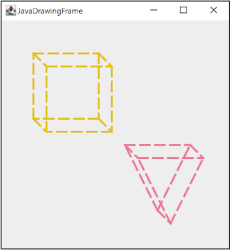
Drawing
1
2
3
4
5
6
7
8
9
10
11
12
13
14
15
16
17
18
19
20
21
22
23
24
25
26
27
28
29
30
31
32
33
34
call addJdorHandler
address jdor
-- Creating and showing a new window
win_width = 350
win_height = 350
NEW win_width win_height
WINSHOW
-- Setting the colors
color LemonLime 228 192 0
color peonypink 235 117 145
-- Draw the Cube
--Creating / Saving stroke
dashphase_stroke1=bsf.createJavaArrayOf("float.class", 15, 8, 15,8)
STROKE strokeA 3 2 0 10 "dashphase_stroke1" 0
-- Draw the front face of the cube
color LemonLime
goto 50 50
STROKE strokeA
drawLine 150 50
goto 150 50
drawLine 150 150
goto 150 150
drawLine 50 150
goto 50 150
drawLine 50 50
-- Draw the back face of the cube
goto 70 70
drawLine 170 70
goto 170 70
drawLine 170 170
goto 170 170
drawLine 70 170
goto 70 170
drawLine 70 70
35
36
37
38
39
40
41
42
43
44
45
46
47
48
49
50
51
52
53
54
55
56
57
58
59
60
61
62
63
64
65
66
67
68
69
70
71
72
-- Connect the corresponding vertices of the front and back faces
goto 50 50
drawLine 70 70
goto 150 50
drawLine 170 70
goto 150 150
drawLine 170 170
goto 50 150
drawLine 70 170
-- Draw the Triangle
-- Draw the front face of the triangle
color peonypink
goto 190 190
drawLine 290 190
goto 240 290
drawLine 190 190
goto 240 290
drawLine 290 190
-- Draw the back face of the triangle
goto 210 210
drawLine 310 210
goto 260 310
drawLine 210 210
goto 260 310
drawLine 310 210
-- Connect the corresponding vertices of the front and back faces
goto 190 190
drawLine 210 210
goto 290 190
drawLine 310 210
goto 240 290
drawLine 260 310
sleep 60
::requires "jdor.cls"
JDOR-CubePyramid.rxj

Slide 14
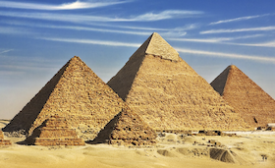
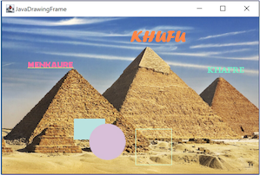
Visualizing with Images
JDOR-images.rxj
-- 1st Pyramid
fontSize16
fontStyle 1 -- 1=BOLD
font 16_Berlin_S "Berlin Sans FB"
color silkribbon
goto 50 100
drawString "MENKAURE"
stringBounds"MENKAURE"
parse var rc x " " y " " width " " height
say width
color citron
drawLine50 + width 100
--2nd Pyramid
fontSize 32
font 32_Forte "Forte"
color blazeorange
goto 250 50
drawString "KHUFU"
-- 3rd Pyramid
fontSize 24
font 24_Arabic_T "Arabic Typesetting"
color jamaicansea
goto 400 110
drawString "KHAFRE"
--Saving the created image in the same directory
saveImage "Names_of_Giza_Pyramids.png"
sleep 40
::requires "jdor.cls"
1
2
3
4
5
6
7
8
9
10
11
12
13
14
15
16
17
18
19
20
21
22
23
24
25
26
27
28
29
30
call addJdorHandler
address jdor
--Creating and showing a new window
win_width = 500
win_height = 308
winsize win_width win_height
winshow
-- import the image
loadImage Pyramids_of_Giza "py.png" -- nickname and path
drawImage Pyramids_of_Giza
-- draw and fill rectangle
color powderblue
goto 140 200
drawRect 60 40
fillRect 60 40
-- draw and fill circle
goto 170 210
color thistle
drawOval 70 70
fillOval 70 70
-- draw rectangle
goto 260 220
color tropicaldream
drawRect 70 70
31
32
33
34
35
36
37
38
39
40
41
42
43
44
45
46
47
48
49
50
51
52
53
54
55
56
57
58
59
60
61
py.png
Names_of_Giza_Pyramids.png

Slide 15
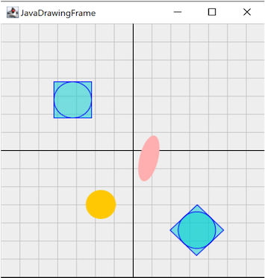
Rotate, Scale, Translate and Shear
call addJdorHandler
address jdor
--Creating and showing a new window
win_width = 350
win_height = 350
WINSIZE win_width win_height
WINSHOW
--setting the colors
color coordinate_system 190 190 190 200
color middle 0 0 0 255
--drawing the system
color coordinate_system
do i=0 to win_width by 25
goto i 0
drawline i win_height
end
do i=0 to win_height by 25
goto 0 i
drawline win_width i
end
color middle
goto win_width/2 0
drawline win_width/2 win_height
goto 0 win_height/2
drawline win_width win_height/2
-- Applying methods
-- draw two lines forming a big X
moveTo 70 80 -- currX=70, currY=80
-- define and set color, register it with the name "pantone"
color pantone 0 206 209 127
fillRect 50 50
color blue
drawRect 50 50
color blue
drawOval 50 50
37
38
39
40
41
42
43
44
45
46
47
48
49
50
51
52
53
54
55
56
57
58
59
60
61
62
63
1
2
3
4
5
6
7
8
9
10
11
12
13
14
15
16
17
18
19
20
21
22
23
24
25
26
27
28
29
30
31
32
33
34
35
36
translate 260 250
moveTo 0 0
rotate 45
color pantone
fillRect 50 50
fillOval 50 50
color blue
drawRect 50 50
color blue
drawOval 50 50
"goto 150 15"
drawPolygon 50 50
rotate 45
drawPolygon 50 50
rotate 45
goto 70 70
color orange
fillOval 40 40
"shear -1 0"
color pink
fillOval 40 40
say "press enter to end."; parse pull
sleep 400
::requires "jdor.cls"
JDOR-manipulate.rxj

Slide 16
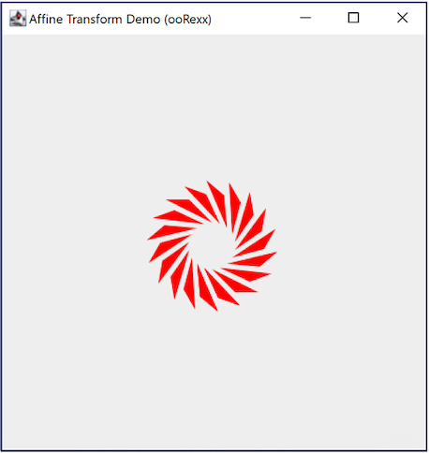
Affine Transformation
1
2
3
4
5
6
7
8
9
10
11
12
13
14
15
16
17
18
19
20
21
22
23
jdh=.bsf~new("org.oorexx.handlers.jdor.JavaDrawingHandler")
say "JDOR version:" jdh~version -- show version
call BsfCommandHandler "add", "jdor", jdh -- add as a Rexx command handler
address jdor -- set default environment from operating system to JDOR
newImage 300 300 -- create new image
winShow -- show image in a window
winTitle "Affine Transform Demo (ooRexx)" -- set window's title
polygonXs="(20,0,40)" -- define three x coordinates for the triangle
polygonYs="(40,20,40)" -- define three y coordinates for the triangle
shape myP polygon polygonXs polygonYs 3 -- create triangle shape
translate 200 200 -- move origin (x=200, y=200)
scale 1.1 1.1 -- increase the triangle shape size 10%
rotate 20 -- rotate by 20 degrees
color red -- set color to red
do 20
fillShape myP -- fill (and show) the triangle shape
rotate 20
end
say 'Hit <enter> to proceed (end) ...'
parse pull data -- wait until user presses <enter> on the keyboard
JDOR-AffineTransformation.rxj

Slide 17
Moving Objects
1
2
3
4
5
6
7
8
9
10
11
12
13
14
15
16
17
18
19
20
21
22
23
24
25
26
27
28
29
30
31
32
33
34
call addjdorhandler
address jdor
call bsf.import "java.lang.math", "calc"
win_width = 500
win_height = 500
square_size = 50
speed = 2
color desertSunrise 255 167 146
winsize win_width win_height
new win_width win_height
background white
clearRect win_width win_height
winshow
color desertsunrise
centerX = win_width / 2
centerY = win_height / 2
radius = win_width / 4
angle = 0
do forever
getstate
currx = centerx + .calc~cos(.calc~toradians(angle)) * radius - square_size / 2
curry = centery + .calc~sin(.calc~toradians(angle)) * radius - square_size / 2
goto currx curry
fillRect square_size square_size
angle = angle + speed
sleep 0.01
end
::requires "jdor.cls"
JDOR-move.rxj

Slide 18
Moving Objects
1
2
3
4
5
6
7
8
9
10
11
12
13
14
15
16
17
18
19
20
21
22
23
24
25
26
27
28
29
30
31
32
33
34
35
36
call addjdorhandler
address jdor
call bsf.import "java.lang.Math", "calc"
win_width = 500
win_height = 500
star_size = 50
speed = 1
color daylightlilac 158 124 243
winsize win_width win_height
new win_width win_height
background white
clearoval win_width win_height
winshow
color daylightLilac
centerX = win_width / 2
centerY = win_height / 2
radius = win_width / 4
angle = 0
delta_angle = .calc~toRadians(72) -- 360 degrees divided by 5 sides of the star
distance = 0
do forever
getState
currX = centerX + .calc~cos(angle) * distance
curry = centery + .calc~sin(angle) * distance
goto currx curry
fillOval star_size star_size
angle = angle + delta_angle
if angle > 2 * .calc~pi then angle = angle - 2 * .calc~pi
distance = distance + speed
if distance > radius then distance = 0
::requires "jdor.cls"
JDOR-PurpleStar.rxj

Slide 19
Moving Objects
1
2
3
4
5
6
7
8
9
10
11
12
13
14
15
16
17
18
19
20
21
22
23
24
25
26
27
28
29
call addJdorHandler
address jdor
-- creating and showing a new window
new 500 500
winShow
-- define the initial size of the square
square_size = 50
-- set the rotation angle
angle = 5
-- calculate the center coordinates of the window
center_x = 500 / 2
center_y = 500 / 2
-- calculate the starting position of the square at the bottom of the window
square_x = center_x - square_size / 2
square_y = 500 - square_size
-- draw and rotate the square
do while square_y > 0
-- draw the square at the current position
goto square_x square_y
drawRect square_size square_size
-- rotate the square
rotate center_x center_y angle
-- update the position of the square
square_y = square_y - 1
-- pause to observe the rotation
sleep 0.005
end
sleep 60
::requires "jdor.cls"
JDOR-RotatingSquare.rxj

Slide 20
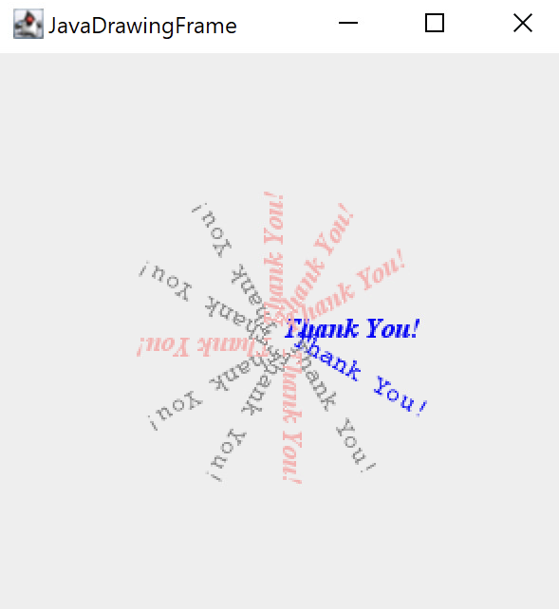
Thank_You_For_Your_Attention.rxj

