Slide 1
Webbrowser
Peter Gruber

Slide 2
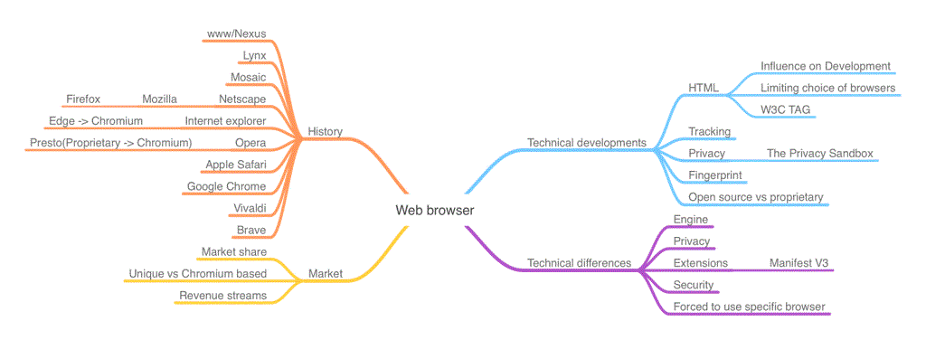
Table of Content
Introduction
Evolution of Web Browsers
2.1. History
2.2. Technical Developments
2.3. Tracking of Users
Market
3.1. Market Share
3.2. Why do Mayor Players have Unique Web Browsers?
3.3. Revenue Streams
3.4. Technical Differences between Web Browsers
Future Outlook

Slide 3
Timetable

