Slide 1
CSS: Concepts, Architecture, Nutshell Examples, Outlook
Marina Wustinger

Slide 2
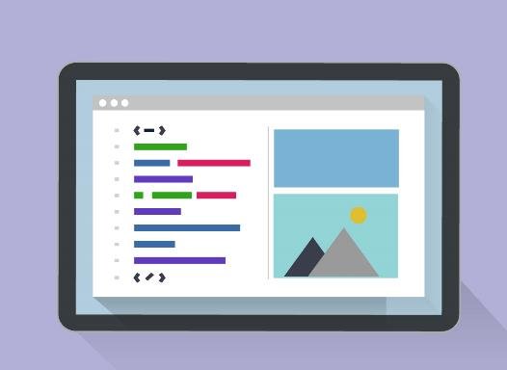
Topics
What is CSS? What does it stand for?
History
Syntax
Implementation of Styles
Nutshell Examples
Outlook
CSS Architecture

Slide 3
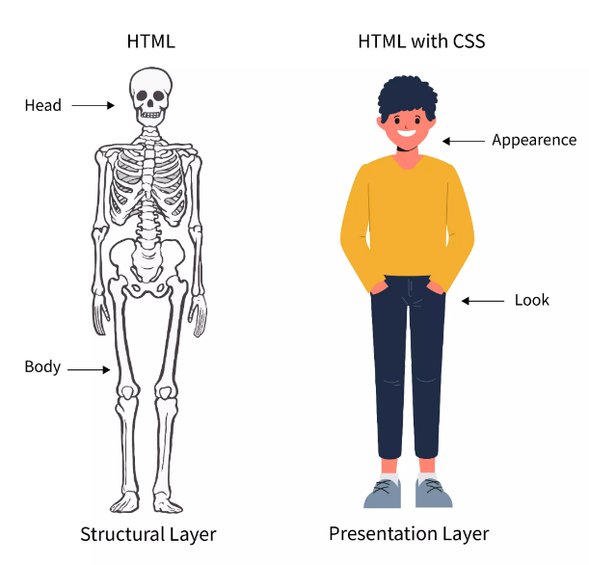
CSS
What is CSS?
CSS is a stylesheet language that specifies how a document is visually presented to users. – style, layout, etc.
What does CSS stand for?
Cascading Style Sheets

Slide 4
History
Invented by Hakon Wium Lie in 1990
First released in 1996
Standardized by W3C – control and develop new features
CSS4 ??

Slide 5
Syntax
selector {
property: value;
}

Slide 6
How are styles implemented?
There are three methods to implement styles in a document.

Slide 7
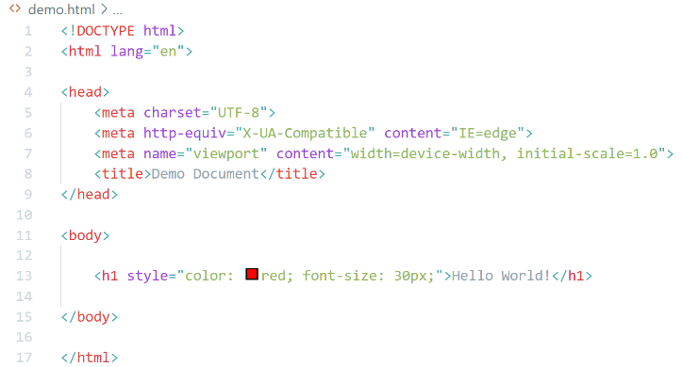
Inline styles
Bad practice
Hard to make changes
Only really useful when specifying a unique style to only one single element.

Slide 8
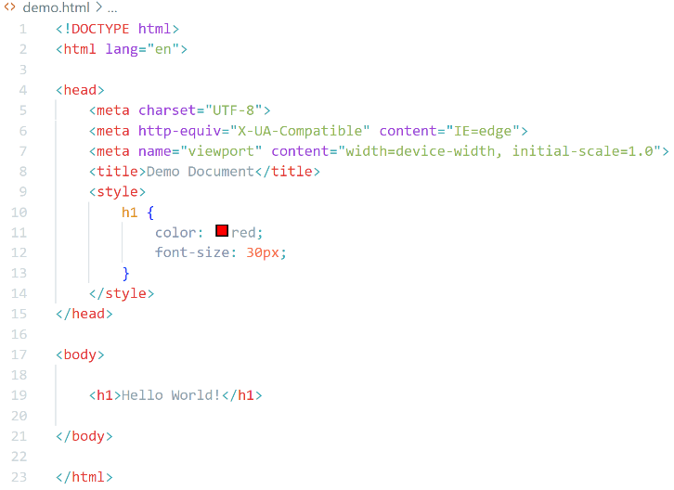
Embedded Styles
Also not recommended
Makes it impossible to share styles

Slide 9
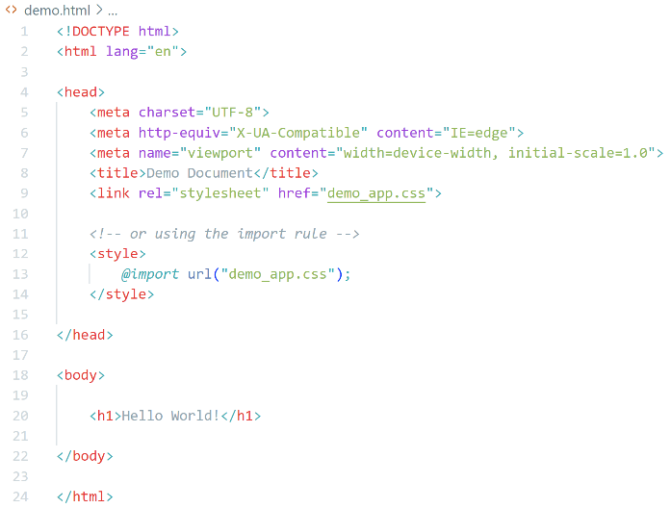
External Stylesheets
Best practice
Great reusability
Can use it to style multiple pages
Can link several stylesheets to one document
@import

Slide 10
CSS Architecture
What is CSS Architecture?
Can be regarded as a set of guidelines and is essential for complex projects.
Gives CSS code a clear structure and enforces consistent styling.
Provides code consistency, reusability and easy maintenance.

Slide 11
SMACSS - Scalable and Modular CSS
Focuses on file/folder organization
Break CSS down based on five rules:
Base
Layout
Modules
State
Theme
Simple and easy to incorporate into workflow

Slide 12
BEM – Block Element Modifier
Simple naming convention
Defining classes in HTML to be able to write independent CSS blocks which can be reused
No complications with code
Works well with parts of SMACSS
[block]__[element]--[modifier]

Slide 14
CSS Architecture
Which Architecture should you use?
Really does not matter. Use the one you are the most comfortable with, the one the team prefers working with.
Highly recommended to include it in the documentation of the project. This gives newcomers the opportunity to catch up easily and quickly.

Slide 15
Nutshell Examples

Slide 16
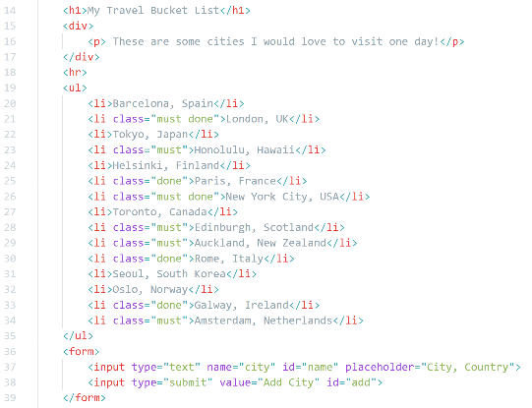
Travel Bucket List

Slide 17
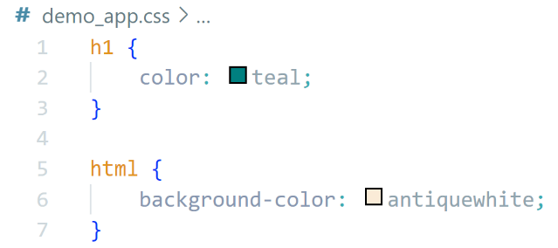
How to Apply and Change Colours
Element Selector: h1
Property: color
Value: green
Element Selector: html
Property: background-color
Value: antiquewhite

Slide 18
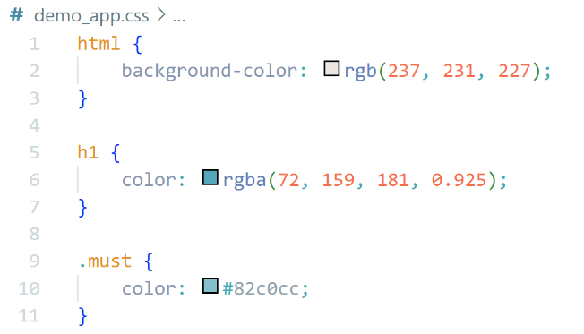
Colours in CSS
Human-readable
RGB/RGBA
(red, green, blue, alpha channel)
0-255
Red: rgba(255, 0, 0, 0)
Hexadecimals
# followed by six hex numbers
0-1
a-f
White: #ffffff
Black: #000000

Slide 20
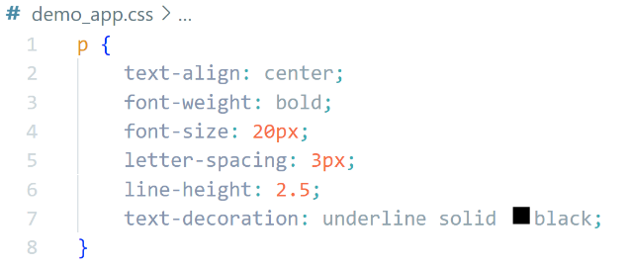
How to Style a Document Using Common Text Properties
text-align: sets horizontal alignment of a content
font-weight: sets weight/ boldness of a text element
font-size: sets size of font, does not affect thickness of characters
letter-spacing: sets space between characters
line-height: sets distance between lines, here: height of line boxes
line-decoration: sets appearance of decorative lines on text

Slide 21
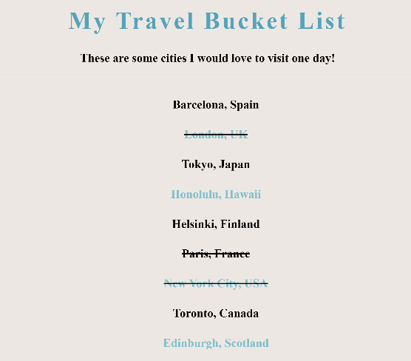

Slide 22
How to Change the Font Style
Styles depend on the ones build into browser
font-family: sets the font style
Font stack: acts as a back-up if browser can’t display a font

Slide 23
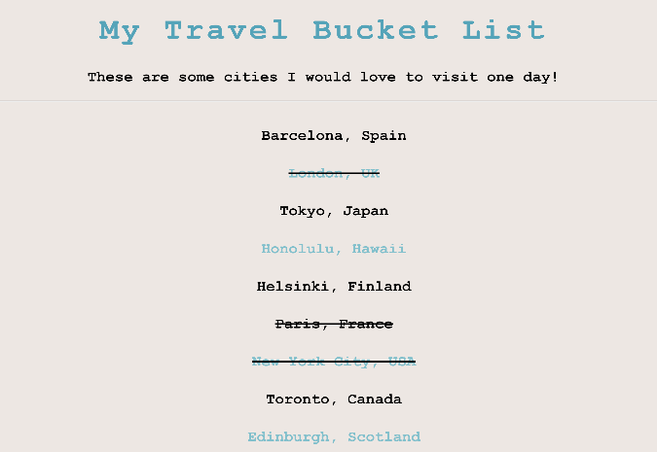

Slide 24
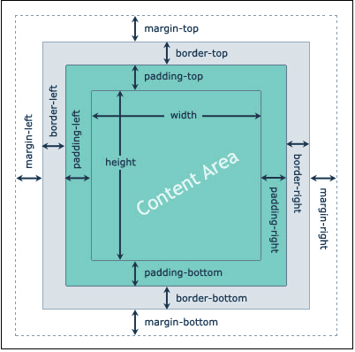
The Box Model
Each element is presented as a box by browser’s rendering engine
Content area: displays content
Padding: creates space around content
Border: runs around element
Margin: separates element from its neighbour

Slide 25
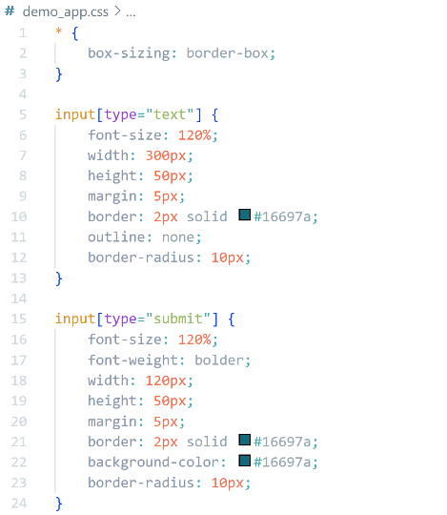
How to Use Box Model Properties
Attribute selector
border-box: any padding and border will be regarded
margin: to increase the distance between elements
border: to set width, colour and style of the border
padding: not necessarily needed for this example
outline: none will stop it from changing when selected
border-radius: to round off boxes

Slide 27
How to Create a Hover Effect
Pseudo-classes: act like a class, specify a certain state of an element
State when hovering on element:
Background colour changes
Cursor changes to hand pointer

Slide 28
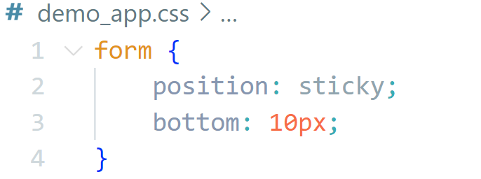
How to stick an element to one position
Different values to position an element
Here: sticky
Sticks element to bottom of the page, making it overlap with others when scrolling up

Slide 29
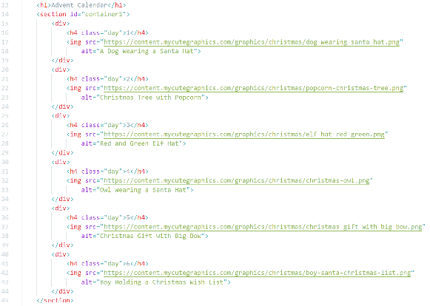
Advent Calendar

Slide 30
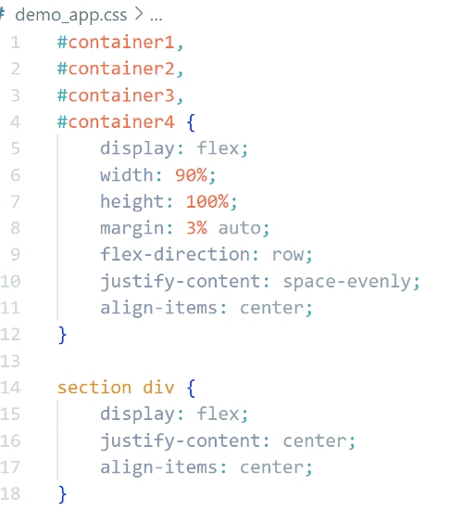
How to Create a Layout Using Flexbox
Display: Containers are set to flex
Flex-direction: specifies direction of main axis
Justify-content: specifies how items are distributed along main axis
Align-items: distributes space between items along cross axis
align-self: sets the behaviour of one element inside a container

Slide 31
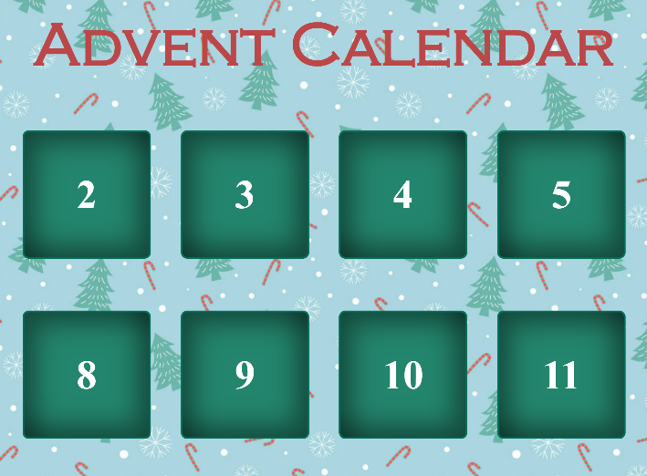

Slide 32
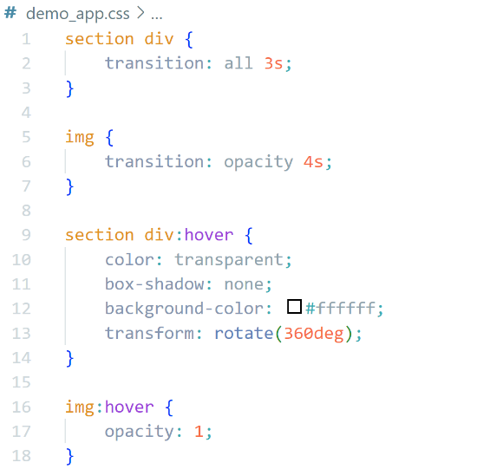
How to Create a Transition
Change the state of an element by specifying transition
Pseudo-classes are used to set the “new” state
transition: property, duration, timing function, delay
transform: gives you the ability to rotate a transformable element

Slide 33
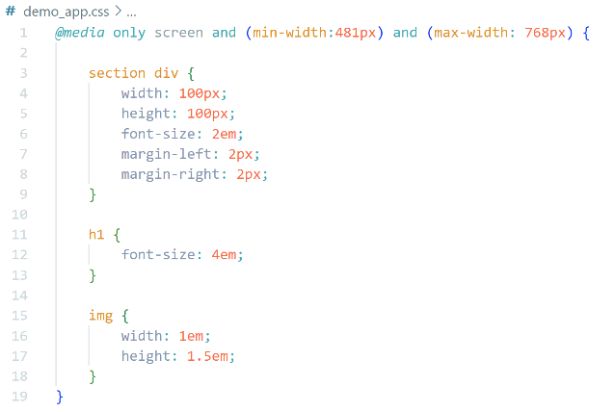
How to Make Design Responsive
Media Queries: used to target media features, make web page more responsive
At-rule: @media
only screen: keeps older browsers from applying styles
Conditions: must be true for styles to be applied

Slide 34
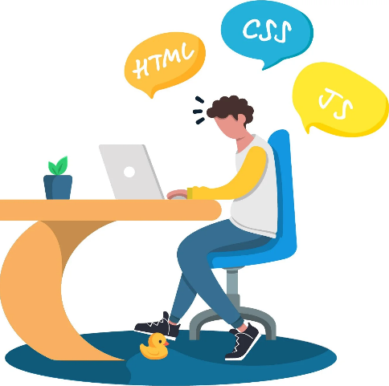
Outlook
Adding scripting language
Making pages dynamic
JavaScript
Working with frameworks
Bootstrap
Web Accessibility
ARIA
Automatic.CSS

Slide 35
The End

Slide 36
Image Sources
Title Page: https://cdn.windowsreport.com/wp-content/uploads/2020/11/10-Best-desktops-for-programming-and-coding.jpg
Topics: https://www.levelaccess.com/wp-content/uploads/2011/06/css.jpg
CSS: https://scaler.com/topics/images/html-and-css-meme.webp
The Box Model: https://static.javatpoint.com/csspages/images/css-box-model.png
Outlook: https://external-preview.redd.it/XKWf2weCD6EGL6HzI28kQXX7SAv7OT3kLOWQh9AMsZA.jpg?auto=webp&s=e9e270390d2e9d40454422e8938e15d43fcdbee9

