Slide 1
Cost Comparisons between Proprietary and
Opensource Software
4142 – Seminar aus BIS
Xibinaku Piters

Slide 2
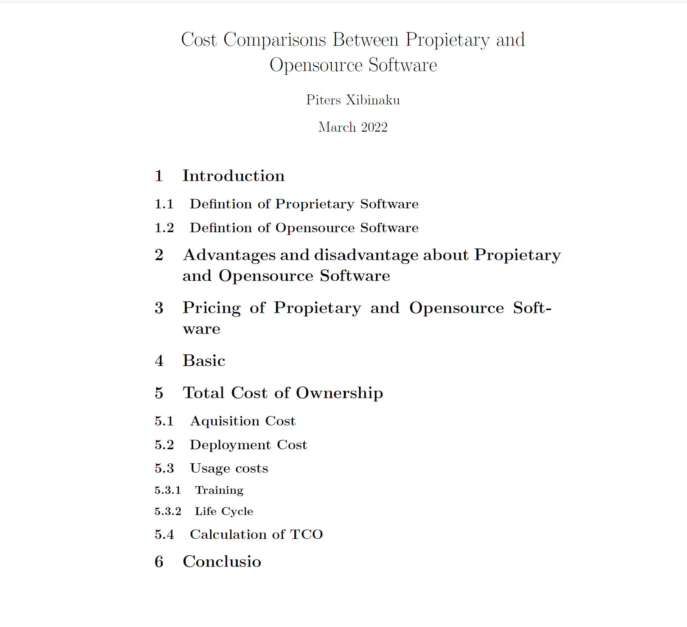
Table of contents

Slide 3
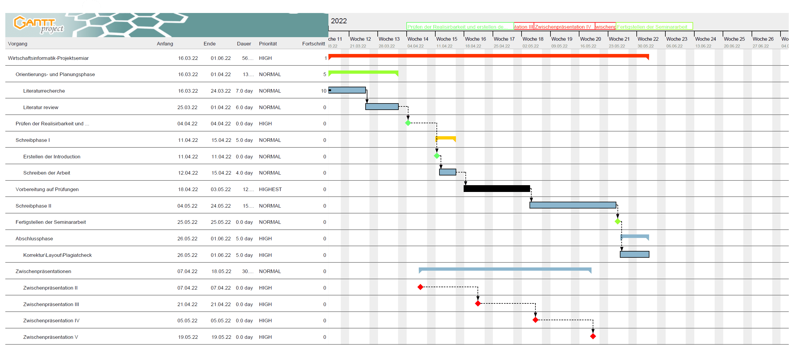
GANTT chart

