Slide 1
Paper on: Comparison and Critical Comparison of Charges for Roaming (cost based, value based or arbitrary prices) Final Presentation by Edin Hadžimehmedović
SBWL Vertiefungskurs V – Business Information Systems
Mentoring professor: Prof. Dr. Rony G. Flatscher

Slide 2
Telefon Bill in amount of € 25.000,00!
Fellow citizen from lower Austria after coming back from vacation in Turkey

Slide 3
Research questions
How roaming prices are being formatted?
What pricing strategy is being . pursued?

Slide 4
Roaming – Ability to Use a Mobile Phone Service in a Visited Network
Geographical:
International
National
Call/Connection
Active
Passive

Slide 5
Market Structure Supply and Demand Conditions
Supply
Wholesale
Retail
Demand
Wholesale
Retail

Slide 6
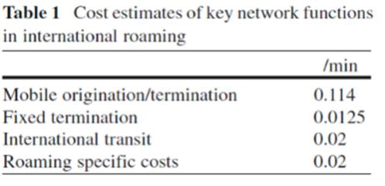
Composition of Roaming Costs
Mobile origination (MO)
Mobile/Fixed termination (MT/FT)
International Transit (IT)
Roaming specific costs (RSC)

Slide 7
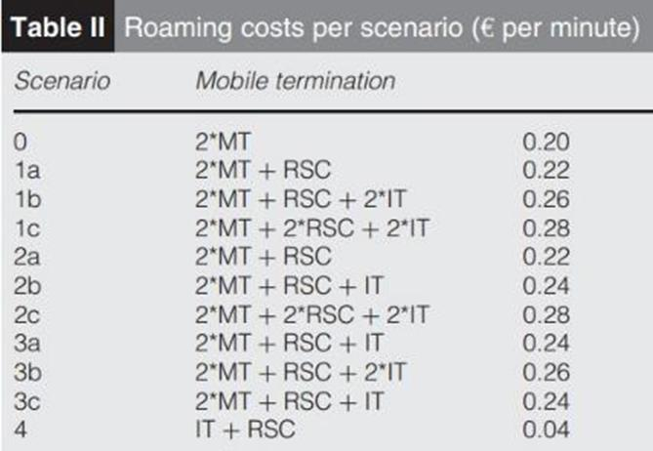
Different Scenario Cost Calculation

Slide 8
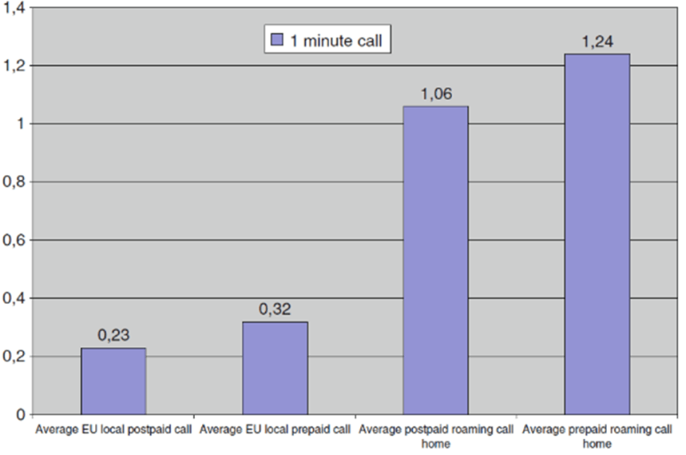
EU Average Prices for Local and Roaming Calls (2006)
Source: CEC 2006a

Slide 9
EU Roaming Regulations were imposed in 4 Steps during the time period 2007-2017
The First Step - 2007 Regulation
The Third Step - (the 2012 Regulation)
The Second Step - the 2009 amended Regulation
The Step four (the 2012 amended Regulation)

Slide 10
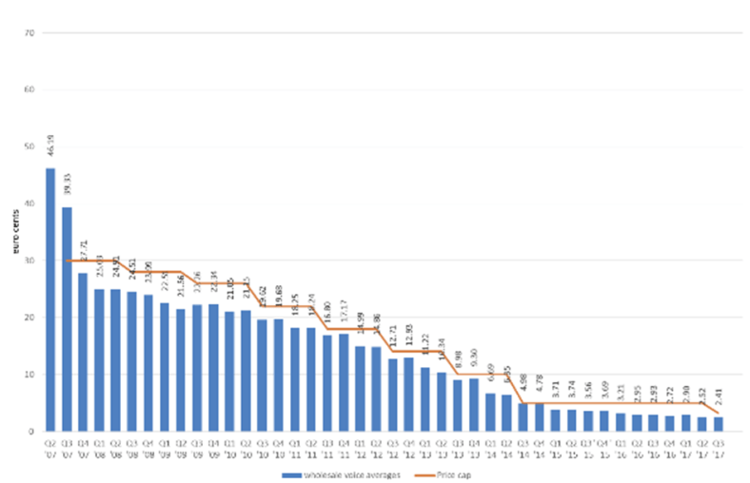
Result:

Slide 11
Questions
What happens in the EU after June 2032?
Can we expect to have roam like at home worldwide?

