Slide 1
Determining Prices in the Information Technology Age:
How Can “Just Prices” Be Achieved for Good?
Ahmed Bary Ramadan; h1551721
0095 - Seminar aus BIS

Slide 2

What Is a Just Price?
What even is a “just price”?
  Does a just price exist? Should everything be free?
  What makes a price just?
  Who determines whether a price is just or not?
  How do we calculate a just price?

Slide 3
Agenda
Part 1: The “Just Price”
Introduction
Definition
History
Critical Evaluation
Part 2: Pricing Mechanisms and the Role of IT
Pricing Strategies
Impact of IT on Pricing Strategies
ITEPS
IT-Enabled Markets

Slide 4
Introduction (1/2)
Today’s consensus: just price = market price
However, consumers still perceive price unfairness
“A just price, a just wage, a just rate of interest, is a contradiction in terms. The question what a person ought to get in return for his goods and labour is a question absolutely devoid of meaning. The only rational questions are what can he get in return for his goods or labor and whether he ought to sell them at all.“
Collingwood, R. G. (1926). Economics as a Philosophical Science.
International Journal of Ethics

Slide 5
Introduction (2/2)
Frey’s (1997) snow shovel experiment:
“A hardware store has been selling snow shovels for 30 Swiss Francs (or 30 German Marks). The morning after a heavy snow storm, the store raises the price to CHF/DM 40. How do you evaluate this price rise?”
-> Result: 83% thought the price was “unfair”
Other examples: Wine prices at fine restaurants, Music on the internet, …
Does this mean that prices are not “just”?

Slide 6
Part 1: The “Just Price”

Slide 7
Defining the Just Price
Fair ≠ just
-> dual meaning of “fair”: either “satisfactory” or “just”
Personal and social fairness
-> personal f.: serving the interest of the individual
-> social f.: abiding by social norms
My definition of a just price: a price that considers both social AND personal fairness equally in the formation of a price

Slide 8
History of the Just Price
Before 500 AD: Ancient Economic Thought
500-1500 AD:
Middle Ages & Scholasticism
16th-18th Century:
Mercantilism
17th-18th Century:
Physiocracy
1776-1870s: Classical Economics
After 1870s: Neoclassical Economics

Slide 9
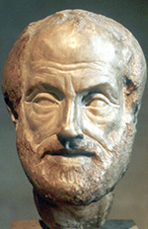
Ancient Economic Thought (Before 500 AD)
Aristotle: “Politics”, “Nicomachean Ethics”
Money as the standard to measure value
Distributive and corrective justice
Natural exchange as the fair form of exchange: it satisfies man’s natural needs; exchanged goods are of equal value
Unnatural exchange: aims to generate profit (unnatural desire)

Slide 10

The Middle Ages (500-1500 AD)
Scholasticism – Thomas Aquinas
Based on Aristotle and writings of the church
-> seeking of profit was condemned
Cost of production price as the just price
Late Middle Ages
  -> separation of economics and theological ideas
  -> profit seeking gradually institutionalized
  -> idea of a just price started to fade

Slide 11

Mercantilism (16th-18th Century)
Goal: to increase nation’s wealth and power
Commercial corporations (profit seeking)
State controls the economy
Prices set freely

Slide 12
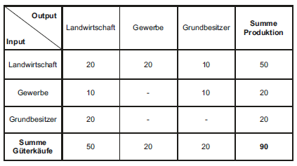
Physiocracy (17th – 18th Century)
First well-developed economic theory
Natural order – freedom (“laissez faire”)
Tableau Economique – focus on agriculture
Use value and exchange value
“Natural price” as the basis for pricing
Tableau Economique - Söllner, 2011

Slide 13

Classical Economics (1786-1870s)
Adam Smith – “The Wealth of Nations”
Free trade
“Invisible hand” -> natural price
Water-diamond paradox
Utility theory of value
Labor theory of value as the standard for pricing

Slide 14
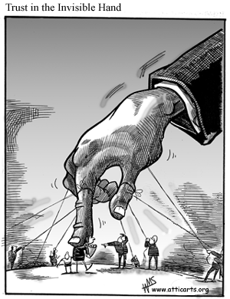
Neoclassical Economics (1870s - Today)
Mathematical models – “hard” science
Shift from macroeconomic to microeconomic perspective
-> Focus on behavior and satisfaction of the individual
Utility theory of value as the standard for pricing
  -> marginal utility
Perfect competition
Market price as the fair price

Slide 15

Alternative Conceptions of the Just Price
Voluntary exchange price
(Michel ,1999)
Non-exploitative price
(Valdman, 2009)
Distributive justice price
(Frank, 1998)

Slide 16
Critical Evaluation (1/2)
 | Natural exchange | Objective/real/ natural price | Free price-setting | Labor theory of value | Market price | Voluntary exchange price | Non-exploitative price | Distributive justice price
Social fairness | ✓ | ✓ | ✓ | ✓ | ✓ | ✓ | ✓ | ✓
Personal fairness | X | X | X | X | ✓ | X | ✓ | ✓
Non-exploitative price: can you think of any flaws?
Distributive justice price: can you think any flaws?

Slide 17
Critical Evaluation (2/2)
What’s wrong with the market price?
Unrealistic assumptions implied by perfect competition
X buyers are rational
X every participant is a price taker
X perfect information (all participants know prices and utilities they would get from each product
X homogeneous products (products are perfect substitutes to each other)
X no entry or exit barriers

Slide 18
Part 2: Pricing Mechanisms and the Role of IT

Slide 19
Pricing Strategies (1/2)
Pricing strategy
Cost-based
Value-based
Competition-based
Price is based on the production costs
Costs are disregarded altogether
Price is based on the estimated value a product product generates to the customer
Price is based on competitors’ prices

Slide 20
Pricing Strategies (2/2)
Cost-based
Unit cost = 10€
Margin = 20%
Value-based
Competitor’s price = 20€
Competition based
Avg. value to customer = 25€
12€
25€
19€

Slide 21
Impact of IT on Pricing Strategies
Increased availability of information
Enhanced reach
Expanding interactivity

Slide 22
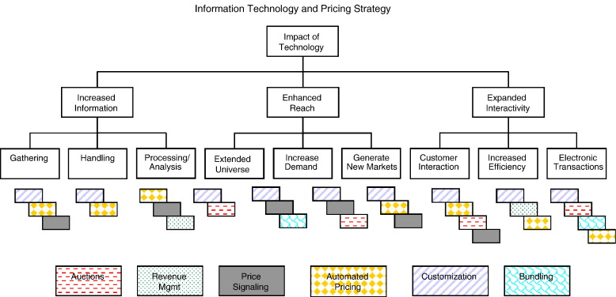
IT-Enhanced Pricing Strategies (ITEPS)
Information Technology and Pricing Strategies – Dixit et. al, 2005

Slide 23
IT-Enabled Markets
E-commerce
Airline industry
Cloud computing
Mobile app industry

Slide 24
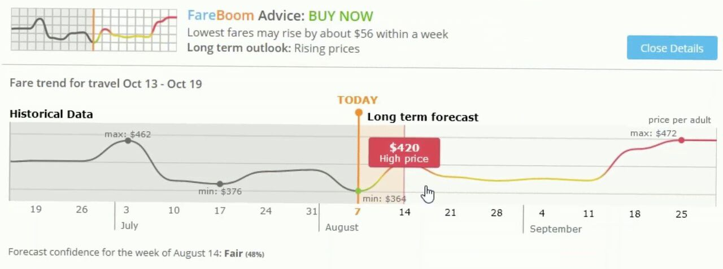
Airline Industry – Dynamic Pricing
Taken from https://www.fareboom.com

Slide 25
Thank you for your attention!
ANY LAST Questions?

Slide 26
Image Sources
https://www.thepublicdiscourse.com/2015/08/15435/
https://images-na.ssl-images-amazon.com/images/I/71dsU1pQbiL.jpg
https://www.euston96.com/en/scholasticism/
http://t1.gstatic.com/licensed-image?q=tbn:ANd9GcS-2gfmuFUq1P9puhi4S3Y2d47n84gt2Wx83sJ5Sn3wicpKzkhRRZws4n1txuLV
https://readvid.com/dynamic-pricing-in-airline-industry-why-flight/
https://checksbalances.clio.nl/2017/03/the-wounded-invisible-hand-regulating-the-world/

