Slide 1
Determining Prices in the Information Technology Age: How Can "Just Prices" Be Achieved for Good?
Ahmed Bary Ramadan
0095 – Seminar aus BIS

Slide 2
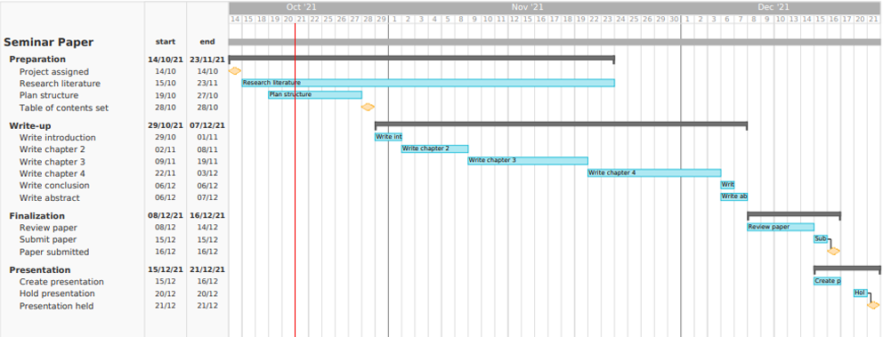
Gantt chart
0095 – Seminar aus BIS

Slide 3
Structure (work in progress)
1. Introduction
2. The Just Price – A Historical Perspective
    Ancient times – Aristotle
    Scholasticism – Thomas Aquinas
    Classicism – Adam Smith
    Neoclassicism
    3. Recent Propositions of the “Just Price”
        Wertheimer (1996)
        Frank (1988)
        Valdman (2009)
        Meng (2005)
        Elegido (2015)
4. Effect of IT on Pricing Decisions
  Transparency
  Pricing of data
  Cloud computing
  Freemium
  5. Conclusion
0095 – Seminar aus BIS

