Slide 1
Determining Prices in the Information Technology Age:
How Can “Just Prices” Be Achieved for Good?
Ahmed Bary Ramadan; h1551721
0095 - Seminar aus BIS

Slide 2
What Is a Just Price?
What even is a “just price”?
Does a just price exist? Should everything be free?
What makes a price just?
Who determines whether a price is just or not?
How do we calculate a just price?

Slide 3
Agenda
Part 1: The “Just Price”
Introduction
Definition
History
Critical Evaluation
Part 2: Pricing Mechanisms and the Role of IT
Pricing Strategies
Impact of IT on Pricing Strategies
ITEPS
IT-Enabled Markets

Slide 4
Introduction – The Just Price (1/3)
Theory
Today’s consensus: just price = market price
However, consumers still perceive unfairness in pricing
“A just price, a just wage, a just rate of interest, is a contradiction in terms. The question what a person ought to get in return for his goods and labour is a question absolutely devoid of meaning. The only rational questions are what can he get in return for his goods or labor and whether he ought to sell them at all.“
Collingwood, R. G. (1926). Economics as a Philosophical Science.
International Journal of Ethics

Slide 5
Introduction – The Just Price (2/3)
Frey’s (1997) snow shovel experiment:
“A hardware store has been selling snow shovels for 30 Swiss Francs. The morning after a heavy snow storm, the store raises the price to 40 CHF. How do you evaluate this price rise?”
-> Result: 83% thought the price was “unfair”
Other examples: Wine prices at restaurants, music on the internet, cookies before Christmas, clothing from sweat shops …

Slide 6
Introduction – The Just Price (3/3)
Consumer perception of price unfairness depends on:
-> reference prices
-> self-interest bias
-> perceived motive of sellers
-> distribution of profit
Consumers are generally inclined to believe that goods are overpriced
Fair prices very important!

Slide 7
Part 1: The “Just Price”

Slide 8
Defining the Just Price
Fair ≠ just
-> dual meaning of “fair”: either “satisfactory” or “just”
Personal and social fairness
-> personal f.: serving the interest of the individual
-> social f.: abiding by social norms
My definition of a just price: a price that considers both personal AND social fairness equally in the formation of a price

Slide 9
History of the Just Price
Before 500 AD: Ancient Economic Thought
500-1500 AD:
Middle Ages & Scholasticism
16th-18th Century:
Mercantilism
17th-18th Century:
Physiocracy
1776-1870s: Classical Economics
After 1870s: Neoclassical Economics

Slide 10
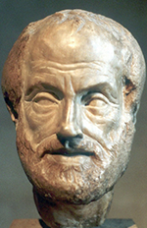
Ancient Economic Thought (Before 500 AD)
Represented by Aristotle
Just exchange = natural exchange: satisfies man’s natural needs; needs are limited; exchanged goods are of equal value
Unnatural exchange: aims to generate profit (unnatural desire); needs are unlimited
Money as the standard to measure value
Notes:
First attempt at a proper economic theory
Philosopher – ethics, politics, economics, logic
Olive example and shoe example
Believed in an intrinsic value - Fails to recognize that value is subjective

Slide 11
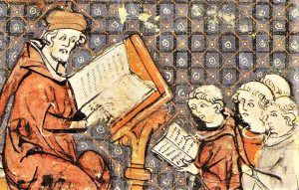
The Middle Ages (500-1500 AD)
Scholasticism – Thomas Aquinas
Just price = cost of production price
Late Middle Ages
-> separation of economics and theological ideas
-> profit seeking gradually institutionalized
-> idea of a just price started to fade
Notes:
Medieval school of philosophy that was heavily influenced by the church
Thomas Aquinas considered the most influential thinker of the Middle Ages and his contributions are regarded as representative for the scholastic economy
Follows Aristotle’s reasoning but makes a few innovations. SHOE EXAMPLE – realizes that the value of a good can increase if you do something productive or useful to it -> just to charge higher price
A little more sophisticated than Aristotle’s view, but he still bases his pricing on an intrinsic or objective value that is inherent in a good – the costs or the input involved in making a good.
-> later heavily criticized.

Slide 12
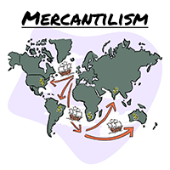
Mercantilism (16th-18th Century)
Goal: to increase nation’s wealth and power
Commercial corporations (profit seeking)
Economy heavily regulated
Prices set freely
Notes:
Mercantilism is an economic policy that was designed to increase a nation’s wealth and power.

Slide 13
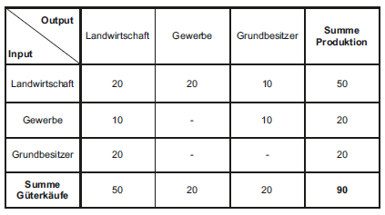
Physiocracy (17th – 18th Century)
Natural order – freedom (“laissez faire”)
Wealth is derived from agriculture
-> agricultural products highly priced
Price based on production costs
Tableau Economique - Söllner, 2011
Notes:
Economic theory By French Economists who were upset with the regulation on trade brought upon by mercantilism
Laissez faire: basically means free market without government intervention, humans are self-sufficient, following individual needs leads to the most optimal outcome

Slide 14
Classical Economics (1776-1870s)
Adam Smith – “The Wealth of Nations”
Laissez-faire approach - free trade
“Invisible hand” -> natural price
Utility theory of value
Labor theory of value as the standard for pricing
Notes:
School of economics established by Adam Smith,
Wrote book after a visit to france – adopts the laissez faire approach
Invisible hand: unintended greater benefit to society when individuals act on their own self interests
Labor theory of value: value of a good is determined by the amount of labor put into it

Slide 15
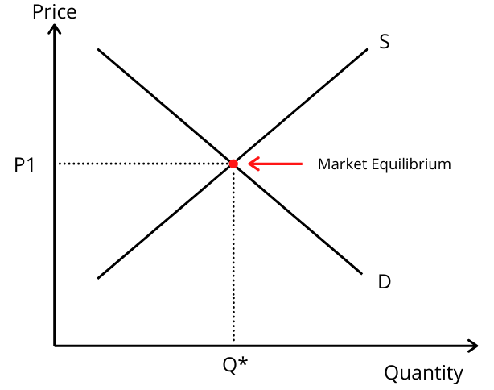
Neoclassical Economics (1870s - Today)
Shift from macroeconomic to microeconomic perspective
-> Focus on behavior and satisfaction of the individual
Utility theory of value as the standard for pricing
Perfect competition
Market price as the fair price

Slide 16
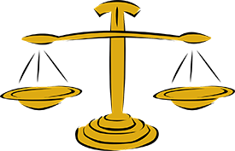
Alternative Conceptions of the Just Price
Voluntary exchange price
(Michel, 1999)
Non-exploitative price
(Valdman, 2009)
Distributive justice price
(Frank, 1998)
Notes:
Non-exploitative criticism:
Distributive: background circumstance over which seller may make reservation price artificially high

Slide 17
Critical Evaluation (1/2)
 | Natural exchange | Objective/real/ natural price | Labor theory of value | Market price | Voluntary exchange price | Non-exploitative price | Distributive justice price
Social fairness | ✓ | ✓ | ✓ | ✓ | ✓ | ✓ | ✓
Personal fairness | X | X | X | ✓ | ✓ | ✓ | ✓
Non-exploitative price: can you think of any flaws?
Distributive justice price: can you think any flaws?
Notes:
Free price setting -

Slide 18
Critical Evaluation (2/2)
What’s wrong with the market price?
Unrealistic assumptions implied by perfect competition
X buyers are rational
X every participant is a price taker
X perfect information (all participants know prices and utilities they would get from each product
X homogeneous products (products are perfect substitutes to each other)
X no entry or exit barriers

Slide 19
Part 2: Pricing Mechanisms and the Role of IT

Slide 20
Pricing Strategies (1/2)
Pricing strategy
Cost-based
Value-based
Competition-based
Focused on production costs
Margin
Focus on customers
Price is based on the estimated value a product product generates to the customer
Price is based on competitors’ prices
Similar products

Slide 21
Pricing Strategies (2/2)
Cost-based
Unit cost = 10€
Margin = 20%
Value-based
Competitor’s price = 20€
Competition based
Avg. value to customer = 25€
12€
25€
19€

Slide 22
Impact of IT on Pricing Strategies
Increased availability of information
Enhanced reach
Expanding interactivity
Notes:
SERVICES

Slide 23
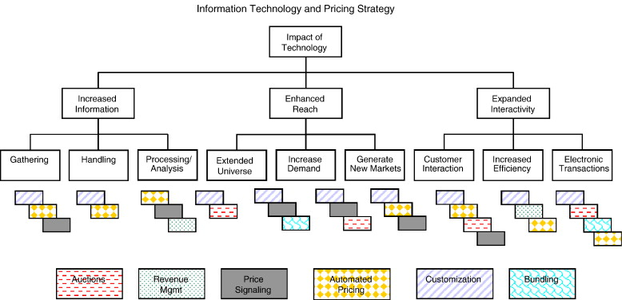
IT-Enhanced Pricing Strategies (ITEPS)
Information Technology and Pricing Strategies – Dixit et. al, 2005
Notes:
Revenue management predicts consumer behavior and based on that optimize the availability of products, and they look at how price sensitive their consumers are to price their products in a way to maximize the revenue. – opportunistic pricing/surge pricing
Price customization – altering the price of goods or services based on consumer factors
Price bundling – strategy that offers 2 or more products in a single package for a special price. IT and rise of information goods and also the internet which has enabled free distribution of these goods, and also because of how easily and how well these goods can be configured and customized

Slide 24
IT-Enabled Markets
E-commerce
(Airline industry)
Cloud computing
Mobile app industry

Slide 25
Airline Industry – Dynamic Pricing
Taken from https://www.fareboom.com
Notes:
The prices for airline tickets are constantly changing. In fact, there even are websites like fareboom that use sophisticated machine learning algorithms to predict the prices. It helps travelers make buying decisions – should they buy the ticket now or later? So why do we even need to predict flying prices and why do they constantly fluctuate? Why do ticket prices change multiple times during the day? Why is American Airlines for example changing up to half a million prices every day?
Well, that’s because of dynamic pricing.
Needs to sell the highest amount of seats for the highest price possible. (inefficient if few seats for high price or all seats for low price.)
To do this, airlines must understand customers.
SEGMENTS – DEMAND (50 seats – first few cheap) – SPEED OF DEMAND (INCRASE/DECREASE) – EXTERNAL CONDITIONS (COST OF FUEL, SEASONAL TRENDS, EVENTS (SUPER BOWL, CONCERT, OLYMPIC GAMES, COMPETITIOR’S PRICES)
FUTURE:

Slide 26
Thank you for your attention!

Slide 27
Image Sources
https://www.thepublicdiscourse.com/2015/08/15435/
https://images-na.ssl-images-amazon.com/images/I/71dsU1pQbiL.jpg
https://www.euston96.com/en/scholasticism/
http://t1.gstatic.com/licensed-image?q=tbn:ANd9GcS-2gfmuFUq1P9puhi4S3Y2d47n84gt2Wx83sJ5Sn3wicpKzkhRRZws4n1txuLV
https://readvid.com/dynamic-pricing-in-airline-industry-why-flight/
https://checksbalances.clio.nl/2017/03/the-wounded-invisible-hand-regulating-the-world/
Snow removal: Choose the right equipment | 2020-11-19 | Safety+Health Magazine (safetyandhealthmagazine.com)
Market Equilibrium Definition - BoyceWire

