Slide 1
Seminar paper
BSF4ooRexx/java: Apache POI (OOXML4J): Microsoft Office - Cookbook (Nutshell Examples)
Wolfgang Eßl/h11717160
Business Information Systems Seminar

Slide 2
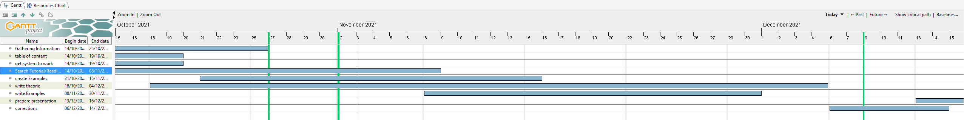
Project timeline

Slide 3
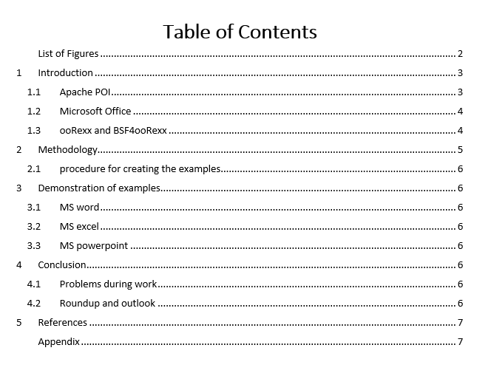
List of content

Slide 4
Until next meeting
Problems so far
Get the environment to run
Create some examples (coding)
Finish examples (coding)
Explain examples

