Slide 1
Seminar paper BSF4ooRexx/java: Apache POI (OOXML4J): Microsoft Office - Cookbook (Nutshell Examples)
Wolfgang Eßl/h11717160
Business Information Systems Seminar

Slide 2
Project timeline

Slide 3
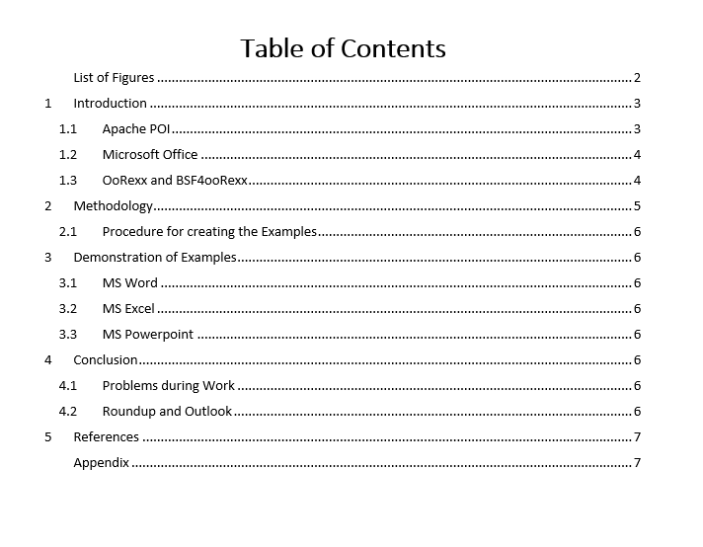
List of content

Slide 4
Until next meeting
Problems so far
Get the environment to run
Create some examples (coding)
Create useful PP Examples
Finish examples (coding)
Explain examples

