Slide 1
Principles and Comparisons of the Open-source Licenses GPL 3.0, LGPL 3.0, AL 2.0, CPL 1.0 (EPL 1.0) and "OpenJDK with CLASSPATH Exception by Victoria Volkova
4152 SEMINAR AUS BIS
LV Leiter: Univ. Prof. Dr. Rony G. Flatscher
SS 2021

Slide 2
AGENDA
Introduction to the Topic „Open-Source Software Licensing“
Paper Structure Explanation
The Main Historical Facts
Software Licensing and Source Code
Free and Open Source Licenses and their Principles
GPL 3.0
LGPL 3.0
AL 2.0
CPL and EPL
OpenJDK and a Classpath Exception
Compatibility Chart
Discussion

Slide 3
Introduction to the Topic „Open-Source Software Licensing“
„When I first got into technology I did not really understand what open source was. Once I started writing Software, I realized how important this would be.“
By Matt Mullenweg, an American Web Developer and Entrepreneur
Wordpress
Moodle
Linux OS
Mozilla Firefox
Android by Google
Phyton
Monday
Ethereum Blockchain
„Certainly there is a phenomenon around open source. You know free software will be a vibrant idea. There will be a lot of neat things that get done there.“
By Bill Gates

Slide 4
Paper‘s Structure Explanation
1
More Amateur than Professionals
Ubiqutous Computing and Digitalisation Era
2
The way People understood the Inportance of the Open Source Code
3
Software Basics
Licensing Agreement
4
Open Source Software Principles
5
GNU GPL v 3.0
6
LGPL v 3.0
7
9
Conclusion
AL v 2.0
8
OpenJDK with Classpath Exception
Overview

Slide 5
The Main Historical Facts
1980: the code for a printer driver by Richard Stallman
1990: Software engineering for private businesses and closed source codes
Stallmans Initiative to create an open-source software system and attract new software engineers to study new projects
1985: Free Software Movement and GNU Manifesto
1997: Eric Raymond publiced the book „The Cathedral and the Bazaar“
1998: Open Source Initiative Foundation

Slide 6
Software Licensing and Source Code
Contractual Agreement
Copyright Law
Regulation of the Underlying source code
Privacy regulations
Sales restrictions
International use
Source Code:is a human-readable text that supports and speeds up programming and development of new software.
Source codes are an intellectual property, the usage of which is protected or managed by licensing
Binary Codes for Open Source Licensing

Slide 7
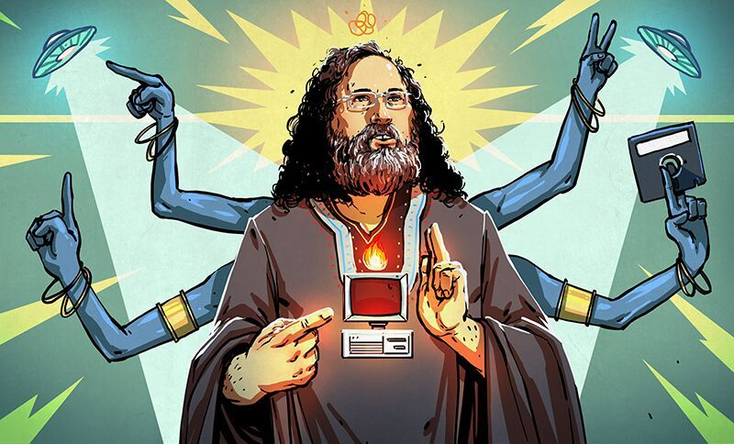
Richard Stallman
„Open Source is a development methodology,
Free software is a social movement.“
By Richard Stallman

Slide 8
Free and Open Source Licensing Principles (not equal to Free of Charge!)
Four basic FREEdoms:
The freedom to run the program as a private user or a commercial organization wish, for any purpose (freedom 0)
The freedom to study how the program works, and change it so it does your computing as you wish (freedom 1)
The freedom to redistribute copies, original or modified software, free or against a charge for sale (freedom 2).
The freedom to distribute copies of your modified versions to others (freedom 3).

Slide 9
Open Source Software Principles
Free Redistribution Source Code Derived Works Integrity of the Author’s Source Code No Discrimination Against Persons or Groups No Discrimination Against Fields of Endeavour Distribution of License License Must Not Be Specific to a Product License Must Not Restrict Other Software License Must Be technology Neutral Open Source Definition by the OSI

Slide 10
General Public License 3.0
GPL 3.0 General Public License | Authorization | Conditions | Limitations
Is a free software license that employs 4 Freedoms philosophy. The fundamental facet is copyleft. Any software under GPL can be run for all purposes, commercial or not. | Distribution | Copyleft | No Warranty
 | Modification | License Protection | Trademark Use
 | Commercial Use | Disclose Source | Liability
 | Private Use | Version Modifications | No proprietary programm integraion
 | Patent Use
LGPL v3.0

Slide 11
Lesser General Public License v 3.0
LGPL 3.0 | Authorization | Conditions | Limitations
Is developed in 2007 with a weaker copyleft system than the one of GPL = no personal custom source code, no requirement to be published under the same license terms. | Commercial Use | Copyleft | Liability
 | Private Use | License + Copyright Information | Warranty
 | Patent Use | Disclose Source
 | Modification | Version Modifications
 | Distribution

Slide 12
Apache License 2.0
APACHE LICENSE 2.0 | Authorization | Conditions | Limitations
permissive open source license that requires preservation and maintenance of its copyright and license information. It widely adopted and refers to "Open Standards". Licensed works, larger works, and modifications are not under the same licensing terms and can be distributed in the absence of. Apache does not require companies to reveal technologies or skills used in order to construct a program on the basis of the work code | Commercial Use | Copyright and Licensing notice | Warranty
 | Disribution |  | Trademark Use
 | Modification | Version Modification | Liability
 | Patented Use
 | Private Use

Slide 13
Common Public License 1.0
CPL 1.0 - Common Public License | Authorization | Conditions | Limitations
Common Public License is a free software AND open-source software license published by IBM. The Free Software Foundation and Open Source Initiative both have approved the license terms of the CPL. Contributors may not remove or alter any copyright notices contained within the Program. Permission for distribution of a modified computer program is granted as long as the source code of a modified program are made available to others. | Commercial Use | Modification Notice | No Warranty
 | Distribution | Copyright and Licensing notice + source code | No or conditional liability
 | Modification

Slide 14
Eclipse Public License 2.0
Eclipse Public License | Authorization | Conditions | Limitations
Is a free AND open source software license that substitues CPL. Freedom to distribute the software under any license (Open Source Initiative) | Distribution | License Information | No Warranty
 | Modification | Source Code Information | No Liability
 | Commercial Use
 | Private Use
 | Patent Use

Slide 15

OpenJDK with Classpath Exception
OpenJDK with classpath Exception | Authorization | Conditions | Limitations
Afree and open source application of the software development kit (a binary product constructed specifically for Java on Windows, Solaris, macOS and Linux). OpenJDK falls under GPL license and is approved by the Free Software Foundation and the Open Source Initiative. | Distribution | GPL conditions | TCK
 | Modification |  | oracle certification

Slide 16
Thank You for Your Attention,
Let‘s Discuss:
Have You heard something about the Software Lisencing?
Do You associate Software Licensing with an expensive and compulsary step to use a software?
Have You heard about the Free Software before?
What open-source licensed software do You use daily?
Have You ever written an open-source code together with other developers?
Are You a pro or con Team? Why?

