Slide 1

Critical Evaluation of Prices in the Information Technology Age:
History, Features and Critical Comparison of Cost Based, Market/Value Based, and Willfully/Arbitrary Prices
Author: Fabian Hekele
Matriculation number: 01604392
Lecture number: 4152
Lecturer: Univ.Prof. Dr. Rony G. Flatscher

Slide 2
Table of Contents
Information on the Seminar Paper
Historical Perspective of Pricing
An Introduction to cost-based,value-based & arbitrage pricing
Critical Evaluation of Prices in the Information Technology Age
Discussion

Slide 3
I. Information on the Seminar Paper
The preparation and writing of the seminar paper has been divided into four blocks.
Phase 1: Preperation
Phase 2: Research & Evaluation
Phase 3: Writing the Paper
Phase 4: Correction & Submission

Slide 4
Facts about the Seminar Paper
    41 pages in total, 32 pages of continous text
    No in-depth previous knowledge, but basic knowledge of pricing
    First seminar paper that was written in English
    In summary: A demanding, but definitely interesting topic that has been extensively discussed and analyzed

Slide 5
Table of contents of the seminar paper
    Declaration of Authenticity 2
    Abstract 3
    Table of Contents 4
    List of Figures 5
    1. Introduction 6
    2. Pricing – A Historical Perspective 7-15
    2.1. Antique - Aristotle and Insights into the Roman Economy 7-9
    2.2. Pre-classical Times - Scholasticism,
    Mercantilismand Physiocracy 9-11
    2.3. Classicism – Adam Smith,
    Jean-Baptiste Say and David Ricardo 12-14
    2.4. Pricing in Modern Times –
    Neoclassicism and Consumption Theory 14-15
    3. Pricing - Theories and Concepts 15-22
    3.1. Cost-based Pricing 16-17
    3.2. Value-based Pricing 17-19
    3.3. Arbitrage Pricing 19-20
    3.4. The Pricing Capability Grid 21-22
    4. Critical Comparison of Prices in the
    Information Technology Age 22-37
    4.1. Pricing Strategies of
    Software Companies 22-26
    4.2. Pricing Strategies in the
    Mobile Gaming Industry 26-28
    4.3. Importance of Data and Current Development in Pricing 28-37
    4.3.1 Pricing of Data 28-31
    4.3.2 Personalized and
    Behavior-based Pricing 31-33
    4.3.3 Outlook on Future
    Developments 34-36
    5. Conclusion 36-38
    References 39-41

Slide 6
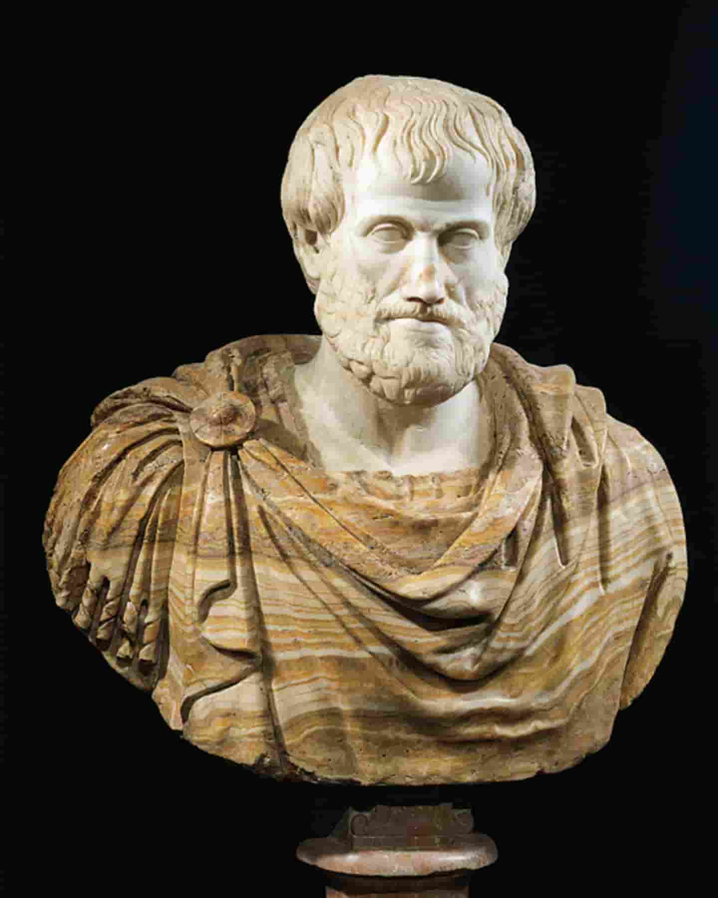

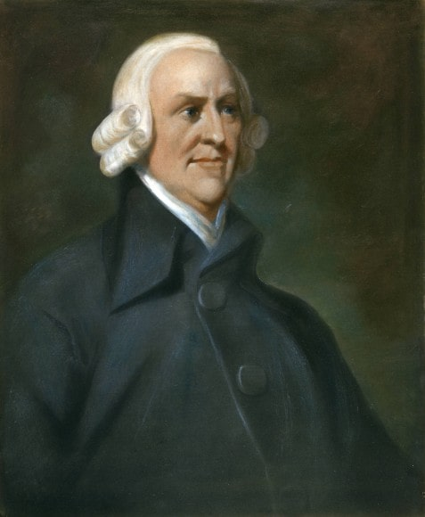
II. Historical Perspective of Pricing

Slide 7
Antique & Pre-classical Times
Antique
    A time of great cultural development and philosophical knowledge
    First economic considerations on the equilibrium of exchange and justice by Aristotle
    Ancient Rome as the first empire with a uniform monetary system
    Prices in ancient Rome for wheat depend on the distance from Rome
Pre-classical Times
    religious and power-political influences on prices
    Trade in a local markets, focus on agriculture
    Thomas Aquinas developed the concept of the just price
    Doctrines of Scholasticism, Mercantilism, and Physiocracy

Slide 8
Classicism & Neo-classicism
Classicism
    Adam Smith as the father of modern economic theory
    Differentiation between market price and natural price
    Influence of supply and demand on price level
    David Ricardo brings interest into economic theory and takes time components into account for price formation
Neo-classicism
    Modern economic theory is based on neoclassical ideas
    No longer the entire economy in focus, but individual subjects
    Consumption theory as a foundation for modern microeconomics
    Willingness of consumers to pay becomes relevant for the first time

Slide 9

Quick Question
‚Do You think that insights from philosophers like Thomas Aquinus are still relevant in pricing today?‘

Slide 10
III. An Introduction to cost-based,value-based & arbitrage pricing

Slide 11
Three Pricing Strategies
Cost-based pricing
Value-based pricing
Arbitrary pricing

Slide 12
Features of the Pricing Strategies
Cost-based pricing
Value-based pricing
Arbitrary pricing
    Price is determined by costs and pre-determined profit mark-up
    Advantages: simple calculation method, calculation of prices with historical data
    Disadvantages: The calculation base must be complete, competition and demand not taken into account
    Price is determined with the perceived value for the customer
    Advantages: Price reflects value exactly, ideal for providers and consumers
    Disadvantages: difficult to determine value precisely in practice
    Markets are not always in balance, so prices are sometimes too high or too low
    Advantages: new products and innovations can often be offered with surcharges
    Disadvantages: Disadvantages for the customer, the value of the goods does not correspond to the price level

Slide 13

Quick Question
‚Which of the presented pricing methods would you pursue as an entrepreneur?‘

Slide 14

IV. Critical Evaluation of Prices in the Information Technology Age

Slide 15
Pricing Strategies of Software Companies I
Software is becoming more and more relevant in the corporate context
New technologies and 5G enable large amounts of data to be exchanged in real time around the world
Focus: Cloud Computing - Software as a Service, Security as a Service, Infrastructure as a Service

Slide 16
Pricing Strategies of Software Companies II
Instead of entire ERP systems, only rent of individual modules
License purchase and software maintenance contracts replaced by rental contracts
individually bookable, flexibly expandable
Examples of providers: SAP, Salesforce, Microsoft and Adobe

Slide 17

Pricing Strategies in the Mobile Gaming Industry
    Mobile games market share increases, penetration rate is 23.9% in 2021
    Focus: free-to-play games
    Free to play, but benefits from in-app purchases
    Use of an internal monetary system
    Currency must be bought with real money
    Computer games are much cheaper, although technically much more complex

Slide 18
Importance and Current Development of Pricing
In the age of information technology, data forms the basis for modern pricing strategies
Personalized Pricing
Data
Behavior-based Pricing

Slide 19
Pricing of Data
The importance of data in business is increasing rapidly
Data is important in all areas of the company
Data is traded through data marketplaces
Relevant data: sensor data, geographic data, personal data
Factors for the value and price level of data: freshness and level of detail
Data marketplaces: Xignite and Microsoft Azure Marketplace

Slide 20
Personalized and Behavior-based Pricing
Personalized Pricing
    With the help of user data, personal offers are made
    Goal: to have the most detailed picture of the customer available
    Privacy is a major point of contention
    Is viewed quite critically in politics and society
Behavior-based Pricing
    Here, too, user data basis, but with reference to the past
    The focus is on the customer‘s purchase history
    In practice: Internet cookies and automatic data collection
    Problem for both strategies: companies are not transparent about the data usage

Slide 21
Outlook into the future
Pricing will remain highly relevant across all industries in the future
Environmental and climate policy will have an impact on prices
-> companies like Apple have already set their own agenda
Algorithmic pricing will become hugely relevant in the 2020s
Bundling as a pricing strategy is experiencing a revival with personalized pricing and data usage
Value-based pricing and perceived value are also gaining in importance

Slide 22

Time for Questions & Discussion

Slide 23
Sources
Pictures:
https://thebulwark.com/voter-suppression-and-civic-vice/
http://www.kathpedia.com/images/1/18/Thomas.von.Aquin3.jpg
https://image.geo.de/30038910/t/ou/v3/w1440/r0/-/aristoteles-gross-jpg--15039-.jpg
https://media1.faz.net/ppmedia/aktuell/wirtschaft/3914681745/1.2536885/width610x580/adam-smith-1723-1790.jpg
https://www.elegantthemes.com/blog/wp-content/uploads/2021/04/featured-discussion-settings.png
https://www.pngkey.com/png/full/809-8090447_the-graphic-concrete-technology-enables-cost-effective-gloucester.png
https://www.kpsol.com/wp-content/uploads/2017/09/discussion-featured.jpg
https://www.microsoft.com/en-us/research/uploads/prod/2019/11/Area_IconHeader_OtherSci_Econ_11_2019_1920x7202.png
https://blog.empatico.org/wp-content/uploads/2018/11/critical-thinking-activities.png
https://encrypted-tbn0.gstatic.com/images?q=tbn:ANd9GcRk23sNSEDUC1fCblKGLs0gOusmDLmN78wgAwwTmyeeR5O5lz6OtpkMb5vPvFeChs_vfcc&usqp=CAU
https://i.redd.it/m1j7x2cyytq31.jpg

