Slide 1
Principles and Comparisons of the Open-source Licenses GPL 3.0, LGPL 3.0, AL 2.0, CPL 1.0 (EPL 1.0) and "OpenJDK with CLASSPATH exception by Victoria Volkova
4152 SEMINAR AUS BIS
LV Leiter: Univ. Prof. Dr. Rony G. Flatscher

Slide 2
Table of Contents
Definition of software licenses
    Types of licenses
    Work principles
2. Open Source Licenses
    For what purposes they were designed
    Main characteristics of open source licenses
3. GPL 3.0 – General Public License
  Technical characteristics and Price
  Permissions and limitations in use
  Warranties and Liabilities
  Legal risks for corporate and commercial users
  Comparison to LGPL 3.0
4. AL 2.0 - Apache License, Version 2
  Definition, description of its characteristics and price
  Permissions and limitations in use
  Warranties and Liabilities
  Legal risks for corporate and commercial users
5. Cpl 1.0 – Common Public License
  Definition, description of its characteristics and price
  Permissions and limitation in use
  Warranties and Liabilities
  Legal risks for corporate and commercial users
6. OpenJDK (Java Development Kit) with Classpath Exception
  Exception Handling with Java
    Definition
    Where it is used and for what
  Technical Characteristics of OpenJDK
  Permissions and limitations in use
  Warranties and Liabilities
  Legal risks for corporate and commercial users
7. Main attributes Overview of GPL 3.0, LGPL 3.0, AL 2.0, CPL 1.0 and OpendJDK
  Comparison of pluses and minuses in use
  Suggestions and Summary

Slide 3
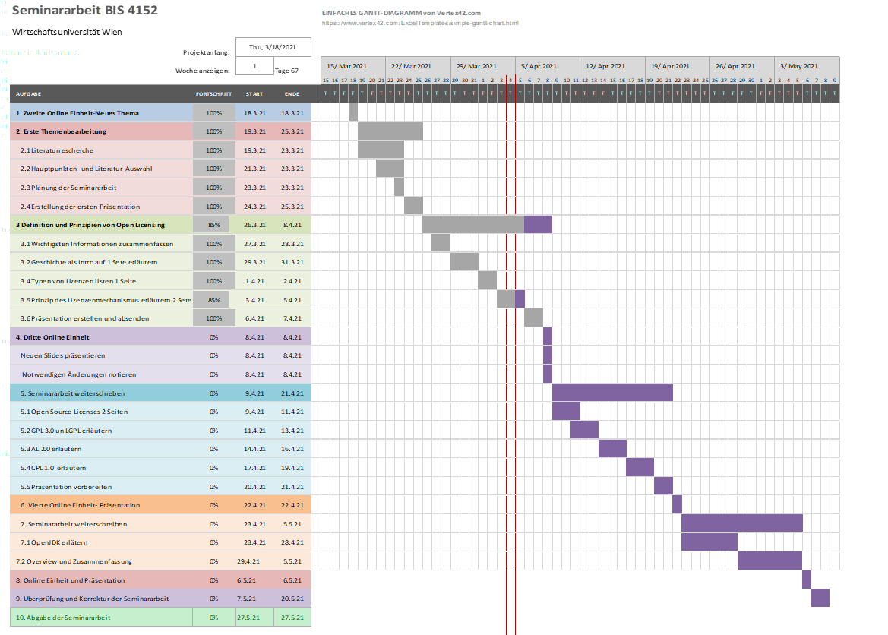
Gantt-Chart

