Slide 1
Critical Evaluation of Prices in the Information Technology Age:
History, Features and Critical Comparison of Cost Based, Market/Value Based, and Willfully/Arbitrary Prices
Author: Fabian Hekele
Matriculation number: 01604392
Lecture number: 4152
Lecturer: Univ.Prof. Dr. Rony G. Flatscher

Slide 2
Table of Contents
Information on the Seminar Paper
Historical Perspective of Pricing
An Introduction to cost-based,value-based & arbitrage pricing
Critical Evaluation of Prices in the Information Technology Age
Discussion

Slide 3
I. Information on the Seminar Paper
The preparation and writing of the seminar paper has been divided into four blocks.
Phase 1: Preperation
Phase 2: Research & Evaluation
Phase 3: Writing the Paper
Phase 4: Correction & Submission

Slide 4
Facts about the Seminar Paper
41 pages in total, 32 pages of continous text
No in-depth previous knowledge, but basic knowledge of pricing
First seminar paper that was written in English
In summary: A demanding, but definitely interesting topic that has been extensively discussed and analyzed

Slide 5
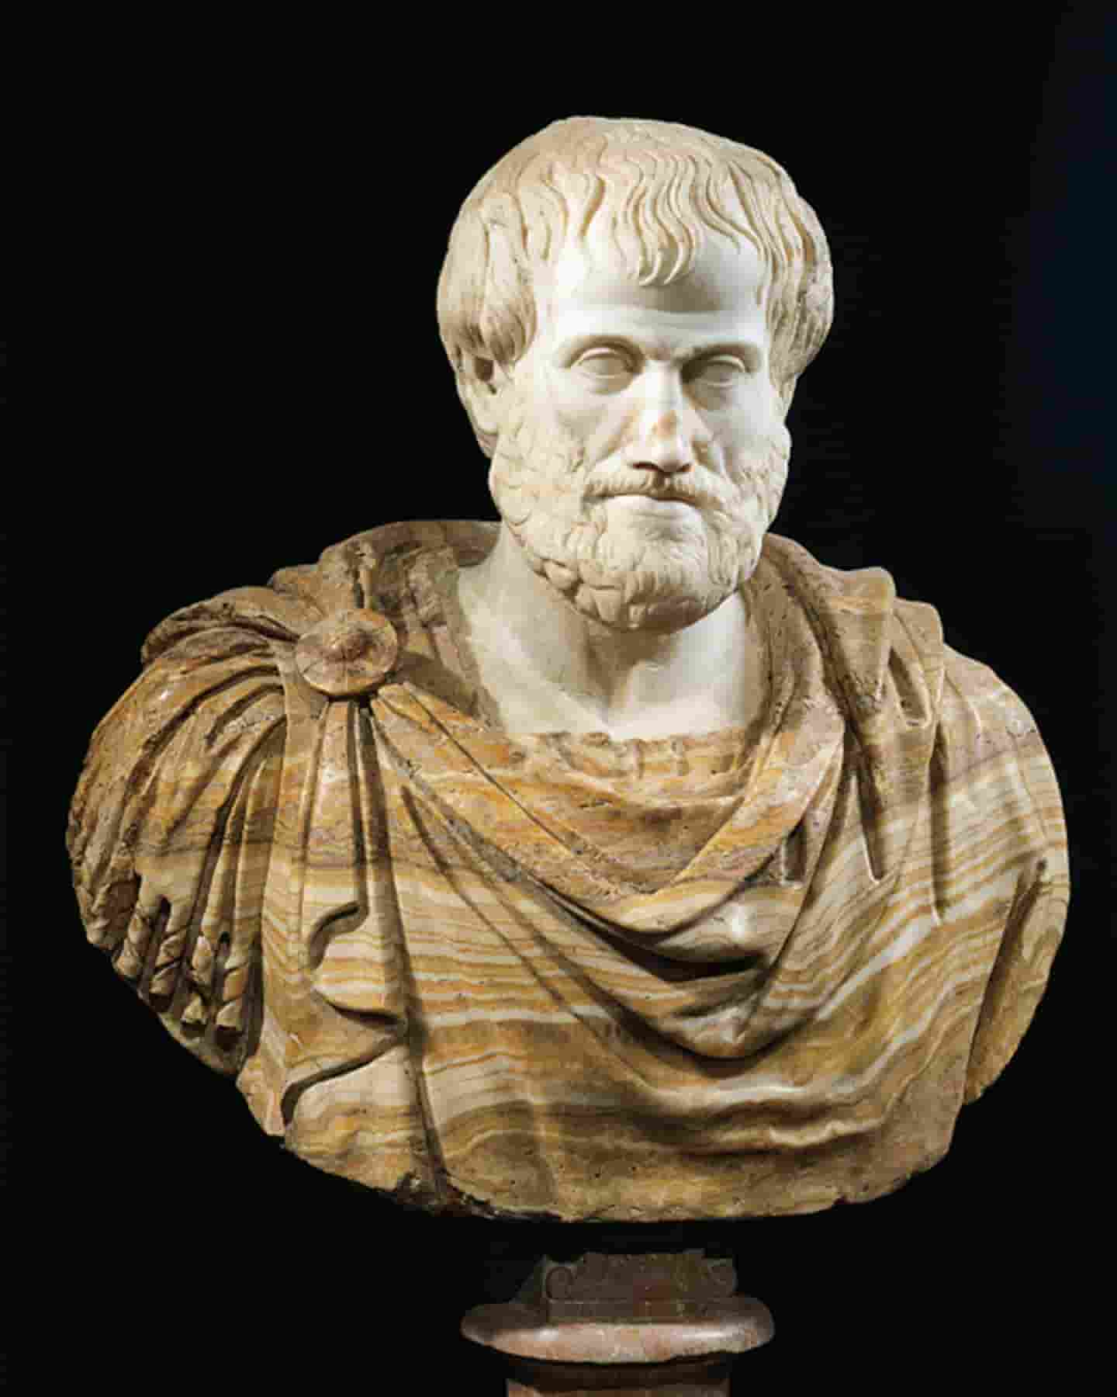
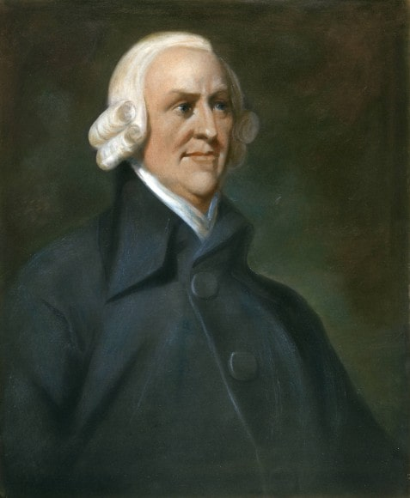
II. Historical Perspective of Pricing

Slide 6
Antique & Pre-classical Times
Antique
A time of great cultural development and philosophical knowledge
First economic considerations on the equilibrium of exchange and justice by Aristotle
Ancient Rome as the first empire with a uniform monetary system
Prices in ancient Rome for wheat depend on the distance from Rome
Pre-classical Times
religious and power-political influences on prices
Trade in a local markets, focus on agriculture
Thomas Aquinas developed the concept of the just price
Doctrines of Scholasticism, Mercantilism, and Physiocracy

Slide 7
Classicism & Neo-classicism
Classicism
Adam Smith as the father of modern economic theory
Differentiation between market price and natural price
Influence of supply and demand on price level
David Ricardo brings interest into economic theory and takes time components into account for price formation
Neo-classicism
Modern economic theory is based on neoclassical ideas
No longer the entire economy in focus, but individual subjects
Consumption theory as a foundation for modern microeconomics
Willingness of consumers to pay becomes relevant for the first time

Slide 8
Quick Question
‚Do You think that insights from philosophers like Thomas Aquinus are still relevant in pricing today?‘

Slide 9
III. An Introduction to cost-based,value-based & arbitrage pricing

Slide 10
Three Pricing Strategies
Cost-based pricing
Value-based pricing
Arbitrary pricing

Slide 11
Features of the Pricing Strategies
Cost-based pricing
Value-based pricing
Arbitrary pricing
Price is determined by costs and pre-determined profit mark-up
Advantages: simple calculation method, calculation of prices with historical data
Disadvantages: The calculation base must be complete, competition and demand not taken into account
Price is determined by costs and pre-determined profit mark-up
Advantages: simple calculation method, calculation of prices with historical data
Disadvantages: The calculation base must be complete, competition and demand not taken into account
Price is determined by costs and pre-determined profit mark-up
Advantages: simple calculation method, calculation of prices with historical data
Disadvantages: The calculation base must be complete, competition and demand not taken into account

Slide 12
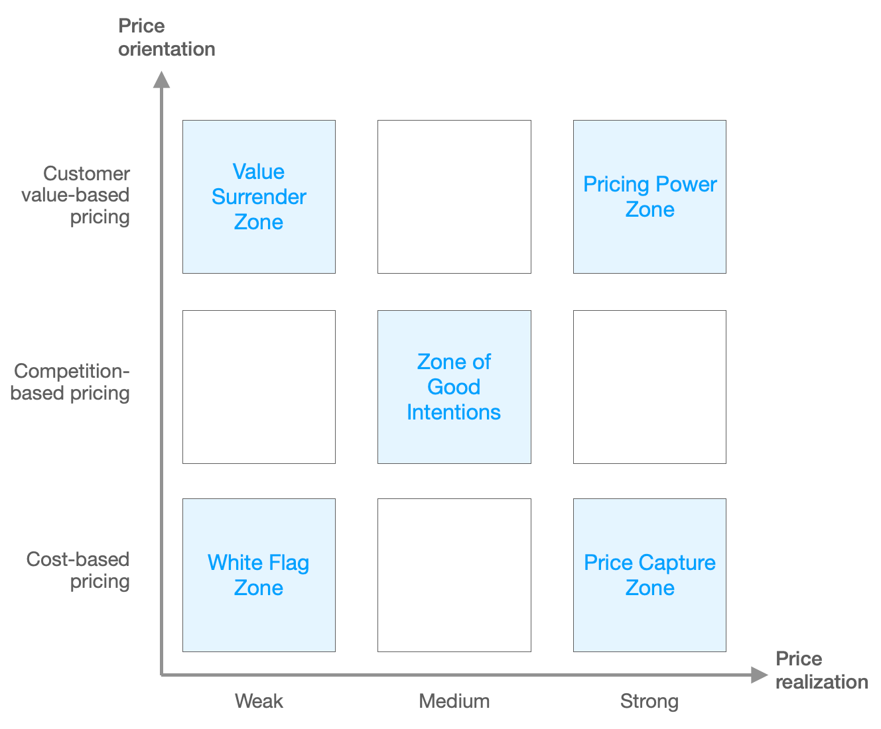
The Pricing Capability Grid
Price is determined by costs and pre-determined profit mark-up
Advantages: simple calculation method, calculation of prices with historical data
Disadvantages: The calculation base must be complete, competition and demand not taken into account

Slide 13
Quick Question
‚ Which of the presented pricing methods would you pursue as an entrepreneur?‘

Slide 14
IV. Critical Evaluation of Prices in the Information Technology Age

Slide 15
Pricing Strategies of Software Companies
Antique
A time of great cultural development and philosophical knowledge
First economic considerations on the equilibrium of exchange and justice by Aristotle
Ancient Rome as the first empire with a uniform monetary system
Prices in ancient Rome for wheat depend on the distance from Rome
Pre-classical Times
religious and power-political influences on prices
Trade in a local markets, focus on agriculture
Thomas Aquinas developed the concept of the just price
Doctrines of Scholasticism, Mercantilism, and Physiocracy

Slide 16
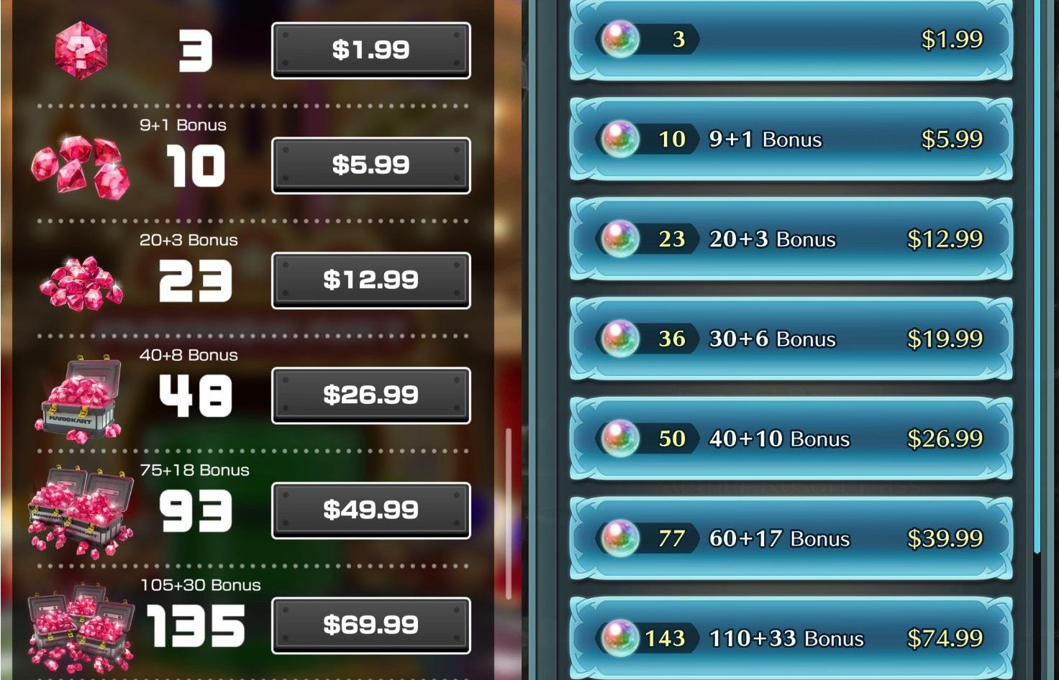
Pricing Strategies in the Mobile Gaming Industry
Mobile games market share increases, penetration rate is 23.9% in 2021
Focus: free-to-play games
Free to play, but benefits from in-app purchases
Use of an internal monetary system
Currency must be bought with real money
Computer games are much cheaper, although technically much more complex

Slide 17
Importance and Current Development of Pricing
In the age of information technology, data forms the basis for modern pricing strategies
Personalized Pricing
Data
Behavior-based Pricing

Slide 18
Welchen Einfluss hat Sprache auf Demokratie? Begünstigt sie die illiberalen Entwicklungen?
Sprache hat entscheidenden Einfluss auf Inklusion & Pluralismus
Populisten verwenden oft exklusive, ausschließende Sprache
Einfache, prägnante Sprache mit schlagkräftigem Vokabular
Euphemismen zu Verharmlosung des Gesagten
Grenze des Sagbaren gezielt verschoben

Slide 19
Gibt es Parallelen zwischen historischen und aktuellen illiberalen Strömungen oder ist die heutige Situation gänzlich anders?
Aktuelle Situation in Ungarn, Polen & der Türkei:
Ungarn: Presse- & Meinungsfreiheit eingeschränkt, Wahlsystem zugunsten Regierung geändert
Polen: Umbau des Justizapparates
Türkei: Opposition systematisch diskreditiert, interreligiöse Akzeptanz massiv reduziert
Parallelen zu historischen Strömungen:
Systematische Diskreditierung von Opposition & Justiz
Verfolgung Kritikern -> Volksfeinde
Schrittweise Abschaffung von Grundrechten
Rückzug aus internationalen Verträgen
Überhöhung nationaler Identität
Einverleibung des Volksbegriffs

Slide 20
Kann dieser Methode Einhalt geboten werden und wenn ja, wie?
Dialog anbieten, konstruktiv argumentieren
Gesagtes kritisch Hinterfragen, „zwischen den Zeilen lesen“
„verlorene“ WählerInnen akzeptieren
Symbolpolitik benennen und widerlegen
Gewaltenteilung & garantierte Grundrechte als Fundament der Republik anerkennen
Presse- und Meinungspluralismus aktiv verteidigen
Aussagen und Statements kritisch bewerten, Beschwichtigungen kategorisch ablehnen
Volksbegriff „stehlen“ und erweitern -> pluralistische Gesellschaft

Slide 21
Time for Questions & Discussion

Slide 22
Sources
Pictures:
https://thebulwark.com/voter-suppression-and-civic-vice/
http://www.kathpedia.com/images/1/18/Thomas.von.Aquin3.jpg
https://image.geo.de/30038910/t/ou/v3/w1440/r0/-/aristoteles-gross-jpg--15039-.jpg
https://media1.faz.net/ppmedia/aktuell/wirtschaft/3914681745/1.2536885/width610x580/adam-smith-1723-1790.jpg
https://www.kpsol.com/wp-content/uploads/2017/09/discussion-featured.jpg
https://www.microsoft.com/en-us/research/uploads/prod/2019/11/Area_IconHeader_OtherSci_Econ_11_2019_1920x7202.png
https://blog.empatico.org/wp-content/uploads/2018/11/critical-thinking-activities.png
https://encrypted-tbn0.gstatic.com/images?q=tbn:ANd9GcRk23sNSEDUC1fCblKGLs0gOusmDLmN78wgAwwTmyeeR5O5lz6OtpkMb5vPvFeChs_vfcc&usqp=CAU
https://i.redd.it/m1j7x2cyytq31.jpg

