Slide 1
Critical Evaluation and Comparison between Proprietary and Open-Source Cloud Systems
Michael WIDY

Slide 2
Agenda
Übersicht und theoretische Grundlage (Cloud)
  Arten von Cloud Computing (Deployment Models)
  Arten von Cloud Services (Service Models)
Open-Source Software vs. Proprietary Software
  Definitionen
  Why OSS matters?
Vor- und Nachteile von Open-Source
Vor- und Nachteile von Proprietary Software
Open-Source vs. Proprietary Cloud Systems
Education Sector

Slide 3
Arten von Cloud Computing (Deployment Models)
Public Cloud
Private Cloud
Community Cloud
Hybrid Cloud

Slide 4
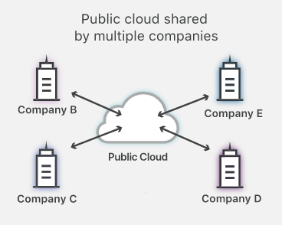
Public Cloud

Slide 5
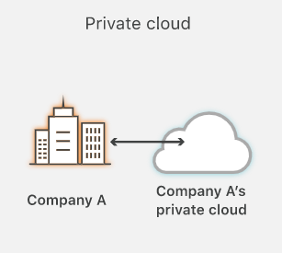
Private Cloud

Slide 6
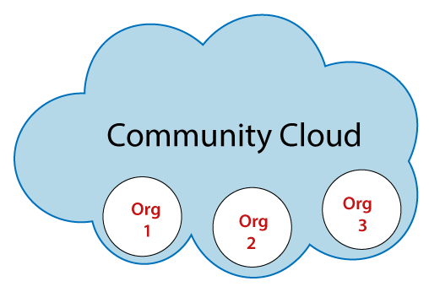
Community Cloud

Slide 7
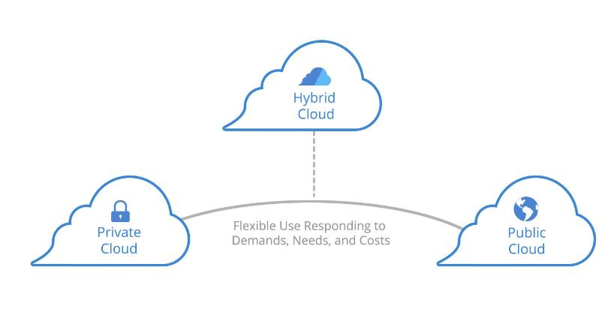
Hybrid Cloud

Slide 8
Arten von Cloud Services (Service Models)
Infrastructure as a Service (IaaS)
Platform as a Service (PaaS)
Software as a Service (SaaS)

Slide 9
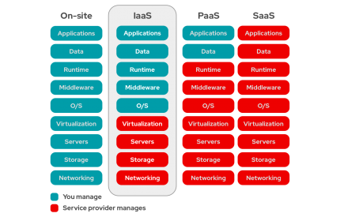
Infrastructure as a Service (IaaS)

Slide 10
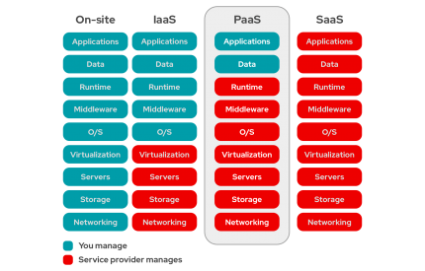
Platform as a Service (PaaS)

Slide 11
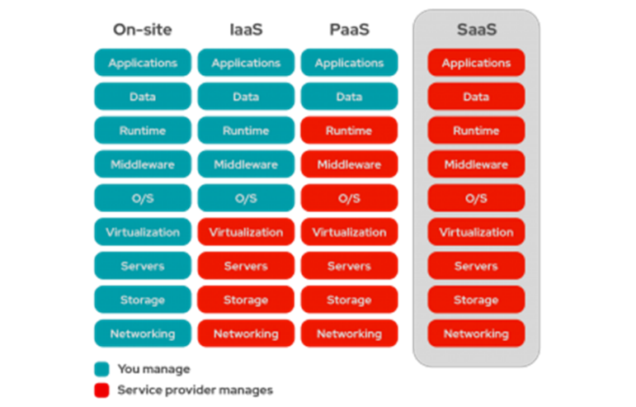
Software as a Service (SaaS)

Slide 12
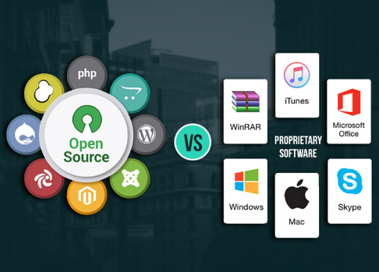
Open-Source Software vs. Proprietary Software
Open-Source Definition
Proprietary Software Definition
Why OSS matters

Slide 13
Open-Source Definition
Open-Source oder Free Software?

Slide 14
Proprietary Software Definition
„proprietas“ – Eigentum
Source Code
EULAs

Slide 15
Why OSS matters
„available for redistribution without restriction and without charge“
„hacker culture“
Warum beitragen?
Innovation
Wettbewerb
Innovation
=> consumer surplus and increasing social welfare

Slide 16
Vor- und Nachteile von Open-Source
Kosten
Service und Support
Innovationen
Sicherheit
Bedienbarkeit
Vendor Lock-In
Verfügbarkeit
Transparenz
Zuverlässigkeit

Slide 17
Vor- und Nachteile von Proprietary Software
Kosten
Service und Support
Innovationen
Sicherheit
Bedienbarkeit
Vendor Lock-In
Verfügbarkeit
Transparenz
Zuverlässigkeit

Slide 18
Open-Source vs Proprietary Cloud Systems
Kosten
Service und Support
Innovationen
Sicherheit
Bedienbarkeit
Vendor Lock-In
Verfügbarkeit
Transparenz
Zuverlässigkeit

Slide 19
Education Sector
Dateien
  Nextcloud (Open Source)
  Office 365 (Proprietary)
Content Management & Learning
  Moodle (Open Source)
  MS Teams (Proprietary)
Kommunikation
  Jitsi (Open Source)
  MS Teams (Proprietary)

Slide 20
Possible further research

Slide 21
conclusion

Slide 22
Vielen Dank für die Aufmerksamkeit
- Diskussion -

