Slide 1

Apache Tomcat - Cookbook
Burgstaller Andreas

Slide 2

Agenda
Overview
Installation Guide
Appetizer
Main Course
Side Dish
Dessert

Slide 3


Overview
Apache Tomcat
ooRexx
Open-Source Webserver
Java
BSF4ooRexx
Java Server Pages
Servlets
BSF Tag Library

Slide 4
Installation Guide
Text Here
ooRexx
Java
BSF4ooRexx
Tomcat

Slide 5
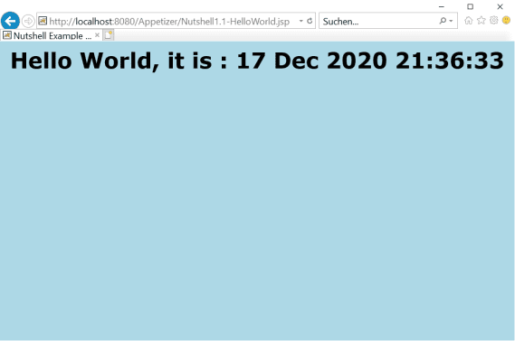

Slide 6
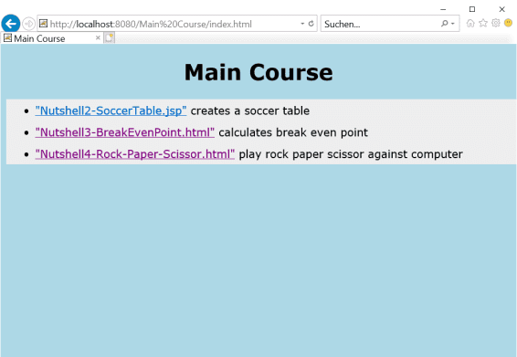

Slide 7
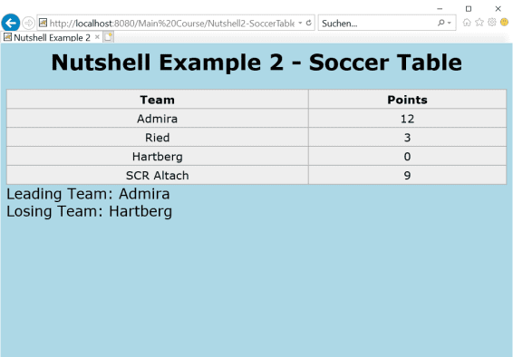

Slide 8
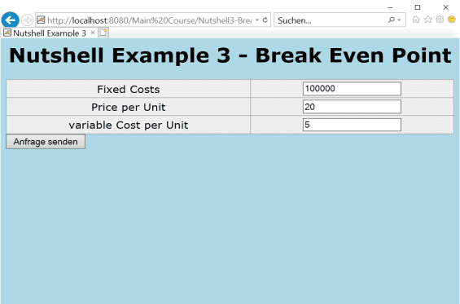

Slide 9
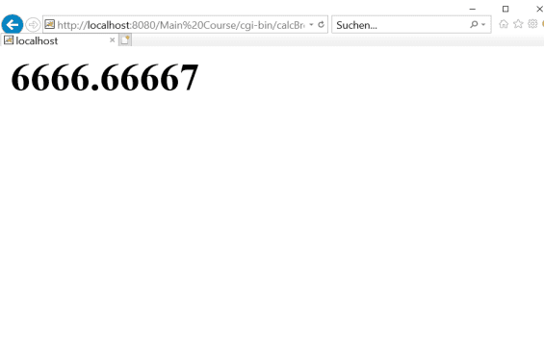

Slide 10
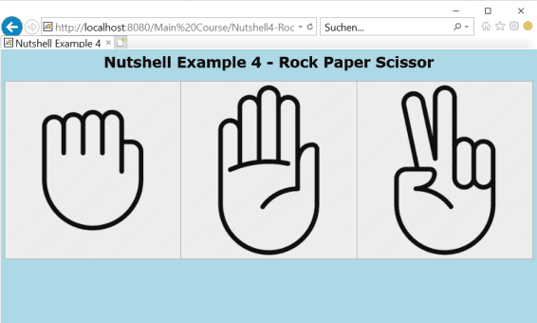

Slide 11
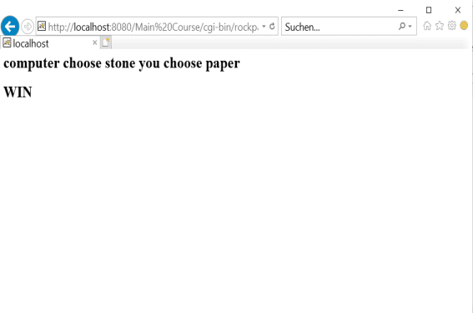

Slide 12
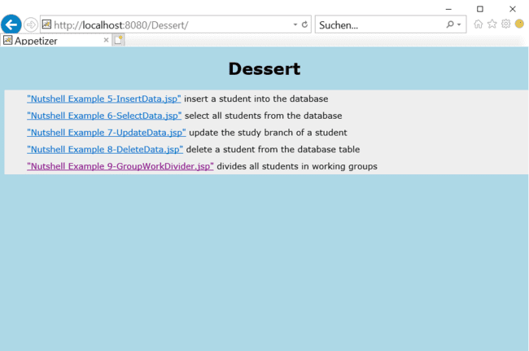

Slide 13
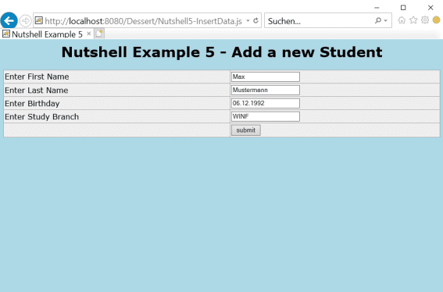

Slide 14
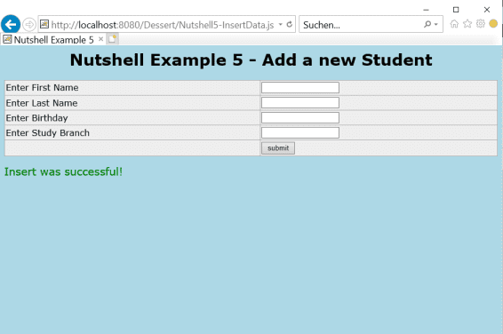

Slide 15
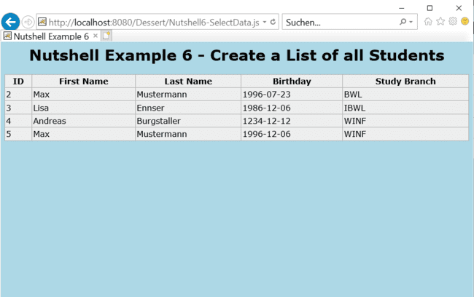

Slide 16
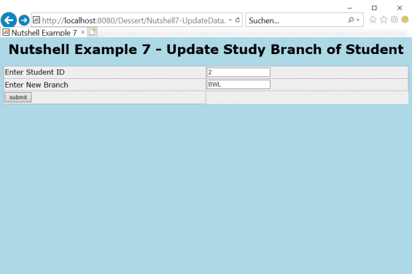

Slide 17
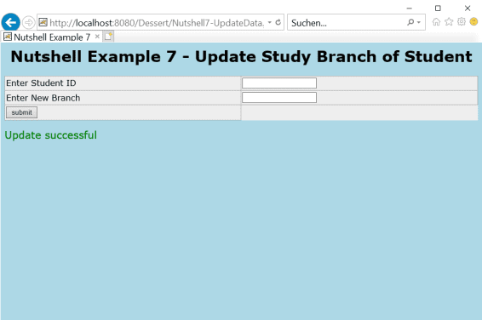

Slide 18
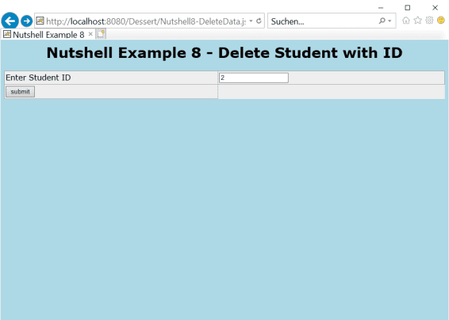

Slide 19
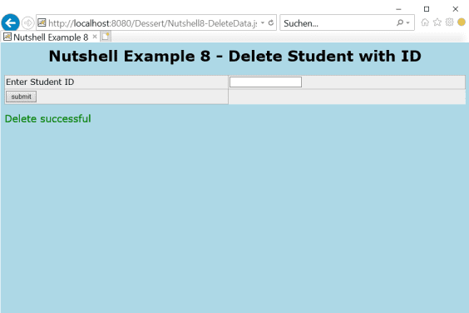

Slide 20
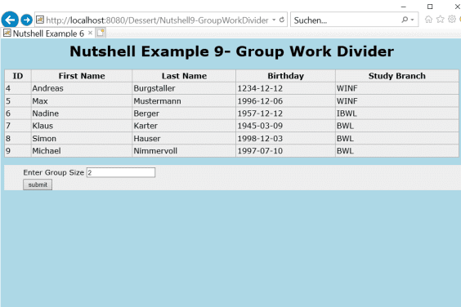

Slide 21
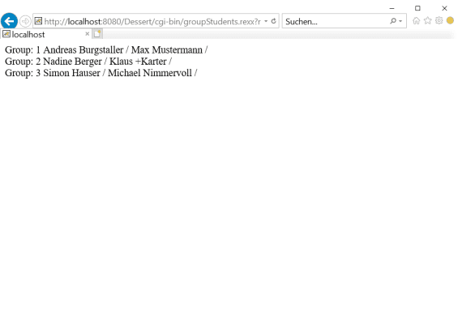

Slide 22
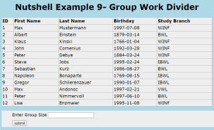

Summary
Outlook

Slide 23
Questions?

Slide 24
Thank You for
Your Attention!

