Slide 1
Contents
1. The economics behind software development
1.1 How do we define successful software
1.2 Subtle aspects of software economics
1.2.1 Scalability of the product
1.2.2 Important of delivery time
2. Different types of open-source software
2.1 Community open-source
2.2 Single-vendor commercial open-source
2.2.1 Business functions of open-source release
2.2.2 How the open-source develops your product
3. What motivates developers to be part of open-source project
3.1 Materialistic motives in open-source participation
3.2 Other motivators and the future of communities

Slide 2
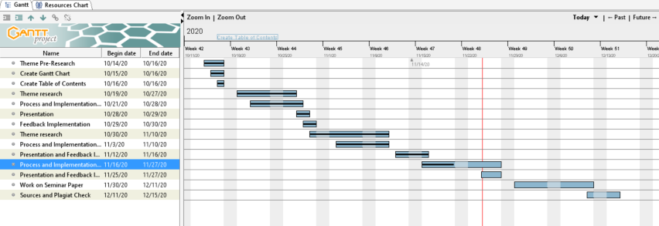
Gantt Chart

