Slide 1
Apache Tomcat Cookbook (Nutshell Examples)
Marion Tomes

Slide 2
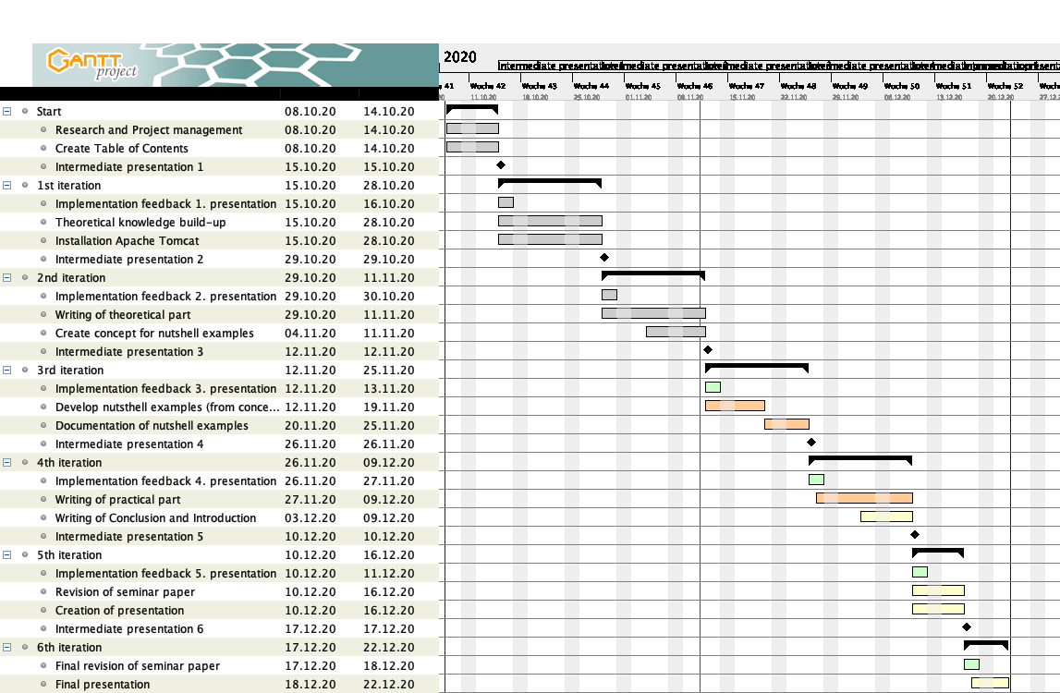
Gantt-Diagramm

Slide 3
Theoretical background
Introduction
Objectives
Methodology
Structure
Background
Apache Tomcat
Apache Groovy
PHP
Java Server Pages (JSP)
Tag Library

Slide 4
Installation
Installation
Apache Tomcat
Tag Library
Apache Groovy
PHP
<s:script type="php" cacheSrc="false"> <?php echo '<p>Hello World it is PHP!</p>'; ?> </s:script>
<s:script type="groovy" cacheSrc="false"> out.println "Hello World it's Groovy!" </s:script>

Slide 5
Nutshell examples
Application of nutshell examples
Apache Groovy Examples | PHP Examples
Hello World | Hello World
Calculations | Decision Making
Decision Making | Registration Form
Lists | Set Cookie
Maps | Set Session

