Slide 1
Critical Evaluation and Comparison between Proprietary and Open-Source Cloud Systems
Michael WIDY
1

Slide 2
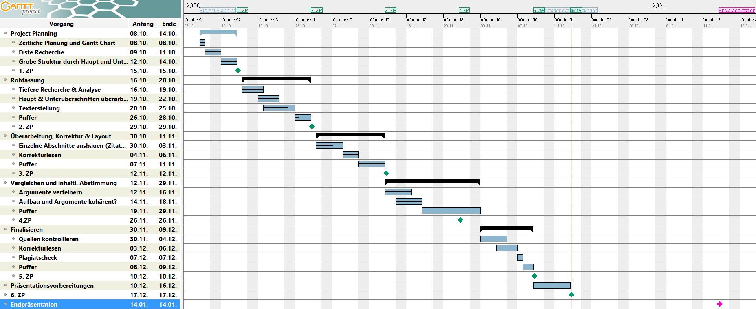
Projektplan
2

