Slide 1
Critical Evaluation and Comparison of MS-Teams and BigBlueButton for University Teaching
Stefan Köchl 11778021
BIS V

Slide 2
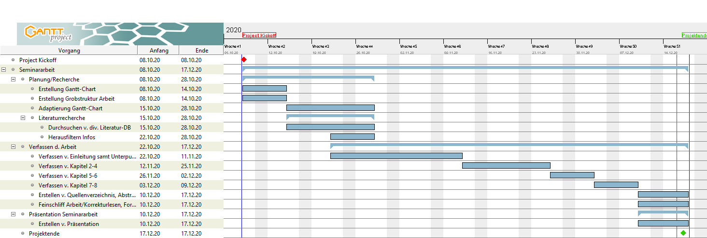
Gantt Chart

