Slide 1
Cost comparisons between open-source and proprietary software
Dzhan Dimitrov - 11808940

Slide 2
The economics behind software development
Procreation of valuable resources for the participating stakeholders
In every project the created value must exceed the expended resources
Clear vision for the risk-return characteristics
Cost-return characteristics in projects with hidden value
Combining of tactical and strategic matter
  Accurate estimation of the costs
  Options and synergies that may emerge by developing the project

Slide 3
What to consider by cost-value calculations
  Synergies and options on the marktet - Example Amozon (Times named Jeff Bezos Man of the Year, when Amazon was selling only books)
  Sustainable design for advantages in the future
  Evaluation of projects as value + option price
  Delivery time of software - trade-off between opportunity costs and the lower efficiency by development costs
    Lucrative chances
    Rule of thumb
    Advantage for proprietary firms in terms of strategic scheduling

Slide 4
Roadmap
to create a real value for existing demand
trade-offs between development time, effort put in work, quality, functional diversity
broad, dynamic, and strategic overlook to the matter
precise decision making by reflecting on different circumstances

Slide 5
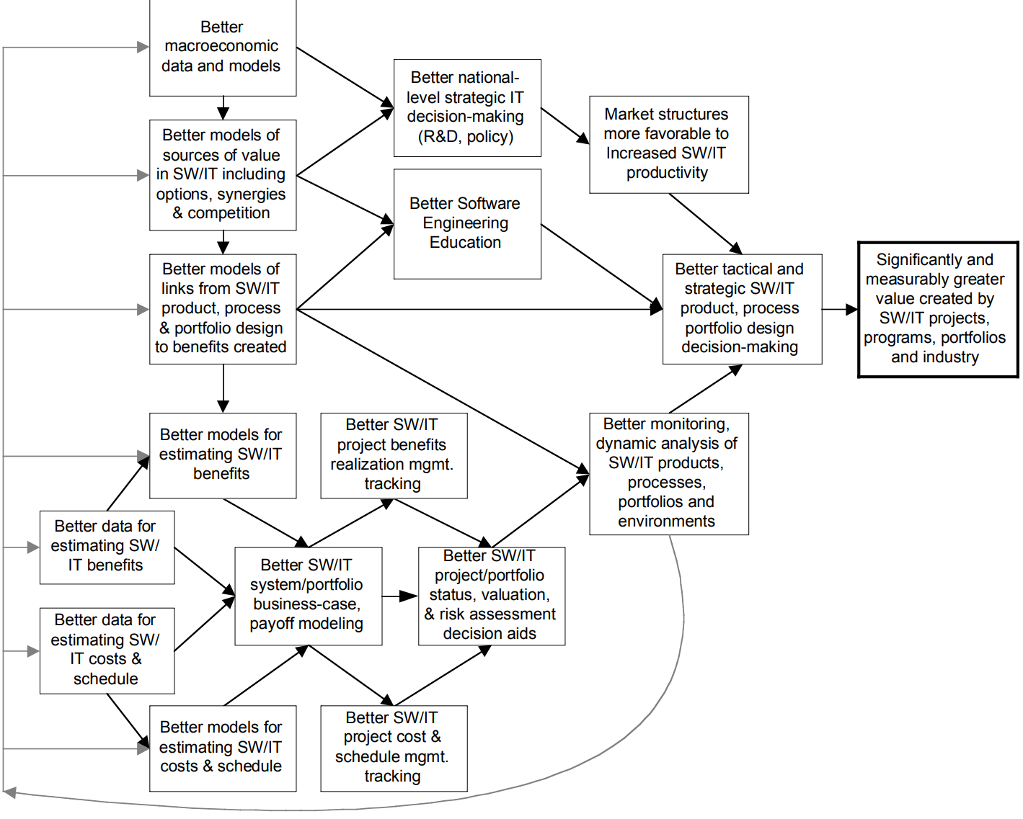
parts above are linked to strategic concerns lower part the roadmap handles tactical matters

Slide 6
Improvement of software creation
Better links between technical design, current circumstances, and value creation
Connections between technical and business side
Designing project portfolio reflecting the current information on the market
Better cost estimation models

Slide 7
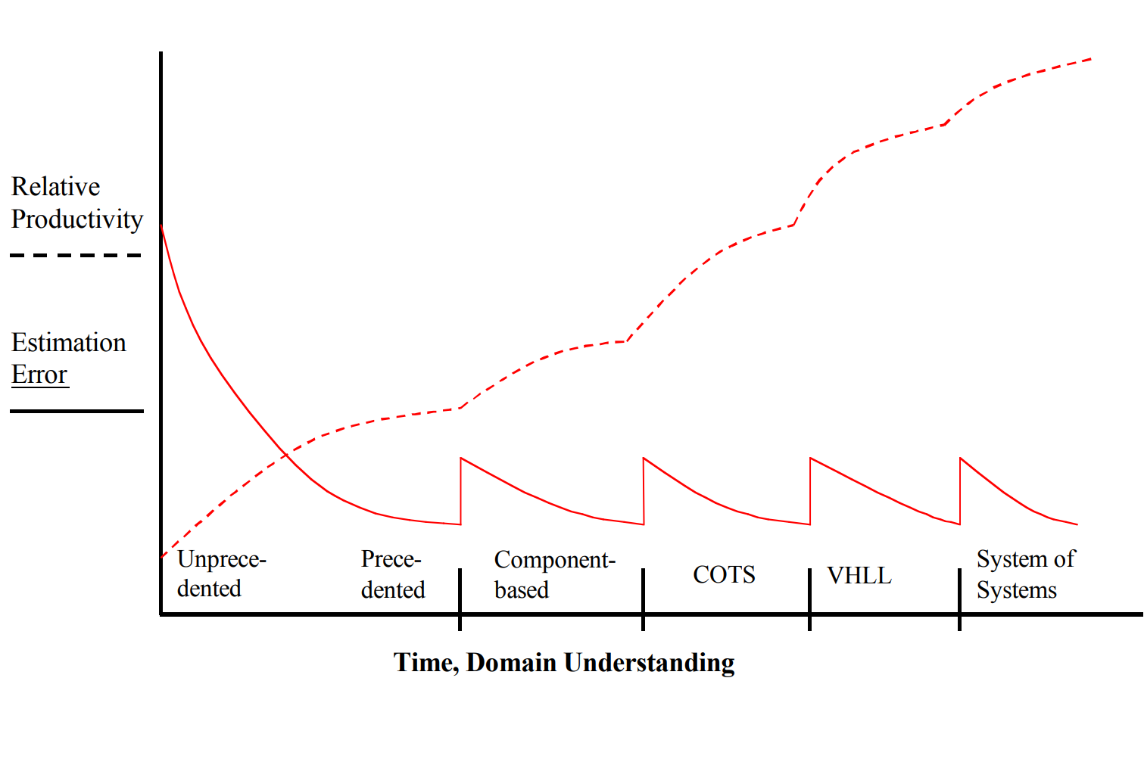
Learning curve

Slide 8
Open source
Community and Single-vendor commercial open source
Effect over different business aspects
  Support costs
  Marketing and sales
  Product management
  Product engineering

Slide 9
Motivation to participate in open source
Developing non-firm specific knowledge
Increase of lifetime revenue
Increase of bargaining power
Recognition
Merit to society welfare

Slide 10
How similar/different are open-source and proprietary firms in their production and selling approaches?
Historically open-source firms relied only on consulting services
Convergence toward dual-licensing strategie
  Reach large user size
  Reduce support costs
  Open-source community to improve their product
  Creating revenues through price discrimination
Evolution of Microsoft and their expenditure on R&D ($28,5 billion between 1989-2003)
Evolution of Red Hat and their expenditure on R&D ($40 million for the first 5 years of the company)

Slide 11
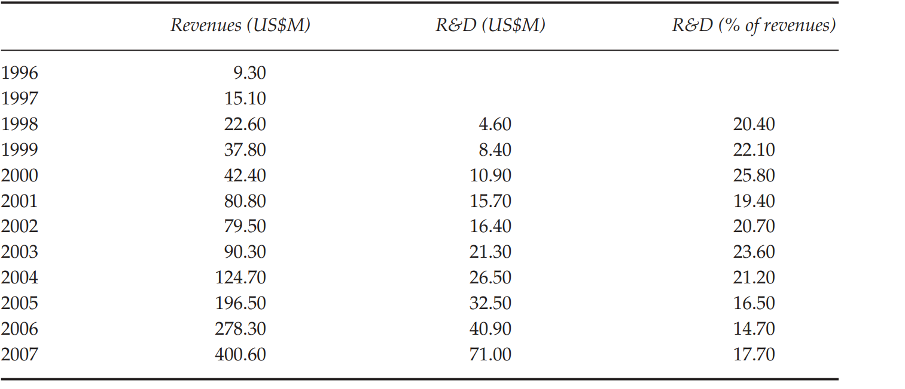
Why open-source firm invests so heavily in R&D (Red Hat’s annual reports)

Slide 12
How firms in ERP industry developed
SAP
  Kept rights for the software
  Great amount of accumulated knowledge
  From service to product (R/2 ERP)
Compiere
  Implementation of the new features from third parties
  Allowed customers to keep right over modifications
  Reduced innovation costs

Slide 13
Equalization in the selling and production approach
Open-source firms rely on dual-licensing strategy to sell their products
Proprietary firms give free versions on disposal
Open-source firms must invest in R&D and acquisitions to keep advantage over the concurrence
Open-source acquire talent and products from other firms to complement their products and create synergies
Less contrast between open-source and proprietary

