Slide 1
Apache Tomcat Cookbook (Nutshell Examples)
Marion Tomes

Slide 2
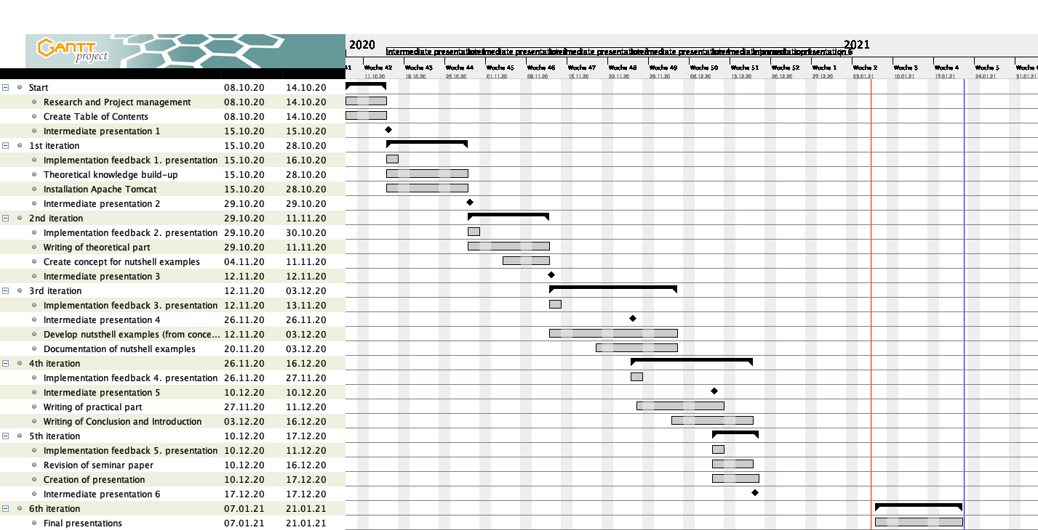
Gantt-Diagramm

Slide 3
Table of contents
Introduction
Objectives
Methodology
Structure
Background
Apache Tomcat
Apache Groovy
PHP
Java Server Pages (JSP)
Tag Libraries
Installation
Apache Tomcat
Apache Groovy
PHP
Tag Libraries
Application of nutshell examples
Nutshell context
Apache Groovy Examples
PHP Examples
Conclusion
Summary
Outlook

Slide 4
Introduction
Introduction
Objectives
Possible implementation for Groovy and PHP
Set up development environment (for testing and appliance)
Methodology
Literature review
Practical installation guide
In-depth literature review
Structure
Theoretical background
Installation guideline
Nutshell examples
Conclusion
Outlook

Slide 5
Apache Tomcat
Background
Lightweight Application | Open Source | Stability
- Easy demployment - Fast-loading times | - High degree of freedom for developers | - Web server runs independent of Apache installation - Error of Tomcat would not cause disfunction of other servers
Web server
Open-source
Used for applications using Java Server Pages (JSP)

Slide 6
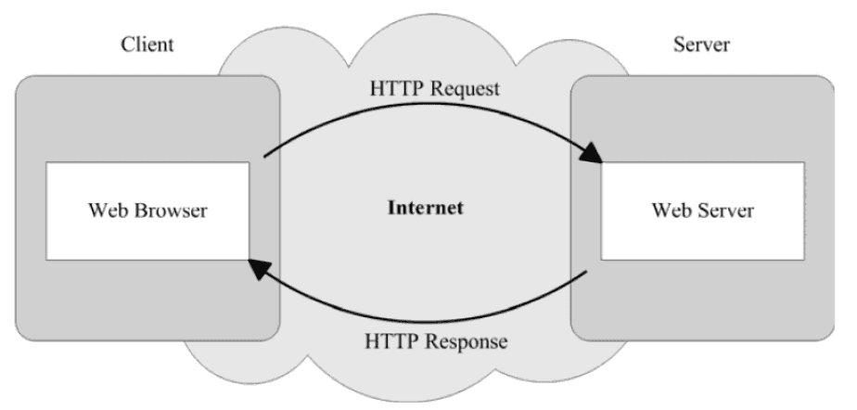
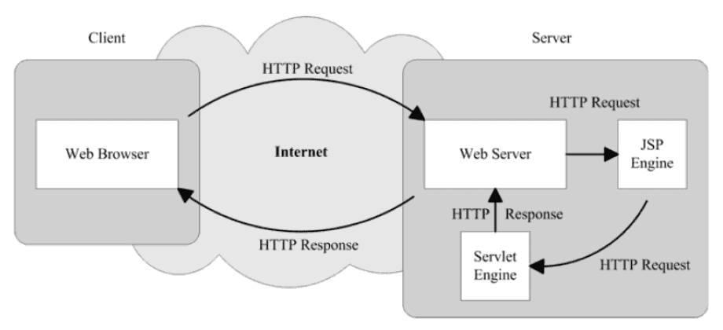
Java Server Pages (JSP)
Background
(Zambon, 2012)
(Zambon, 2012)
Dynamical web pages/content

Slide 7
Apache Groovy
Background
Scripting language
100% compatible with Java
Pre-imported classes
Extra keywords (e.g. def, as, if)
Frameworks based on Groovy:
Grails
Gradle

Slide 8
PHP
Background
Scripting language
Integrate in HTML for web scripting
Server-side scripting
Access PHP output with web browser
Processed on server where HTML is created

Slide 9
Tag Libraries
Background
Interpret different scripting languages used in a JSP page
BSF (Bean Scripting Framework) | JSR-223 (Scripting for the Java Platform)
Open-source interface for scripting languages within Java applications | Inspired by BSF
Write JSP files with languages other than Java | Pluggable and scripting language-independent architecture
Does not consist of language engines | Generating web content of programs written in scripting languages for web content

Slide 10
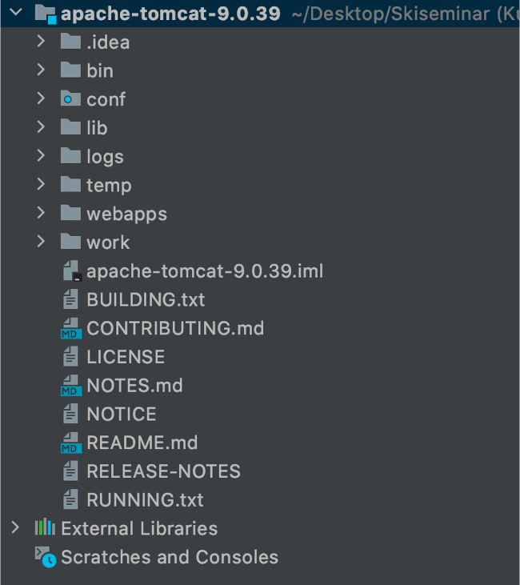
Apache Tomcat
Installation

Slide 11
Tag Libraries
Installation

Slide 12
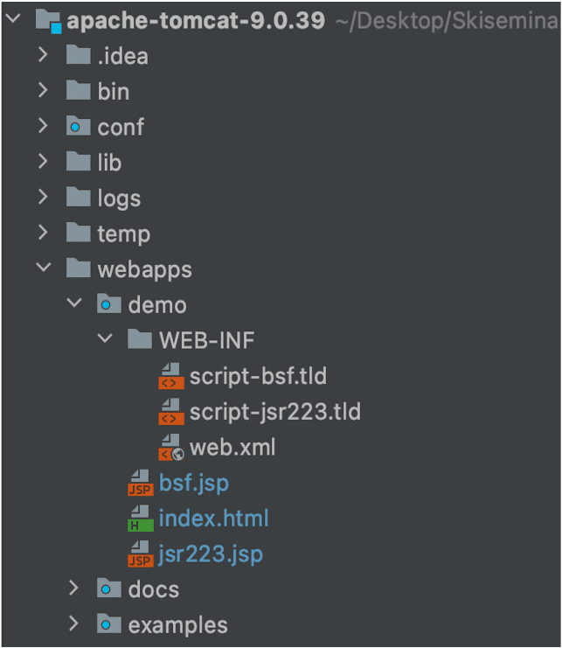
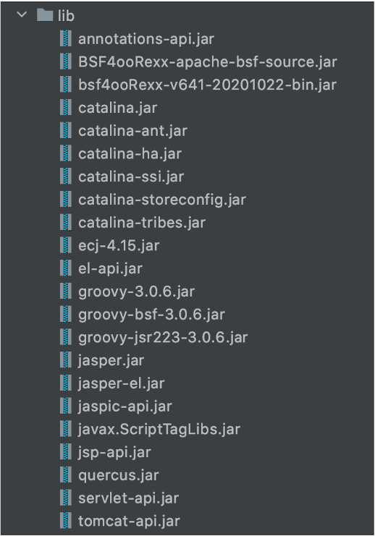
Apache Groovy & PHP
Installation

Slide 13
Nutshell context
Application
B2B Online News Publisher
Business Topics:
IT
Marketing
Finance
Economics
Mathematics

Slide 14
If-Else-If
Application
Groovy
PHP
<s:script type="groovy" cacheSrc="false"> def userstatus = 'user'
if (userstatus='user') { out.println("You can find the latest news from your field of interest here!"); } else if (userstatus ='premium') { out.println("View your personalized news section!"); } else { out.println("Have a look at the latest news!"); } </s:script>
<s:script type="php" cacheSrc="false"> <!DOCTYPE html> <?php $userstatus = user; if ($userstatus == "user") { echo "You can find the latest news from your field of interest here!"; } elseif ($userstatus == "premium") { echo "View your personalized news section!"; } else { echo "Have a look at the latest news!"; } ?> </s:script>

Slide 15
Switch
Application
Groovy
PHP
<s:script type="php" cacheSrc="false"> <!DOCTYPE html> <?php $preference = "IT"; switch ($preference) { case "IT": echo "See the latest IT news"; break; case "Marketing": echo "See the latest marketing news"; break; case "Finance": echo "See the latest finance news!"; break; default: echo "You can see some articles that you may find interesting"; } ?> </s:script>
<s:script type="groovy" cacheSrc="false"> def preference = 'IT' switch(preference) { case 'IT': out.println("See the latest IT news"); break; case 'Marketing': out.println("See the latest marketing news"); break; case 'Finance': out.println("See the latest finance news!"); break; default: out.println("You can see some articles that you may find interesting"); break; } </s:script>

Slide 16
Lists
Application
<s:script type="groovy" cacheSrc="false"> def number = (1..10) def topic = ['Marketing - ' , 'IT - ', 'Finance - ', 'Economics - ', 'Mathematics - '] def preference = [topic, number].combinations().collect { it.join() } def dashboard = preference.asImmutable() assert preference.size() == 50 preference.shuffle() assert preference.every { pref -> dashboard.contains(pref) } println preference.take(5) </s:script>

Slide 17
Maps
Application
<s:script type="groovy" cacheSrc="false"> def user = [ user123 : 'Economics', user234 : 'Marketing', user657 : 'Economics', user986 : 'IT' ] user.each { key, val -> println "$key = $val," } </s:script>

Slide 18
Sessions
Application
<s:script type="php" cacheSrc="false"> <!DOCTYPE html> <?php session_start(); $_SESSION["preference"] = "IT"; if(!isset($_SESSION)) { echo "Welcome to our page Guest!"; } else { echo "Do you want to view the latest news from the " .
$_SESSION["preference"] . " sector?"; } ?> </s:script>

Slide 19
Cookies
Application
<s:script type="php" cacheSrc="false"> <!DOCTYPE html> <?php $cookie_name = "user"; $cookie_value = "Marion"; setcookie($cookie_name, $cookie_value, time() + (86400 * 30), "/"); if(!isset($cookie_name)) { echo "Welcome to our page Guest!"; } else { echo "Welcome to our page " . $cookie_value . "!"; } ?> </s:script>

Slide 20
Summary
Conclusion
Apache Groovy & PHP applied in different contexts – still similarities
Tag libraries enabled use of both languages (Even PHP)
Possiblities of Apache Tomcat

Slide 21
Outlook
Conclusion
Other scripting languages & tab library
More complex examples of the scripting languages

Slide 22
References
Zambon, G. (2012). Beginning JSP, JSF and Tomcat: Java Web Development. Apress.

