Slide 1
Seminar paper
Proprietary vs. Open Markets in IT: Apple, Microsoft, Google
by Dominique Prinz, h11704419

Slide 2
Plan - IST
To do‘s:
Fertigstellung Kapitel:
The Way to the Top
Strategies based on Examples
Pricing & Terms of Condition
Next steps:
Beginn Kapitel:
Criticism
Future Developments
Start: Conclusion

Slide 3
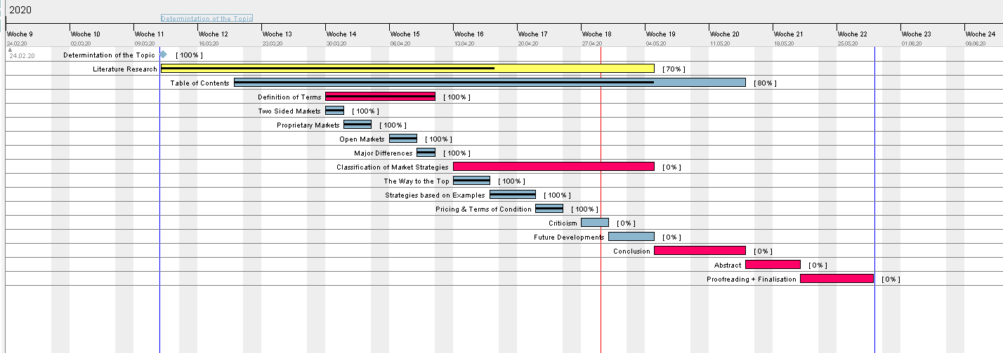
Gantt Chart:

