Slide 1
Critical Evaluation of Prices in the Information Technology Age: History, Features and Critical Comparison of Market/Value Based, Cost Based and Arbitrary Prices
Basara Djordje

Slide 2
Provisional Table of Contents
Abstract
Introduction
Pricing strategies during the twentieth century
2.1. Power of branding
2.2. Importance of product placement and packaging on the end-price
Pricing in the information technology age
3.1. Historical overview
3.2. Information technology as the enabler of determining the most appropriate price
3.2.1. Consumer data gathering methods
3.2.2. Influence of consumer-behavior data on setting the right price
3.3. Pricing practices of the market-leading companies and their methods of determining the right price
4. Comparison between market/value based, cost based and arbitrary prices
4.1. Utilizing the discriminatory price strategies
4.2. Adjusting the prices to the ever-changing consumer behavior via the market data
Conclusion
Glossary
Bibliography

Slide 3
Progress over the last two weeks
-Insignificant progress due to the exam week
-Exam week’s float time added to the Gantt Chart
-Second Chapter completed

Slide 4
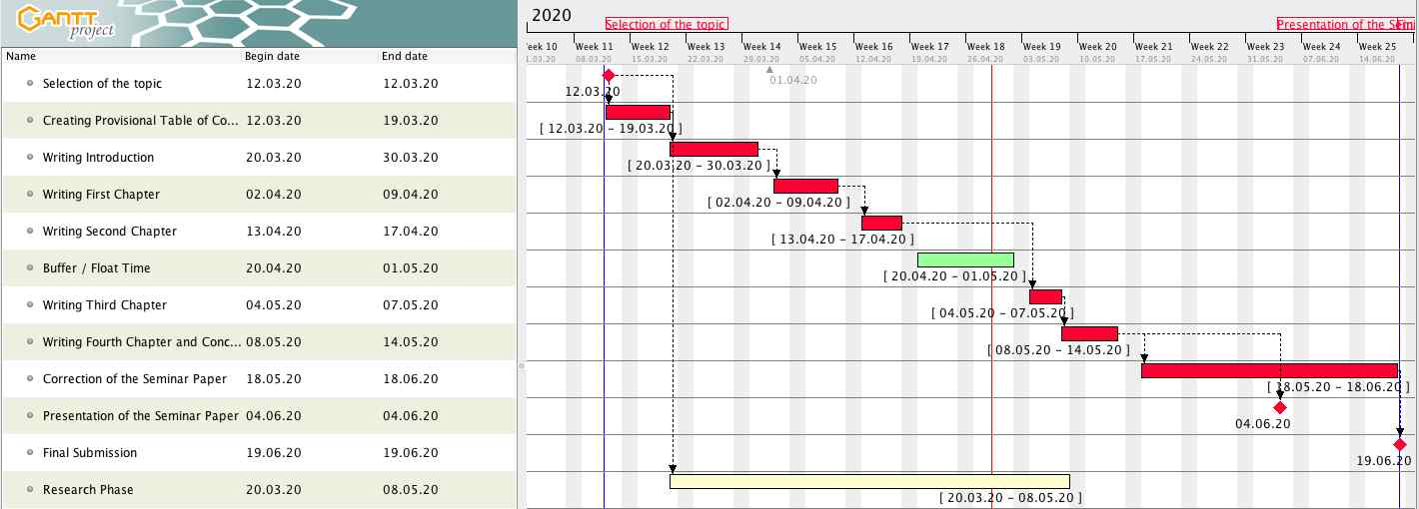
Gantt Chart

