Slide 1
BANKING CHARGES IN THE DIGITAL AGE
Critical Evaluation Of Banking Charges In The Era Of Automatization And Self-Service
Markus Cservenka
4167 BIS Seminar

Slide 2
STRUCTURE
1. Abstract
2. Introduction
3. Research Question
4. Terminology
4.1. Financial Institutions
4.2. Banking Fees And Charges
4.3. Taxes
4.4. Interest
4.5. Digitalization
5. Banking In Europe
5.1. Types Of Banking Institutions
5.1.1. Traditional Banks
5.1.2. Direct Banks
5.2. Recent Developments
5.3. Market Analysis
6. Historical Developments In Banking
6.1. Beginning of Banking
6.2. Continuous Developments
6.3. After World War II
6.4. Banking In The 21st Century
7. Digitalization And Automation Of The Banking Industry
7.1. FinTech
7.2. Changing Business Models
7.3. Automation Of Banking Processes
7.3.1. Electronic Banking
7.3.2. Self-Service Technologies
8. Development Of Banking Charges in Europe
8.1. European Law Restrictions
8.2. Banking Fee Models
8.3. Comparison Of Banking Charges In Europe
8.3.1. Austria
8.3.2. Germany
8.3.3. Italy
8.3.4. Netherlands
9. Conclusion

Slide 3
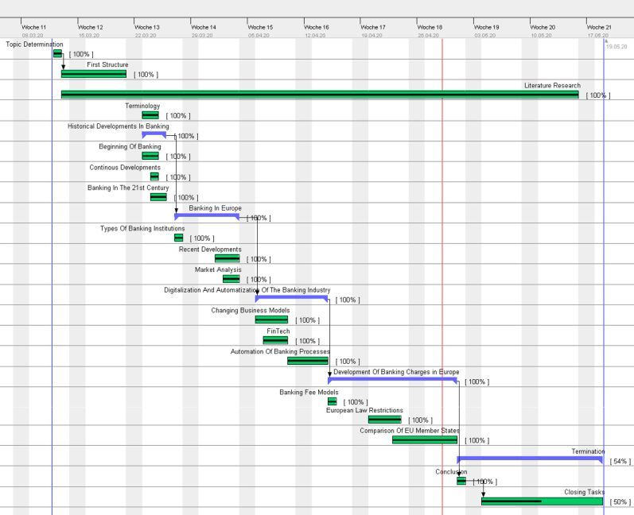

Slide 4
THANK YOU
Markus Cservenka
4167 BIS Seminar

