Slide 1
Security Concerns in Proprietary and Open-source Software Fabiola Welzenbach 01552712

Slide 2
Structure
Introduction
Definition software
Definition of a proprietary software and open-source software
History of proprietary and open-source
Obstacles: licencing open source and proprietary software
Comparison of proprietary software and open-source software
Advantages
Disadvantages (restrictions etc.)
Security concerns
Security concerns Proprietary
Security concerns open source
Application of proprietary and open-source software (Whatsapp vs. Signal)
What can be done to guarantee a higher security level of security
Microsoft software strategy
Advice in which cases it would make more sense to use open-source, whether than proprietary
Conclusion

Slide 3
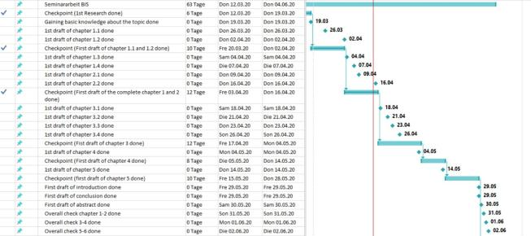
Timeline (MS Project)

