Slide 1
Seminar Paper Presentation Critical Evaluation of Prices in the Information Technology Age: History, Features and Critical Comparison of Market/Value Based, Cost Based and Arbitrary Prices
Basara Djordje (h01453805)

Slide 3
Evolution of Marketing and Pricing Strategies
In the beginning of the 20th century considered as an art
Marketing as a science from the 1950s
In the 1920s, 4 P‘s of Marketing Mix introduced
Until the 1970s, the market competitors utilized advertisement and branding only

Slide 4
Evolution of Marketing and Pricing Strategies
Optimal Marketing Mix for the company decided by the upper-management, mostly by CEO
At the start of the twentieth century, additional marketing factors were developed: People, Performance, Psychodynamics, Pace, and Packaging

Slide 5
Power of Branding
Utilized from the 1970s
Lowest risk when compared to other marketing alternatives
Especially important for the service-providing companies
Consumers relate branded products with higher exclusivity, and with consistent performance
Companies should invest in product branding to improve company‘s image

Slide 6
Importance of Product Placement and Packaging on the End-Price
Both have significant influence on the price
Consumers' willingness to pay at the moment of purchase can be higher due to product placement and product packaging
Information technology advancement enabled for RFID chips, thus lowering the production, distribution, and storage costs

Slide 7
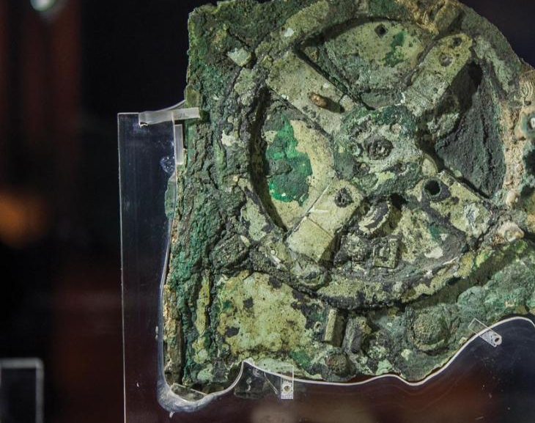
Development of the Information Technology
Until the 20th century, computing reffered to the human processing the necessary information
Clay tablets firstly used to spread the informations
First mechanical analog computer (Antikythera mechanism)
Information technology advancements stagnated until the 16th century

Slide 8
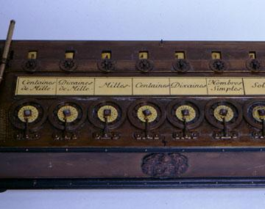
First mechanical calculator was invented in 1645, capable of processing four arithmetical equations
However, the first mass-produced calculator was introduced in 1820
In the 19th century, even the most advanced devices were analog
Based on the wheel-and-disc integrator
Provided a base for the research of the electronic devices

Slide 9
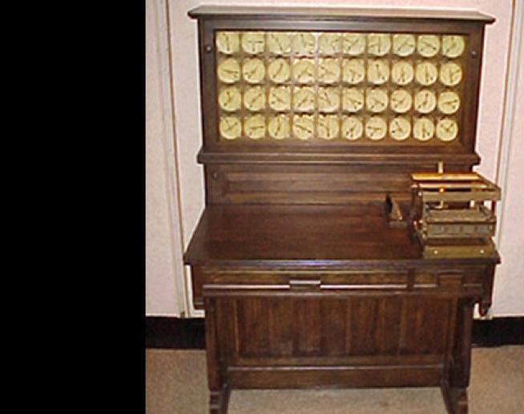
Punched Card Data Storage System
Invented at the end of the 19th century as the storage medium
Further developed as a necessity for the U.S. Statistic‘s Department
Consequently, Tabulating Machine was developed
The punched card data system stayed the most utilized data transportation and data storage medium until the 1950s

Slide 10
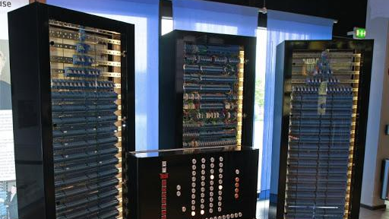
Zuse Z3 and Colossus
During the 1940s, the transition from the electromechanical to electronic computation occured
Introduction of the world‘s first programmable computer, Zuse Z3
In the same decade, Colossus, the first electronic digital computer was introduced
Both computers were unable to store their programms internally, and were designed to perform a single task

Slide 11
SSEM and Ferranti Mark 1
In 1948, SSEM, the first computer with internal storage capacity was developed
Thereafter, Ferranti Mark 1, the first general purpose computer with both primary and secundary storage capabilities became commercially available

Slide 12
The Second Generation of Computers
The second generation computers had transistors replacing traditional vacuum tubes
Transistors were significantly faster, tinier, produced less heat, and required less power. Moreover, transistors lowered the cost, the size, and operational costs of running the computer
The Atlas, the world's first supercomputer, was finished and operational by 1962. The Atlas presented the pinnacle of the second generation computers

Slide 13
The Third and Fourth Generation Computers
The third generation of computers were developed during the mid-1960s
The major innovation responsible for this technological progress was the integrated circuit. IC allowed for the smaller devices, available to the broader audience
Finally, the fourth generation of computers is marked by microprocessors
In 1971, Intel developed Intel 4004 (4-bit) and Intel 8008 (8-bit)
Intel 4004 had just over 4000 transistors, while today's modern microprocessors possess 10 to 50 billion
Even today, Moore's law serves as the guideline and measurement of the success for the microprocessor developers

Slide 14
Market/Value Based Pricing
The price is set according to competitors
Utilized mostly in the highly competitive markets
To determine the market-based price, the product's production costs, market factor price, and additionally, product premium should be added
However, pricing policies usually depend on competitors' actions, and therefore, neglect the consumer demand
Starbucks uses Market/Value based pricing to increase the profit margins. By processing the consumer data, Starbucks determines the highest price the consumer is willing to pay

Slide 15
Cost-Based Pricing
Cost-based pricing is aimed towards covering the total product cost and towards achieving a substantial profit margin
Even though it achieves the smaller profit margins, larger total revenue
The companies utilizing the cost-based pricing strategy have to keep their production costs low
Desired price combines the total cost of the product with desired markup
Ryanair and Walmart utilize the cost-based pricing in combination with advanced data-processing, to achieve the most desirable price

Slide 16
Arbitrary Pricing and Price Discrimination

Slide 17
Adjusting the Prices to the Ever-Changing Consumer Behavior via the Market Data and Machine Learning Algorithms
At the start of the twenty-first century, the large corporations, mostly from the technology sector, started implementing new strategies to price their goods more effectively
Information goods demanded a new pricing technique due to their characteristics
The information goods are cheap to reproduce, have no production limits, and do not have incremental production costs
However, their production cost is high. Therefore, if not successful, they are usually presenting sunk costs for the company
The large corporations adopted the machine learning algorithms to assist them in scaling their price optimally
Three types of machine learning: supervised learning, unsupervised learning, and reinforcement learning

Slide 18
Machine Learning on the Example of Google
Google‘s advertisement pricing strategy is dynamical and utilizes the PageRank algorithm
PageRank algorithm is based on the second price auction system that combines several constraints: 1) Advertisement‘s expected clickthrough rate; 2) Landing page experience; 3) Advertisement‘s relevancy; 4) Advertisement's formatting style
By utilizing the Page Rank algorithm, Google guarantees not only the best experience for the users by showing them relevant and highly optimized advertisements but for the advertisers also

