Slide 1
Determining Prices in the Information Technology Age: How Can "Just Prices" Be Achieved for Good?
Mariusz Nitecki 11711554

Slide 2
TABLE OF CONTENTS
1. INTRODUCTION
2. JUST PRICES
2.1 WHAT ARE „JUST PRICES“
2.1.1 ETHICS OF FAIR PRICES OVER HISTORY
2.1.2 HOW „JUST PRICES“ ARE DETERMINED
2.2 ECONOMIC VIABLITY OF „JUST PRICES“
3. CURRENTLY PRACTICED PRICING SCHEMES
3.1 INDIVIDUAL PRICING
3.2 VERSIONING
3.3 GROUP PRICING
3.4 BUNDLING
4. USE OF TECHNOLOGY FOR PRICE SETTING
4.1 PROCESSING OF PERSONAL DATA TO DETERMINE FAIR PRICES
4.1.1 CUSTOMER PROFILING
4.1.1.1 BEHAVIOUR DATA
4.1.1.2 NON-BEHAVIOURAL DATA
4.1.2 PREDICTION MODELS
4.2 USE OF ARTIFICIAL INTELLIGENCE
4.3 DATA PROTECTION CONCERNS AND ETHICS
5. CONCLUSION

Slide 3
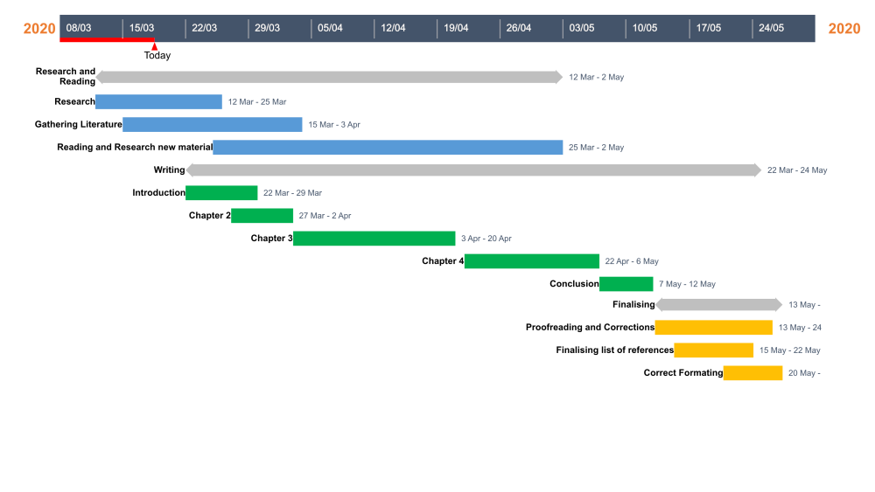
Gantt-Chart

