Slide 1
JavaFX: History, Concepts, Nutshell Examples
BIS Seminar – Summersemester 2020
Elise Landman h1551237
Source: https://en.wikipedia.org/wiki/JavaFX_Script

Slide 2
Agenda
General Overview
History of JavaFX
Live Demo
JavaFX Architecture
Start Using JavaFX
Development Examples

Slide 3
Let‘s do a poll!
Please go to www.kahoot.it
Source: https://kahoot.it/shared/theme/kahoot/img/icn_kahoot_logo.svg

Slide 4
What is java Fx?
Toolkit for developing Rich Internet Applications (RIA) and Graphical User Interfaces (GUI) with the programming language Java (Wikipedia, 2020)
Source: https://en.wikipedia.org/wiki/JavaFX_Script

Slide 5
What is A Rich Internet Application?
Implemented in Browser Applications
Offer a better visual user experience
Better accessibility and usability
More interactive
.. than traditional HTML (Shaath, Y., 2011).
Source: https://en.wikipedia.org/wiki/JavaFX_Script

Slide 6
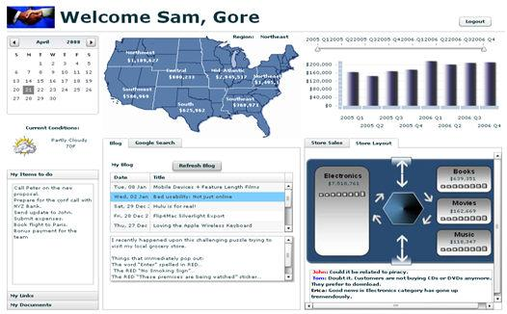
What is A Rich Internet Application?
Source: https://lw.microstrategy.com/msdz/MSDL/GARelease_Current/_GARelease_Archives/931/docs/mergedProjects/GenericContent/topics/sdkintro/SDK_Rich_Internet_Applications_(RIAs)_and_Mashups.htm

Slide 7
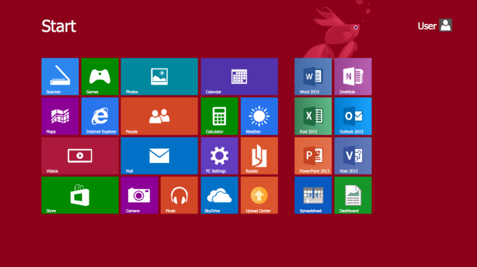
What is A Graphical User Interface?
Source: https://www.conceptdraw.com/How-To-Guide/graphical-user-interface-examples

Slide 8
How did java FX Come to life?
Released in December 2008
by Sun Microsystems
Creator of Java
Acquired by Oracle in April 2009 for 5.6 billion USD (Wikipedia, 2020)

Slide 9
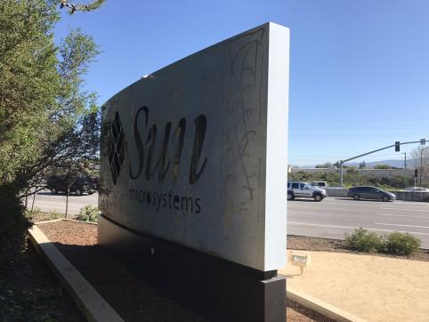
Fun Fact
Sources: https://www.conceptdraw.com/How-To-Guide/graphical-user-interface-examples https://www.vancourier.com/living/visiting-google-facebook-and-apple-in-california-s-silicon-valley-1.23401683
Notes:
Menlo Park

Slide 10
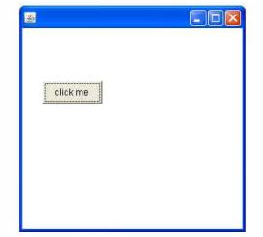
Ancestors of java fx
1995: Abstract Window Toolkit (AWT)
First Java GUI Library
Platform Dependent: different interface on different OS
Heavyweight (JavaTpoint, 2020)
Source: https://www.javatpoint.com/java-awt

Slide 11
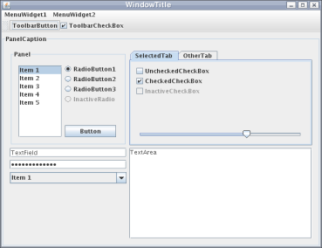
Ancestors of java fx
1996: Swing
Successor of AWT
Platform Independent: same „look and feel“ on each OS and device
Lightweight (JavaTpoint, 2020)
Source: https://en.wikipedia.org/wiki/Swing_(Java)

Slide 12
Time machine
12 years fast forward…
Source: https://gifer.com/en/Oi8y

Slide 13
Release of java fx
2008: JavaFX
Not an official successor of Swing – but will be replaced in the future (Oracle, 2020)
Support of RIAs
Support for Windows, MacOS, Linux, Android, iOS and Raspbian OS (Wikipedia, 2020)

Slide 14
Swing VS Java FX
Swing:
Standard UI components
Decent look and feel
Basic controls (Buttons, Check Boxes, etc.)
No support for touch devices
No new releases
(Educba, 2020)
JavaFX:
Rich GUI components
Modern look and feel
Many modern and new controls
Stylish animations
Touch screen support
New releases in the future

Slide 15
Live Demo
Live Demo

Slide 16
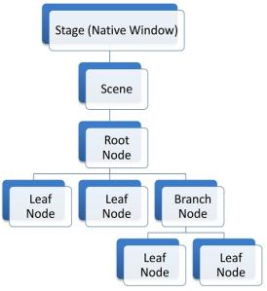
Java FX Architecture
Scene Graph tree structure
Logical representation of individual UI components
Stage: native OS window
Scene: specific page view of an application
Nodes: images, buttons, text fields, etc.
→ A change in parent node is applied to all its child nodes (FXdocs, 2020)
Source: https://fxdocs.github.io/docs/index.html

Slide 17
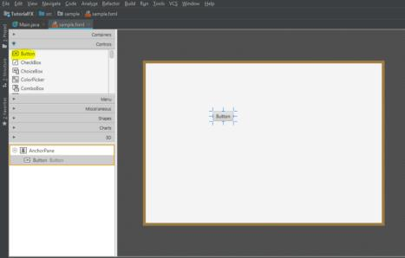
Scene Builder
Drag and Drop tool for simplified UI design
No need of programming experience!
Source: https://blog.usejournal.com/javafx-step-by-step-part-2-ui-design-with-scene-builder-4dc8473b3c2c

Slide 18
How to Start developing?
Install Java – JDK: http://jdk.java.net/14/
Install Java FX: https://gluonhq.com/products/javafx/
Suggestion - install IntelliJ IDEA: https://www.jetbrains.com/idea/

Slide 19
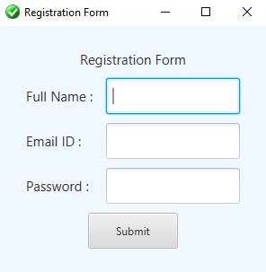
Code snippets
General-purpose text field:
<Label text="Full Name : "
GridPane.columnIndex="0" GridPane.rowIndex="1" >
</Label>
<TextField prefHeight="40"
GridPane.columnIndex="1" GridPane.rowIndex="1"/>
Password text field:
<Label text="Password : "
GridPane.columnIndex="0" GridPane.rowIndex="3" >
</Label>
<PasswordField prefHeight="40"
GridPane.columnIndex="1" GridPane.rowIndex="3"/>
Application window icon:
Stage.getIcons().add(new Image(getClass().getResourceAsStream("icon.png")));

Slide 20
Thank you for your attention!
Any Questions?
Source: https://www.pixilart.com/art/mario-and-question-mark-gif-22231991cc24155

Slide 21
References
Taman, M., 2015. JavaFX Essentials. Birmingham, UK.: Packt Publishing Ltd.
Wikipedia.org, 2020. Swing (Java). [Online] Available at: https://de.wikipedia.org/w/index.php?title=Swing_(Java)&oldid=196092289 [Accessed 30 March 2020].
Wikipedia, 2020. Java (programming language). [Online] Available at: https://en.wikipedia.org/w/index.php?title=Java_(programming_language)&oldid=956349384 [Accessed 18 May 2020].
Wikipedia, 2020. Scene graph. [Online] Available at: https://en.wikipedia.org/w/index.php?title=Scene_graph&oldid=953884868 [Accessed 18 May 2020].
Wikpedia.org, 2020. JavaFX. [Online] Available at: https://en.wikipedia.org/w/index.php?title=JavaFX&oldid=947700994 [Accessed 30 March 2020].
Oracle, 2020. JavaFX FAQ. [Online] Available at: https://www.oracle.com/technetwork/java/javafx/overview/faq-1446554.html#6 [Accessed 4 April 2020].
JavaTpoint, 2020. Java Swing Tutorial. [Online] Available at: https://www.javatpoint.com/java-swing [Accessed 2020 May 2020].
JavaTpoint.com, 2020. Java AWT Tutorial. [Online] Available at: https://www.javatpoint.com/java-awt [Accessed 30 March 2020].
Shaath, Y., 2011. Rich Internet Applications. [Online] Available at: https://www.slideshare.net/SebaYoussef/rich-internet-applications-8711592 [Accessed 3 June 2020]

