Slide 1
Comparison and Critical Comparison of Charges for NFC Payments Accounted for by Credit Cards and Debit Cards Instead of Paying with Cash. (Vergleich und kritische Evaluierung der verrechneten Kosten beim Bezahlen über NFC mit Kreditkarten und Bankomatkarten (Debit-Cards) anstatt mit Bargeld
Yasir Durmaz h01429347
SBWL – K5 / Thema 6

Slide 2
Gliederung
1.Introduction
2.NFC Introduction
2.1 History
2.2 Overview
2.3 NFC Mobile Architecture
2.4 Functioning of Contactless Payment (NFC) with Smart Devices
2.5 Operation Modes
2.5.1 Reader NFC
2.5.2 Peer-to-Peer Mode
2.5.3 Card Emulation
2.6 Concerns
3.Usage Areas of NFC
3.1 Smart Card Technology
3.1.1 Types of Smart Cards: Based on Capacity
3.1.1.1 Memory Based Smart Cards
3.1.1.2 Microprocessor Based Smart Cards
3.1.2 Smart Card Operating Systems
3.1.3 Types of Smart Cards: Based on Mechanism
3.1.3.1 Contactless Smart Cards
3.1.3.2 Hybrid Models
3.1.4 Smart Card Applications
3.3 Other Usage Areas for NFC
4. Actual Charges for Usage
5. Comparison Between Different Providers
5.1 EU
5.2 Non-EU Countries
6. Critics and Justification

Slide 3
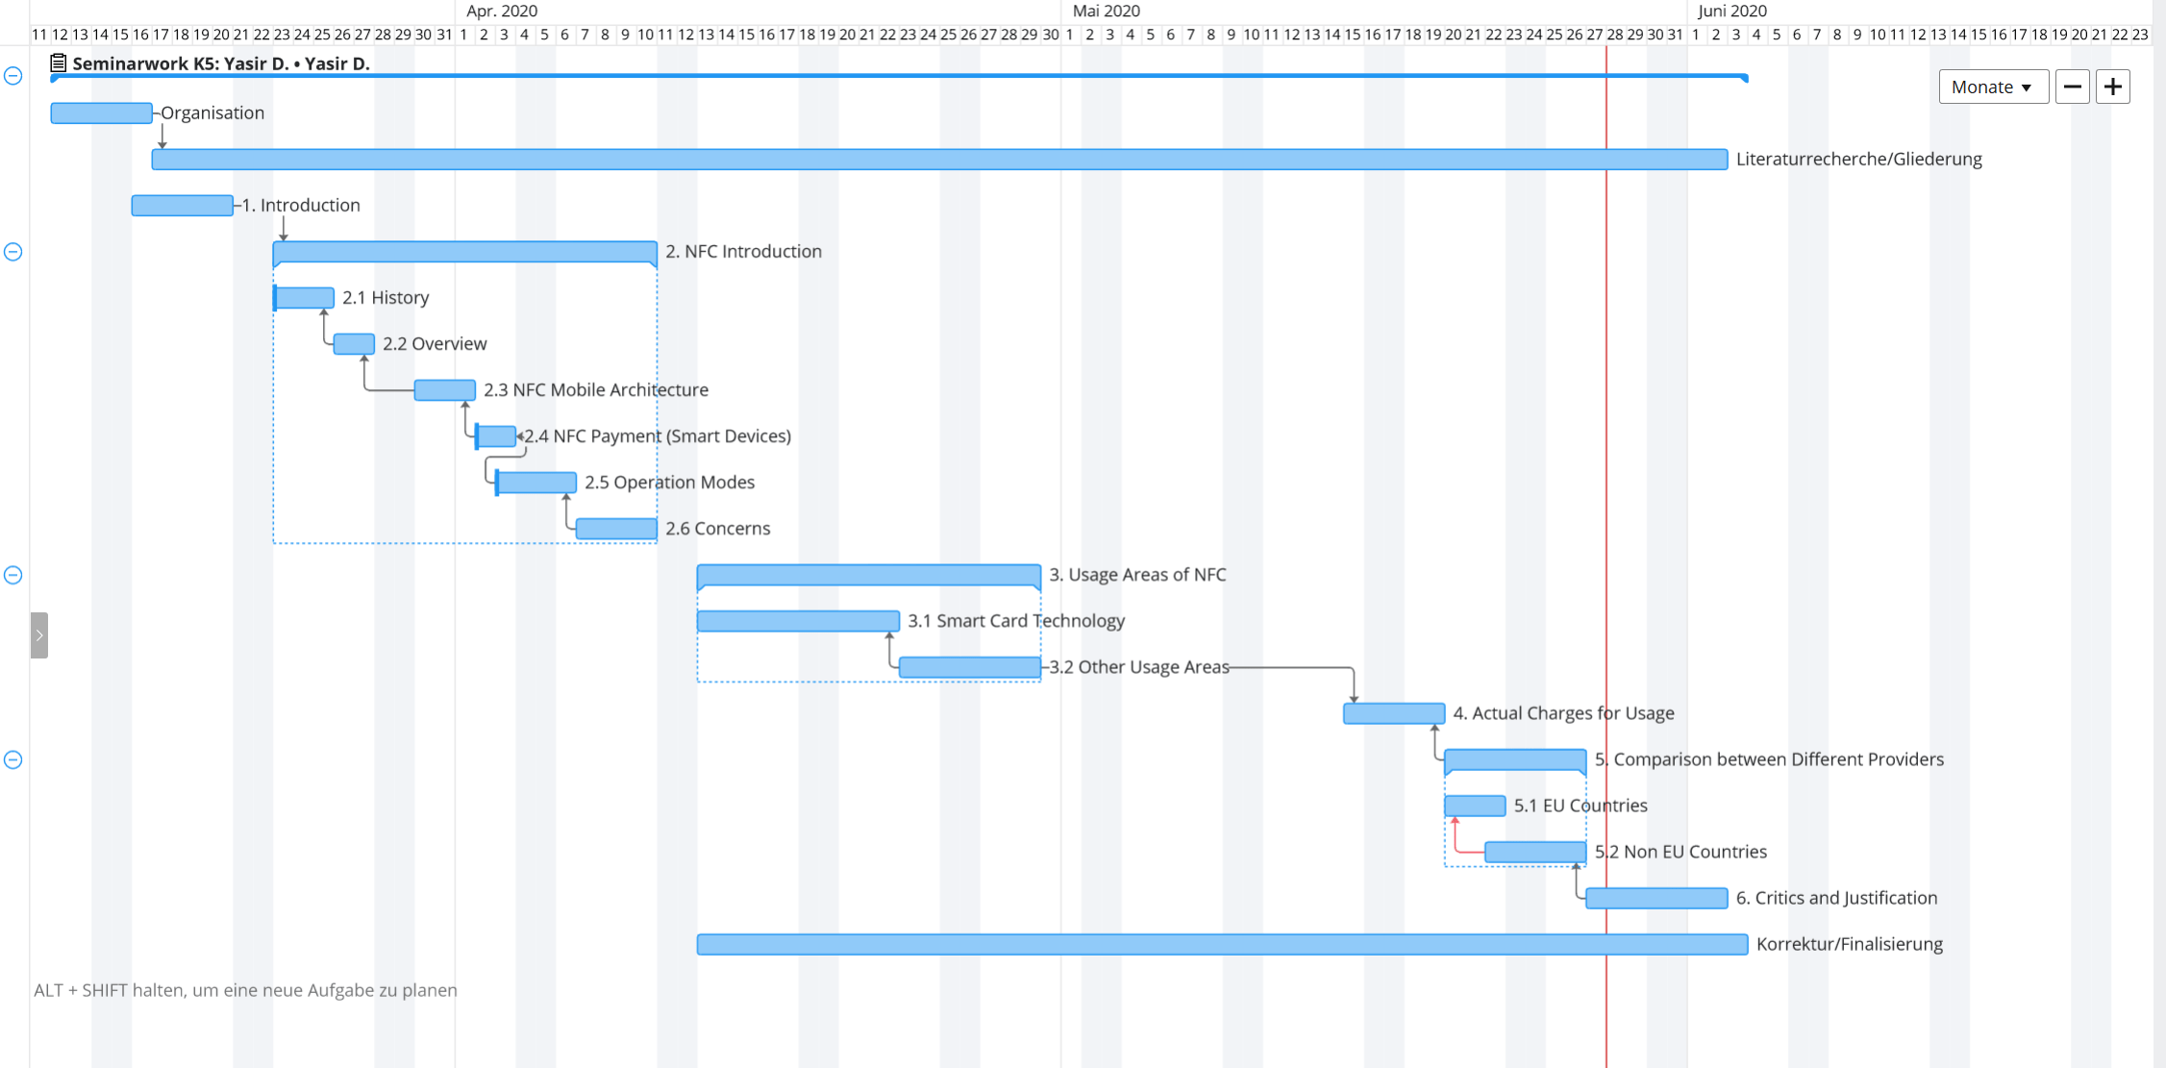
Gantt Chart

