Slide 1

Security Concerns in Proprietary and Open-source Software
Fabiola Welzenbach 01552712

Slide 2
Structure
Introduction
  Definition software
  Definition of a proprietary software and open-source software
  History of proprietary and open-source
  Obstacles: licencing open source and proprietary software
Comparison of proprietary software and open-source software
  Advantages
  Disadvantages (restrictions etc.)
Security concerns
  Security concerns Proprietary
  Security concerns open source
  Application of proprietary and open-source software (Whatsapp vs. Signal)
  What can be done to guarantee a higher security level of security
Microsoft software strategy
Advice in which cases it would make more sense to use open-source, whether than proprietary
Conclusion

Slide 3
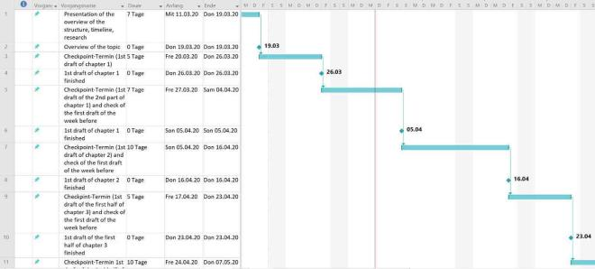
Timeline (MS Project)

