Slide 1
ooRexx 5.0 Beta
new features and nutshell examples
Thomas Dabernig (h1451744)

Slide 2
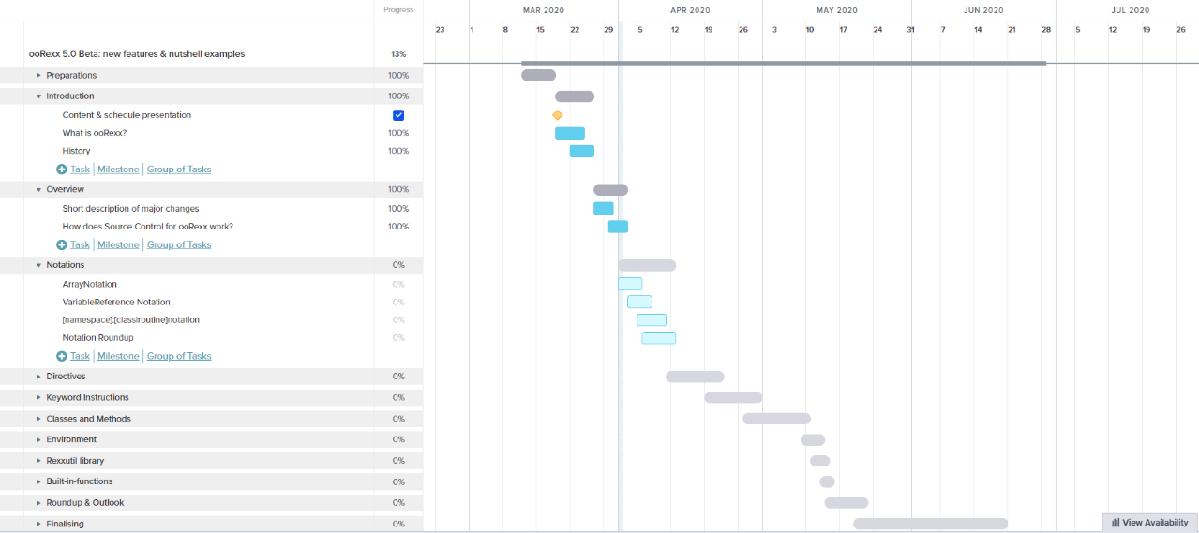
Gantt chart (02.04.2020)

